Slide 1
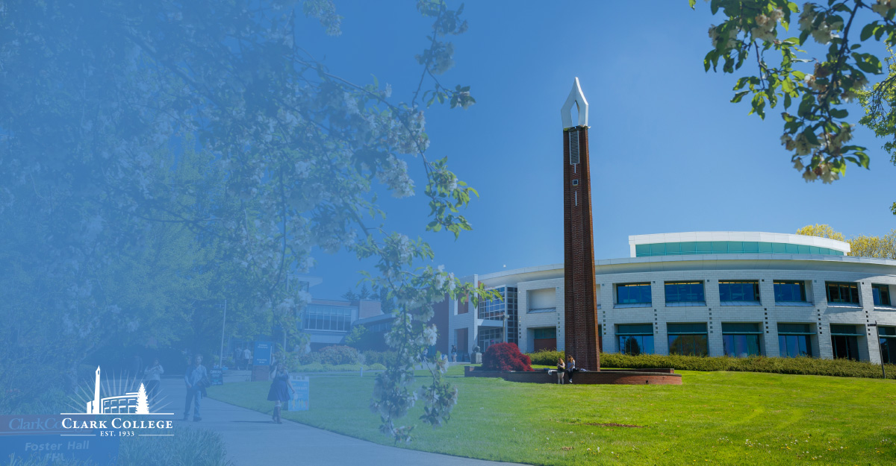
ctcLink
UPDATES, GO LIVE PLANNING AND…….
Tanya Kerr, ctcLink Internal Controls & Business Analyst
Susan Maxwell, ctcLink Project Manager
Shelley Ostermiller, Associate Registrar
Mirranda Saari, Associate Dean of Enrollment and Registrar

Slide 2
GO LIVE DATE
44 DAYS!!!!!!!!!
TRADE IN YOUR SID FOR A ctcLink ID, MORE EXCITING THAN UPGRADING YOUR CELL PHONE!!!!!!

Slide 3
KEY PROJECT DATES
EVALUATING GO LIVE READINESS BY SEPTEMBER 17
SEPTEMBER 18: STEERING TEAM RECOMMENDATION TO THE PRESIDENT
SEPTEMBER 24: SBCTC STEERING TEAM DECISION (GO/NO GO)
GO LIVE OCTOBER 28TH

Slide 4
CONFIGURATION UPDATE AND CELEBRATION
Transfer equivalencies | 9911
Courses on course lists | 2412
AAR Requirement lines | 728
AAR Requirements | 176
AAR Degrees built | 60
Prereqs configured | 234
Prereqs configured on courses (Enr Reqs) | 336
Classes built | 3260

Slide 5
CLARK SYSTEM DATES AND DEADLINES
October 4, 2019 – Last day for submission of travel advance requests.
October 15, 2019 - Time sheets must be in on time.
No new employees will be processed Oct 16 to 31st. All will start November 1st if not started by October 1st-15th pay period. This includes work-study students.
October 17, 2019 – Last day for all enrollment transactions.
No adds, drops, withdrawals, etc.
No repackaging in financial aid.
No more finance related activities beyond today.
Last day any Purchase Orders will be processed.
Last day for drop for non-payment
October 18, 2019 – Web transaction server down and no Cybersource.
Campus CE – No more transactions (no changes to SMS, no Cybersource to use).
All travel advance checks will be run this day.
Cashiering process all refunds and close all batches.
Financial Aid – Reconcile discrepancies (similar to year-end)
Student Affairs can collect paper documents to process in PS
October 21, 2019 – Business Services will cut all checks before system is down, including student loan checks. Some checks will not be distributed immediately.
October 22, 2019 – Close October financial books.
October 24, 2019 – The legacy system (HP3000) will be taken down.
October 25-28, 2019 – Conversion to PeopleSoft

Slide 6
DATES AND DEADLINES CONT.
October 28, 2019 – GoLive Date on PeopleSoft, FAM, CyberSource – All offices closed to public (10/28 and 10/29). We will continue to have classes. The following activities will be taking place:
Data Entry
Enter blanket purchase orders and any pending purchase orders (estimated to be approximately 1,000)
Student updates: DOB, names, completed milestones, residency
Student class withdrawals – Process. Need to note those that are Running Start. They will need to be processed for the monthly billing.
Human Resources update default schedules
Employees sign into PeopleSoft
Walk through business processes
Verify security access
Customize / favorites
October 28-30, 2019 – Closed to the Public, Employees access PeopleSoft

Slide 7
GO LIVE STUDENT COMMUNICATION
JUST IN TIME STUDENT EMPLOYMENT COMMUNICATION BEGAN ON SEPTEMBER 9

Slide 8
STUDENT EMPLOYMENT COMMUNICATION

Slide 9
GO LIVE STUDENT COMMUNICATION
STUDENT COMMUNICATION PLANNING TEAM
FULL SCALE COMMUNICATION CONTINGENT ON GO LIVE SIGN OFF
STRATEGIES
EMAIL TO STUDENTS
STUDENT CENTER
TABLE TENTS
COLLEGE 101
READERBOARD
ROBOCALL TO STUDENTS
CANVAS MESSAGE
EMAIL SIGNATURE LINE FOR ALL STAFF

Slide 10
COLLABORATION SENSATION

Slide 11
WHAT TO EXPECT AT GO LIVE
THURSDAY AND FRIDAY BEFORE GO LIVE
CLARK TOOLBOX ACCESS
OCTOBER 27: SUNDAY, FOOTBALL AND ctcLink
MONDAY AND TUESDAY
CLOSED TO THE PUBLIC
October 30-31, 2019 – Plan for limited staffing for all offices
October 31, 2019 – Students will have access to PeopleSoft
November 1, 2019 – SERVICES RESUME

Slide 12
GO LIVE SUPPORT PLAN
STUDENT LOGIN SUPPORT
TECH HUB/HELP DESK
THE ROOM STILL TO BE NAMED/TRIAGE CENTER
ADDITIONAL PHONE SUPPORT ON SWITCHBOARD
INFORMATION DESK
ONGOING SUPPORT THROUGHOUT THE WINTER ENROLLMENT CYCLE

Slide 13
GO LIVE SUPPORT PLAN CONT.
FACULTY AND STAFF LOGIN SUPPORT
TECH HUB/HELP DESK
RESOURCE ROOM/TEAM
ONGOING ASSISTANCE FOR FACULTY AND STAFF THROUGHOUT THE WINTER ENROLLMENT CYCLE
CLOSE OUT FALL QUARTER
WINTER QUARTER START AND BEYOND

Slide 14
GO LIVE CHANGE UPDATES
MyClark/CURRENT STUDENTS PAGE
ENROLLMENT CYCLE
WINTER QUARTER ENROLLMENT ONLY
ANNUAL SCHEDULE STILL IN GOVERNANCE

Slide 15
ACADEMIC ADVISEMENT REPORTS AND ctcLink

Slide 16
Academic Advisement Report Demo
CtcLink Gateway: https://ptprd.ctclink.us/psp/ptprd/?cmd=login

Slide 17
TRAINING
SIGN UP
WHERE TO FIND INFORMATION: www.clark.edu/myclark
ADDITIONAL RESOURCES

Slide 18
FUTURE STATE STUDENT COMMUNICATION PLAN
STATUS UPDATES
PATH FORWARD
NEW OPPORTUNITIES TO SUPPORT STUDENTS
MESSAGE CENTER
3C's - COMMUNICATIONS, COMMENTS AND CHECKLISTS

Slide 19
SUPPORT EACH OTHER
TEAM EFFORT
PATIENCE AND PATIENCE
GO LIVE IS A BENCHMARK, THE WORK WILL CONTINUE
ADDITIONAL IMPLEMENTATION WAVES
SOFTWARE UPDATES

Slide 20
QUESTIONS?

