Slide 1
Creating a Requisition in MyClark
Sabra Sand, Director of Business

Slide 2
Requisition Basics
Requisitions are the initial purchase request that college users create to begin the purchasing process
A Requisition’s final goal is to be turned into a Purchase Order.

Slide 3
Requisition Basics
Those who created requisitions in Procure+ will have access to create requisitions in MyCLark.
Requisitions are entered in the Finance Pillar of MyClark
The Purchasing Office takes that requisition information and then turns it into a PO, assigning it a vendor and ordering the goods or services.

Slide 4
Requisition life cycle
N
Create a Requisition
Budget Pre-check
Pass
Y
Submit for Approval
N
N
Purchasing Ofiice Sources Req to PO
Approved
Y
Budget Check
Pass
Y
Goods or services ordered

Slide 5
Requisition life cycle
N
Create a Requisition
Budget Pre-check
Pass
Y
Submit for Approval
N
N
Approved
Y
Budget Check
Pass
Y
Source Req to PO
Downstream Process

Slide 6
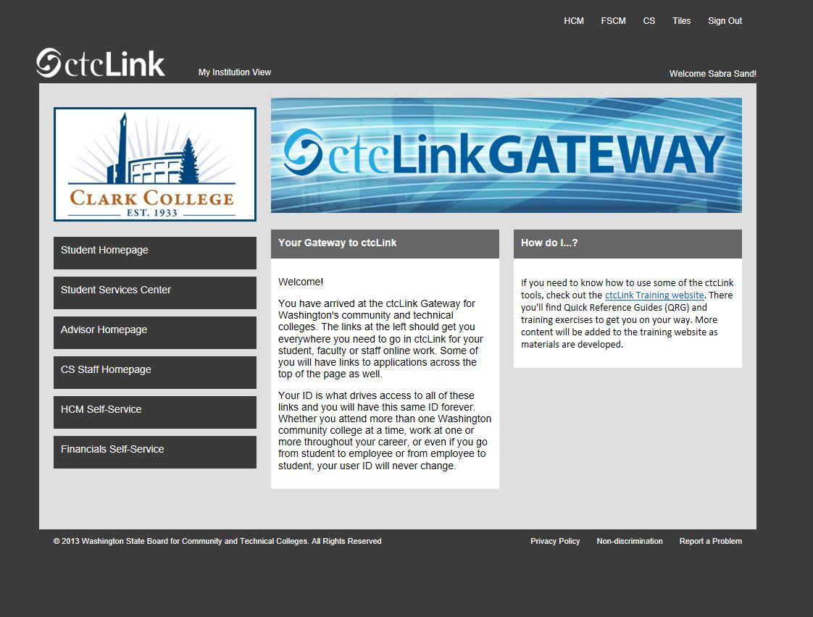

Slide 7
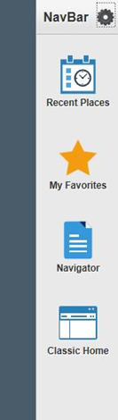
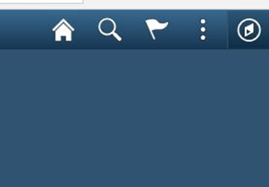
Create a Requisition
First go to Navigation (Nav Bar) on the upper right corner, click on it and it will give you a drop down menu of your options..

Slide 8
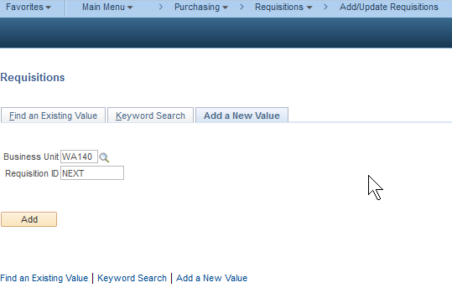
CREATE A REQUISITION
In the Finance pillar, Navigate to Purchasing > Requisition > Add/Update Requisition
Click on Add button.

Slide 9
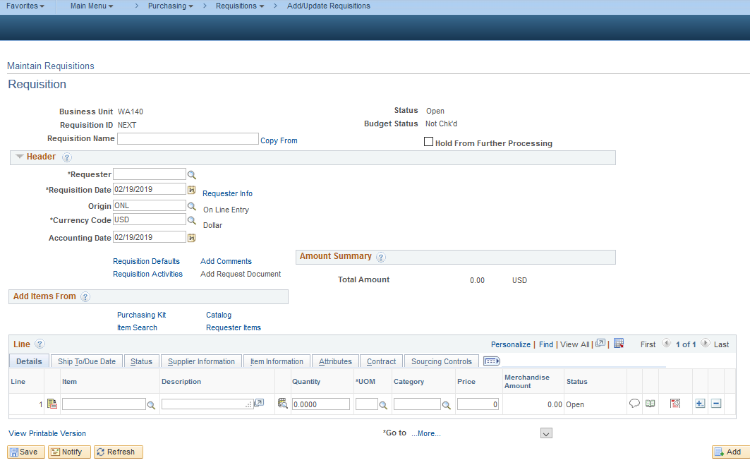
CREATE A REQUISITION
The top section of the Maintain Requisition page includes a free form field for Requisition Name. This field should be used for a department specific numbering scheme. Below that section is two main parts, Header and Line data.
Header
Line

Slide 10
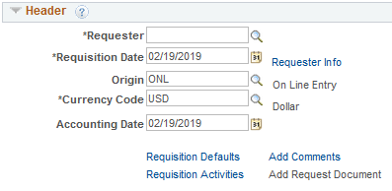
CREATE A REQUISITION
Requisition Header items that have asterisks are required fields.
Requester
The person making the request
Requisiton Date
The date the request was made
Currency Code
Will always be US Dollars (USD)
Your User Preference Settings can be defined so these fields can be defaulted for you.
Notes:
People can be authorized to fill out a Requisition on behalf of someone else, and in this situation they would be selecting that other person’s name as the Requester instead of their own
Who’s name is in that box is important because it can have an effect on approvals; currently, FLC include supervisor approvals in their Req approval process.

Slide 11
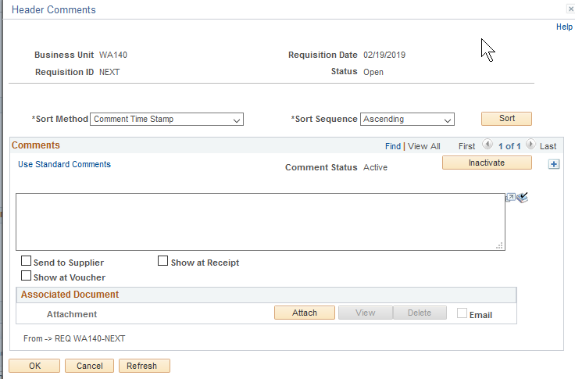
CREATE A REQUISITION
Add Comments link is used to record both text comments and attachments.
Notes:
You can also add notes at a line level that works the same way

Slide 12
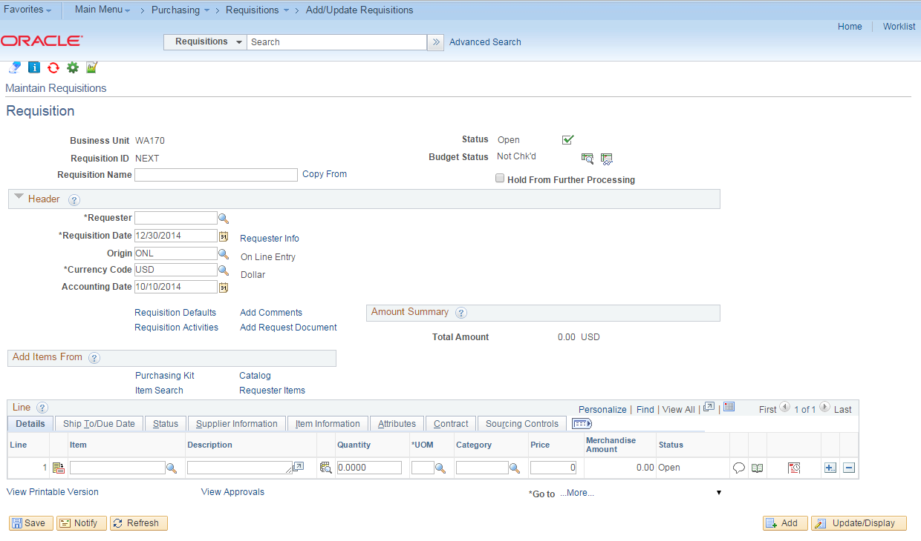
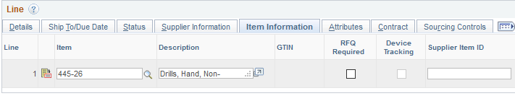
CREATE A REQUISITION
On the Requisition Line, select an Item (optional) and Description (can be overwritten) will be defaulted based on the Item.
Specify Quantity and identify its corresponding Unit of Measure.
Category is used to classify what is being purchased. This is also tied to the Item you’ve selected.
Price is the unit price of the goods/services purchased.
Supplier Item ID can be found under Item Information tab
Notes:
Item ID corresponds to a 5 digit NIGP (Natl Institute of Governmental Purchasing) code.
Importance of using Item – reporting spend and analytics
Connect to FNC to show Item – Description dynamics
Supplier Item ID is the place where you can include the Suppliers Item/Part number

Slide 13
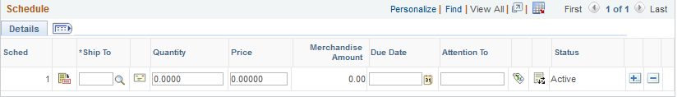
CREATE A REQUISITION
The first level of detail below the Requisition Line is the Requisition Schedule. Click on the red and white icon. Schedule gives you the ability to move to the section where you will enter the accounting detail.
The next level of detail below the Schedule is the Requisition Distribution detail (or accounting information). You can get to the Distribution detail screen by clicking on the icon that looks like a piece of paper with three arrows:
Notes:
The same thing can be accomplished by separating one line into two different lines with different Ship-To locations

Slide 14
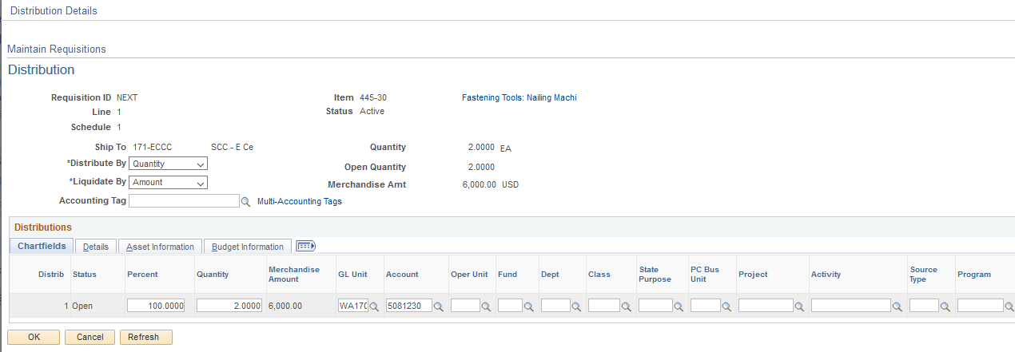
CREATE A REQUISITION
The Requisition Distribution details shows the funding source(s) being allocated for that Line/Schedule. Funding sources can be split by Percentage, Amount or Item Quantity as many times as needed.

Slide 15
PEOPLESOFT DISTRIBUTION BASICS
A PeopleSoft distribution line is made up of blocks called Chartfields. Many Chartfield values are derived from the Legacy accounting structure, but some will be new. Examples include:
PeopleSoft Chartfield | Legacy Equivalent
Business Unit | College District Code (eg. 010, 030, 110, 130, 300)
Operating Unit | Individual College Codes (eg. 010, 030, 110, 130, 300)
Account | Sub-Objects, Revenue Source Codes and Legacy GL Codes
Fund | Legacy Fund – part of Appropriation Index
Appropriation | Legacy Appropriation – part of Appropriation Index
Department | ORG_Index
Class | PROG_Index
State Purpose | None – Identifies Items that are IT related for OFM

Slide 16
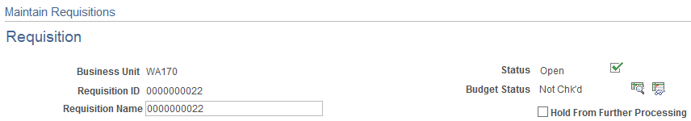
CREATE A REQUISITION
When a Requisition is saved, it is assigned a Requisition ID number. This will be the next available sequence number from PeopleSoft.
If a Requisition Name was not specified, it defaults to the Requisition ID; this can be overwritten with a new name if needed. Also, new Requisitions are created with an “Open” status, which it keeps after being saved. This status won’t change until the Requisition is submitted for approval.
Notes:
A unique Requisition name can be used to easily Search for an existing Req

Slide 17
Requisition life cycle
N
Create a Requisition
Budget Pre-check
Pass
Y
Submit for Approval
N
N
Approved
Y
Budget Check
Pass
Y
Source Req to PO
Downstream Process

Slide 18
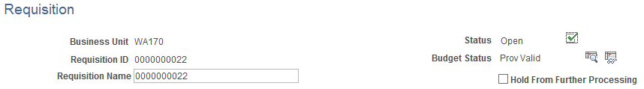
BUDGET PRE-CHECK
You initiate a Budget Pre-Check from the Maintain Requisitions front page by clicking on the rightmost icon to the right of the Requisition’s Budget Status indicator:
A successful Budget Pre-Check will return a Budget Status of Prov Valid (for “provisionally valid”) meaning that budget was available for the provided amounts and sources:
Notes:
Provisionally Valid = Temporarily Valid until something permanent will replace it
Failing budget pre-check or generating an error depends on how the Budget process option is set.
Budget process options:
Control – checks chartfields and monetary amount (grant funded requisition)
Track w Budget – checks chartfields only and not monetary amount (most expenses for FLC)
Track w/o Budget - all budget check passes without error

Slide 19
Requisition life cycle
N
Create a Requisition
Budget Pre-check
Pass
Y
Submit for Approval
N
N
Approved
Y
Budget Check
Pass
Y
Source Req to PO
Downstream Process

Slide 20
REQ APPROVAL WORKFLOW
Requisition approval in PeopleSoft is governed by the Approval Workflow Engine, or AWE. These process definitions are also commonly called Workflow processes. The Workflow defines each level of approval needed for a requisition.
Approved Requisitions can be further processed, while denied requisitions are sent back to the requestor who can make necessary changes and resubmit for approval.

Slide 21
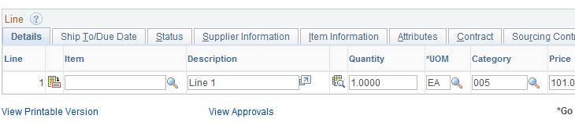
SUBMIT FOR APPROVAL
Another task you can perform before submitting your Requisition for approval is to do an Approval Preview. At the bottom of the Maintain Requisitions front page, below the Line detail section, is a View Approvals link:
Clicking this link will bring up a list of the people who will be involved in approving your Requisition. This link can also be used to track where your Requisition is in its approval process after it’s been submitted.

Slide 22
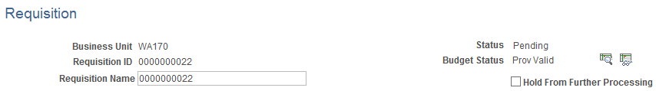
SUBMIT FOR APPROVAL
When you are ready to submit your Requisition for approval, click on the check box near the top of the front Maintain Requisitions page:
Requisition status will change from “Open” to “Pending” for pending approval.

Slide 23
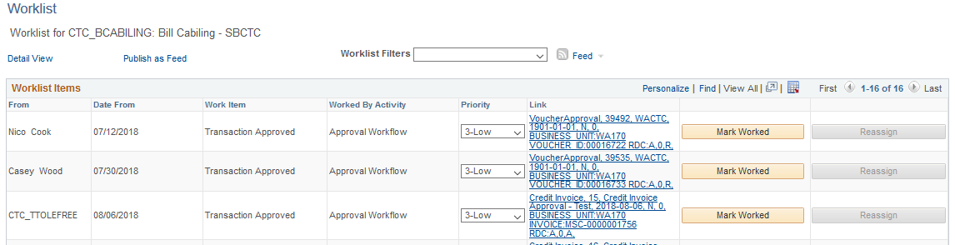
APPROVAL OF A REQUISITION
To approve a Requisition, Navigate to Worklist > Worklist
The Worklist provides a line item overview as well as links that will take you to a review screen showing details on the approval actions taken or needed for each line item.

Slide 24
APPROVAL OF A REQUISITION
Requisition Approvals
Enter Comments pertinent to your approval action.
Values | Description
Approve | Status changes to Complete upon saving. The system sends an email to the requester stating that the requisition has been Approved.
Deny | Status changes to Denied upon saving. The system sends an email to the requester stating that the requisition has been Denied.
Recycle | Status changes to Recycled upon saving. The system sends an email to the last user who approved the requisition.

Slide 25
Requisition life cycle
N
Create a Requisition
Budget Pre-check
Pass
Y
Submit for Approval
N
N
Approved
Y
Budget Check
Pass
Y
Source Req to PO
Downstream Process

Slide 26
BUDGET CHECK
Budget Checking will perform the same validation as the Budget Pre-Check, but this time it will create Commitment Control entries. Specifically, Budget Checking a Requisition will result in a Pre-Encumbrance entry. This will act as a reservation of budgeted funds needed to process the requested items to payment.
Requisition Budget Checking can be done individually, on the Requisition page, or in batch via a PeopleSoft application engine process.
Budget status:
N (Not checked) – Not budget checked
E (Error) – Failed budget check
V (Valid) – Passed budget check

Slide 27
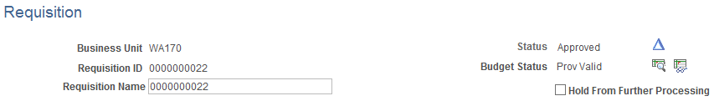
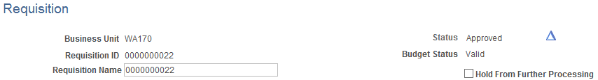
BUDGET CHECK
You need special permissions to be able to run Budget Checking from the Requisition page. Clicking the appropriate icon in the upper-right corner of the front Maintain Requisitions page will initiate a budget check:
Requisitions that pass Budget Checking will get a “Valid” Budget Status when the process completes.

Slide 28
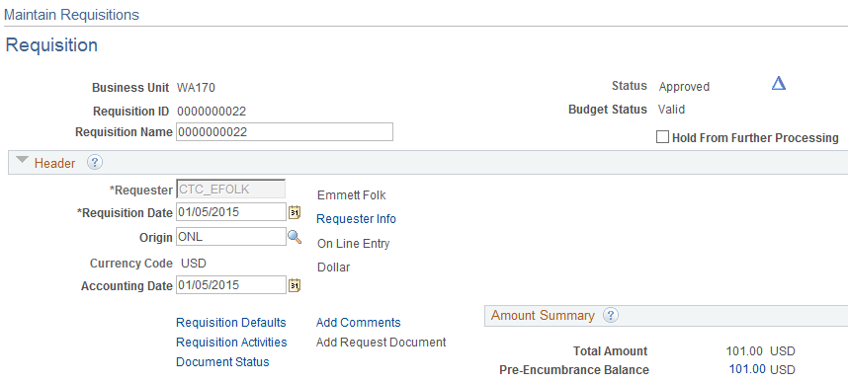
BUDGET CHECK
In addition to the Valid budget status, the Maintain Requisitions page will also indicate the Pre-Encumbrance Balance in the Header’s summary section:
Only Approved Requisitions with a Valid Budget Status are eligible to be turned into a Purchase Order.

Slide 29
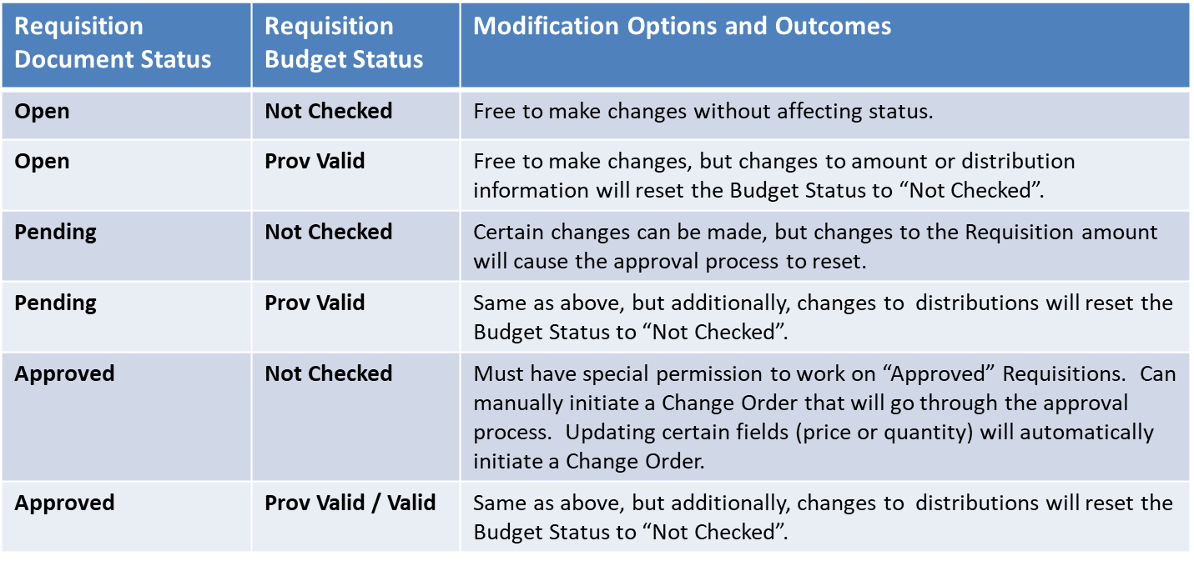
Modifying a REQUISITION
There are a few modification scenarios with Requisition, each with their own set of options and outcomes:

Slide 30
Requisition life cycle
N
Create a Requisition
Budget Pre-check
Pass
Y
Submit for Approval
N
N
Purchasing Office Sources Req to PO
Approved
Y
Budget Check
Pass
Y
Goods and services ordered

Slide 31
Purchase Order Basics
Purchase Orders are designed to contain the final information that will be used to place an order with a Supplier. Purchase Orders are more complex than Requisitions, and are created by Purchasing Office staff, based on requisitions submitted.

Slide 32
Walk through in MyClark

Slide 33
Questions?

