Slide 1

HCM: Manager Self-Service
Human Resources Department

Slide 2
Things that will be covered:
Approvals Tile
  Managing Approvals
My Team Tile
  Making Changes to Employees
Team Time Tile
  Managing Employee Time
CTC Team Time Tile

Slide 3
Things that will NOT be covered:
Recruiting/Activities – Clark College is not using the PeopleSoft Talent Acquisition Management (TAM) software, therefore, this tile will not be utilized.
CTC Delegation – Will not be available when we go live.

Slide 4
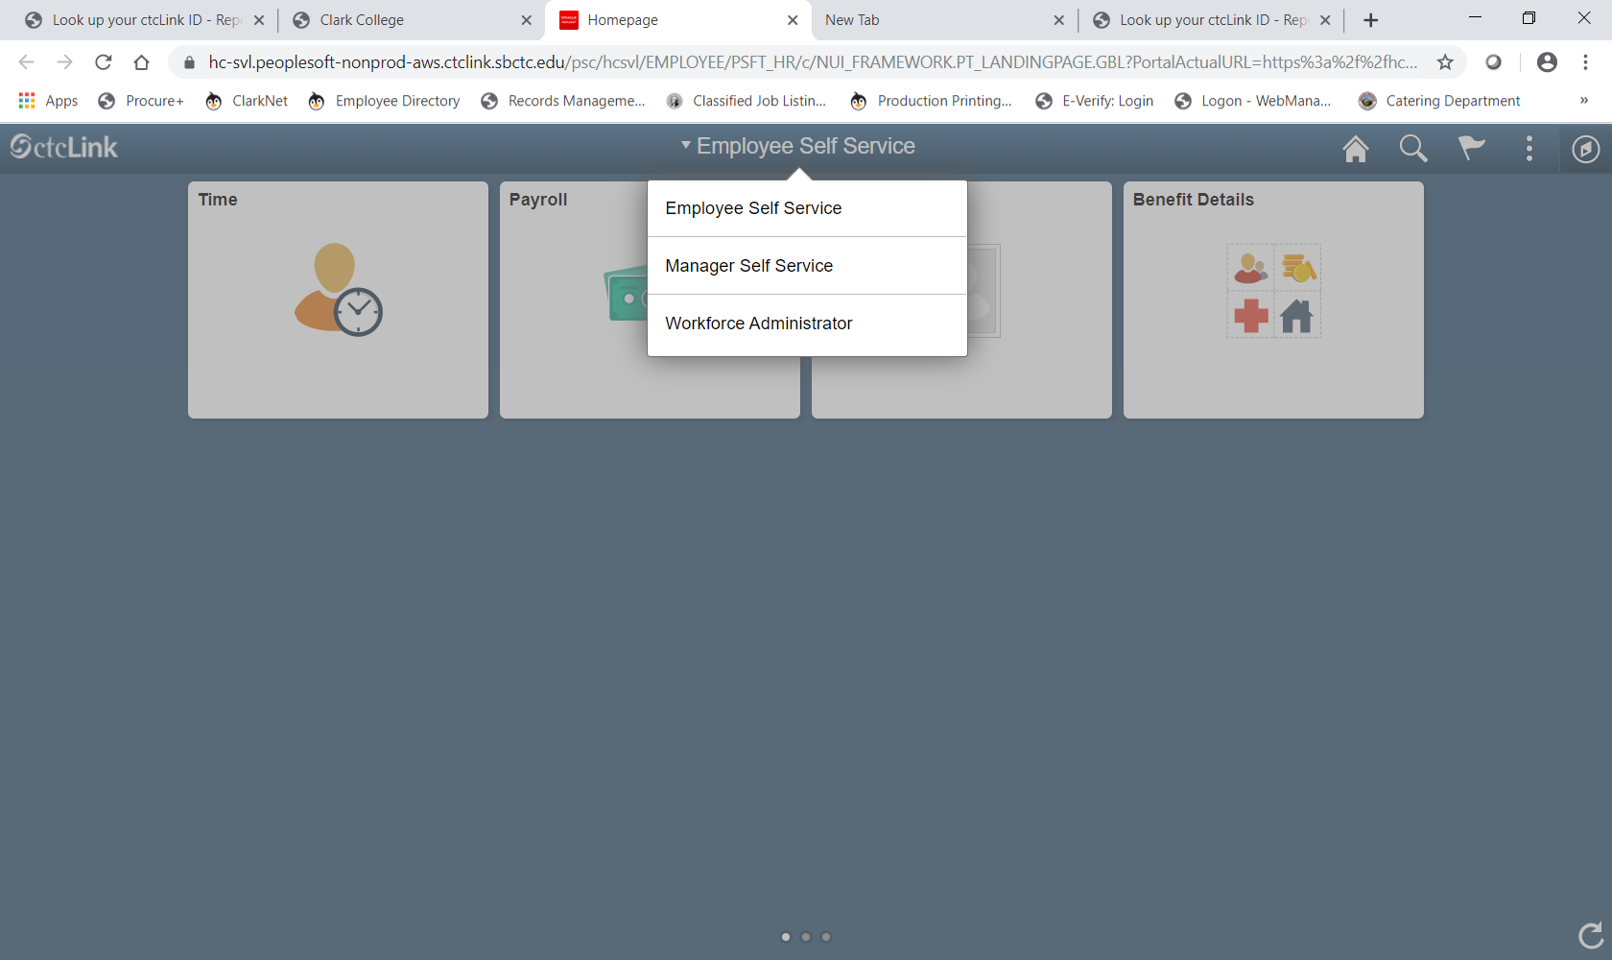

Slide 5
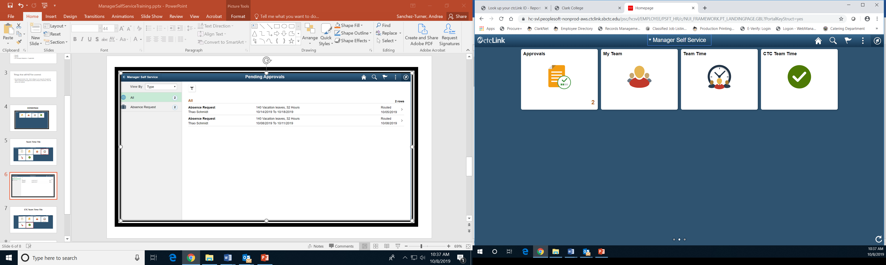
Manager Self-Service Homepage

Slide 6
Approvals Tile

Slide 7
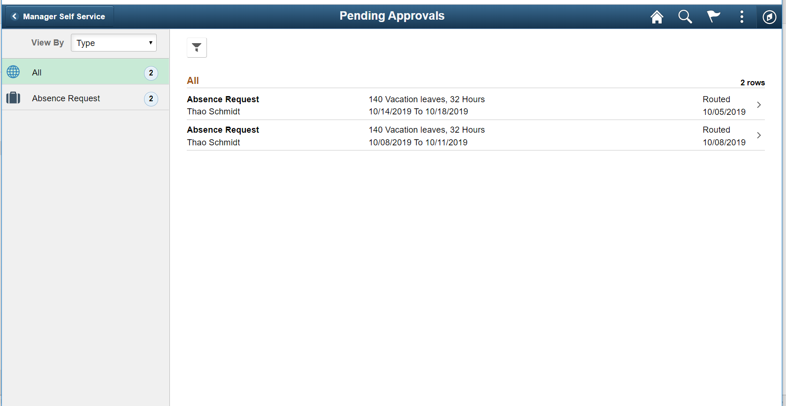

Slide 8
My Team Tile

Slide 9
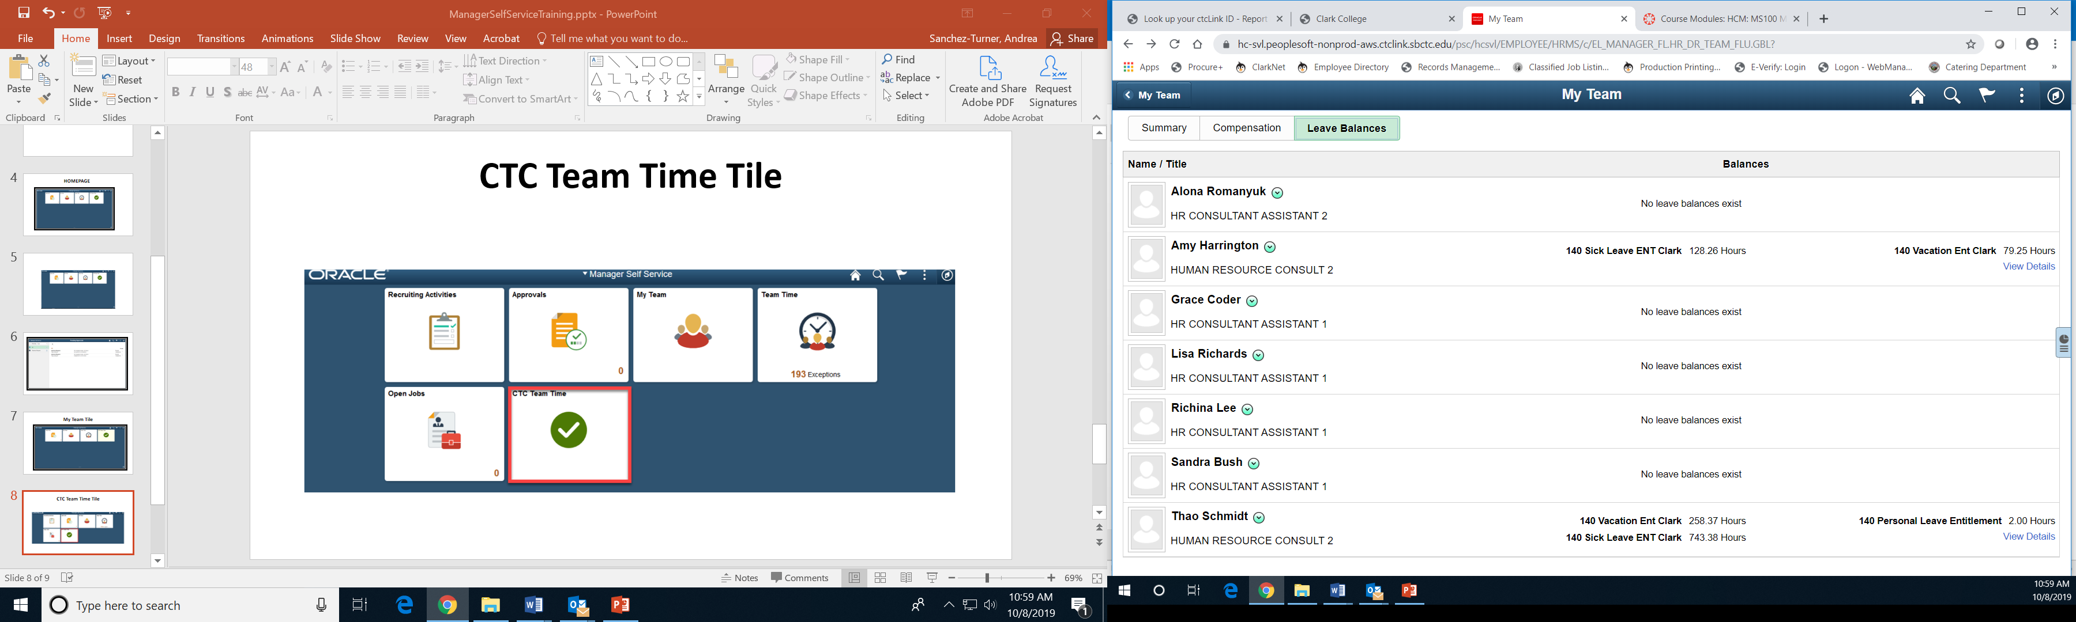

Slide 10
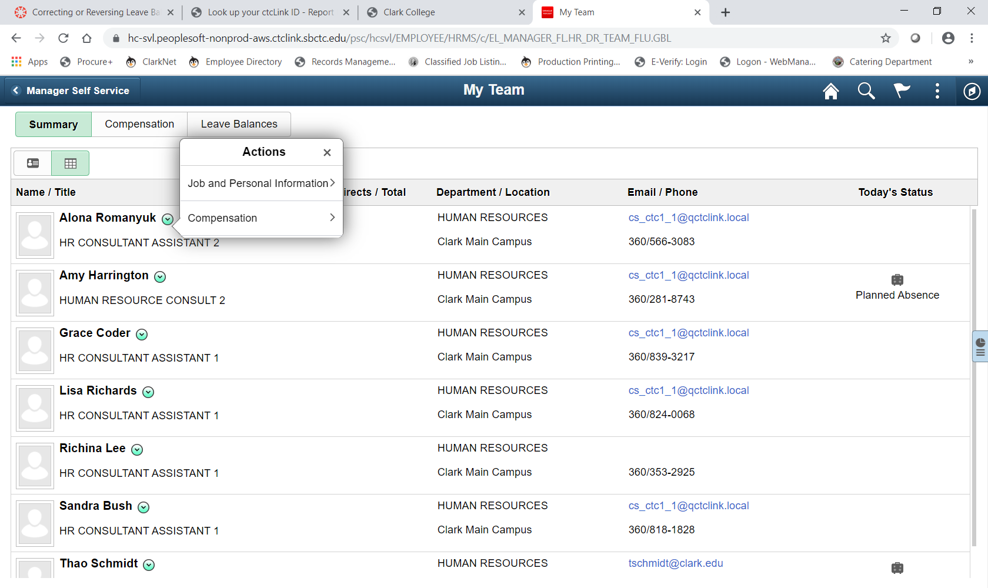

Slide 11
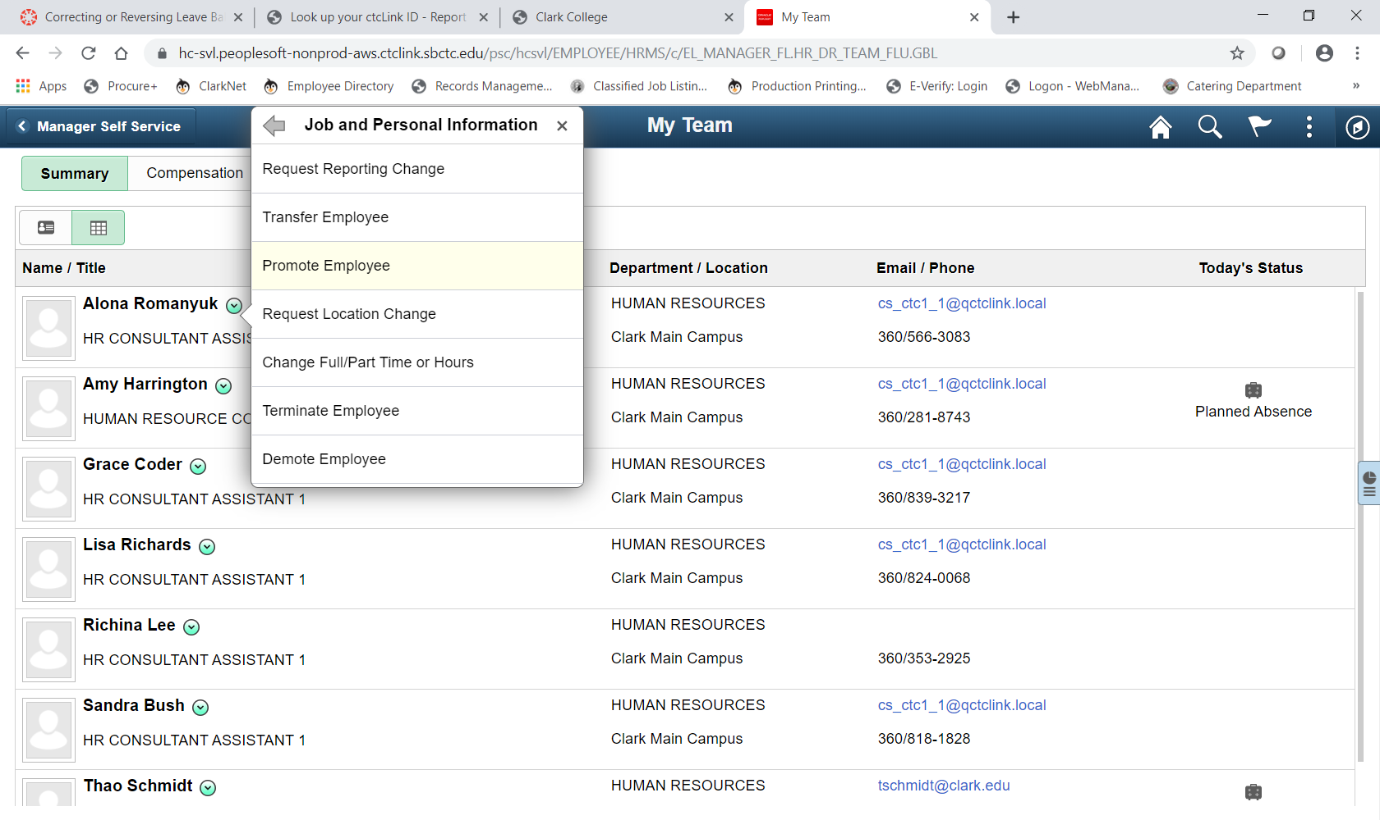

Slide 12
Team Time Tile

Slide 13
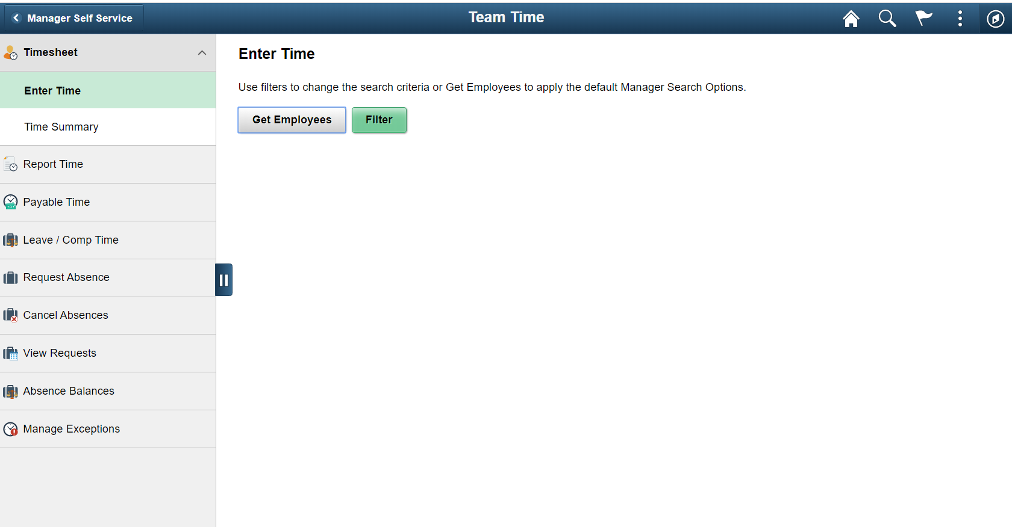

Slide 14
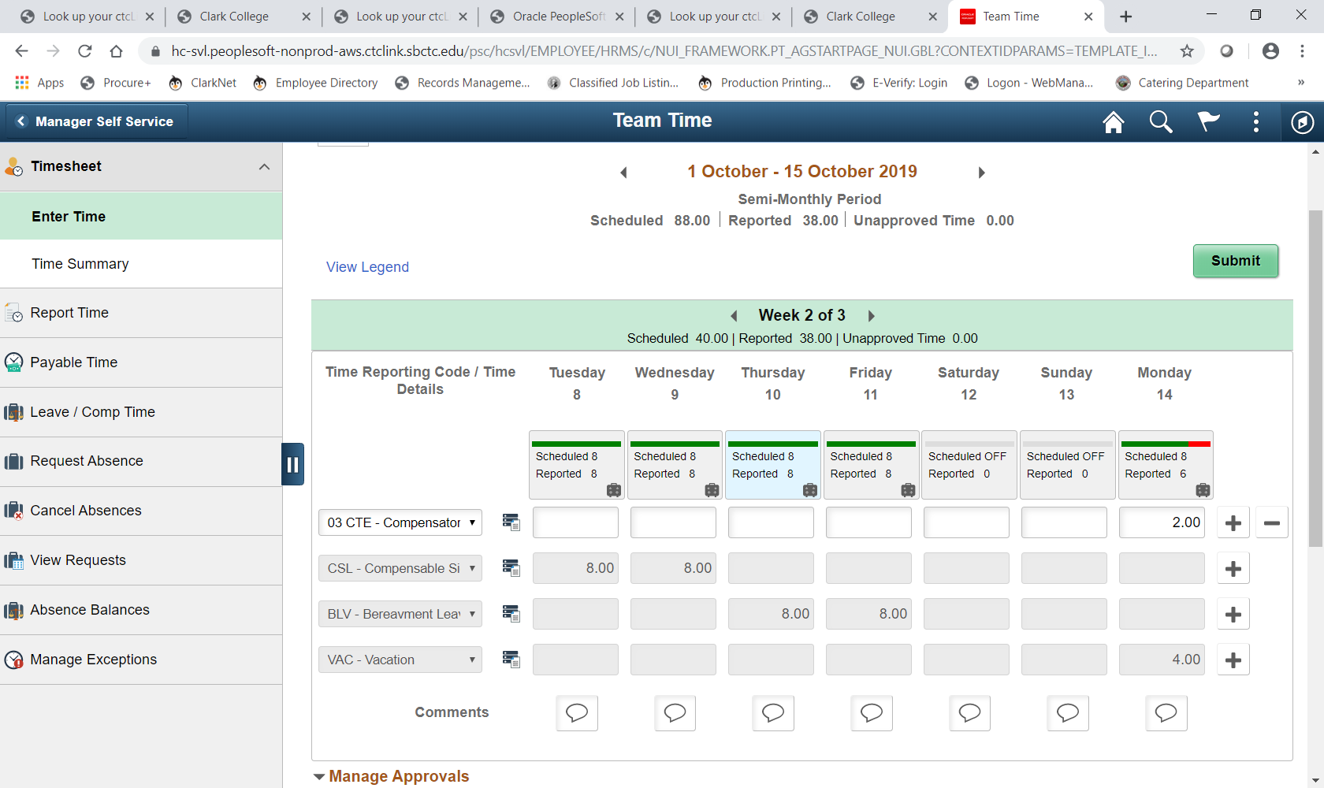

Slide 15
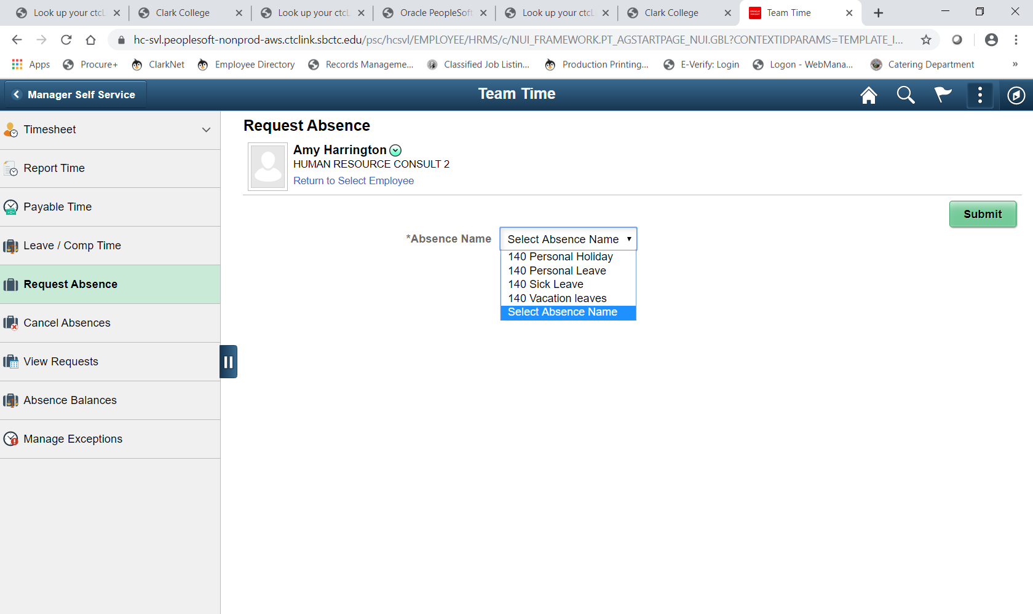

Slide 16
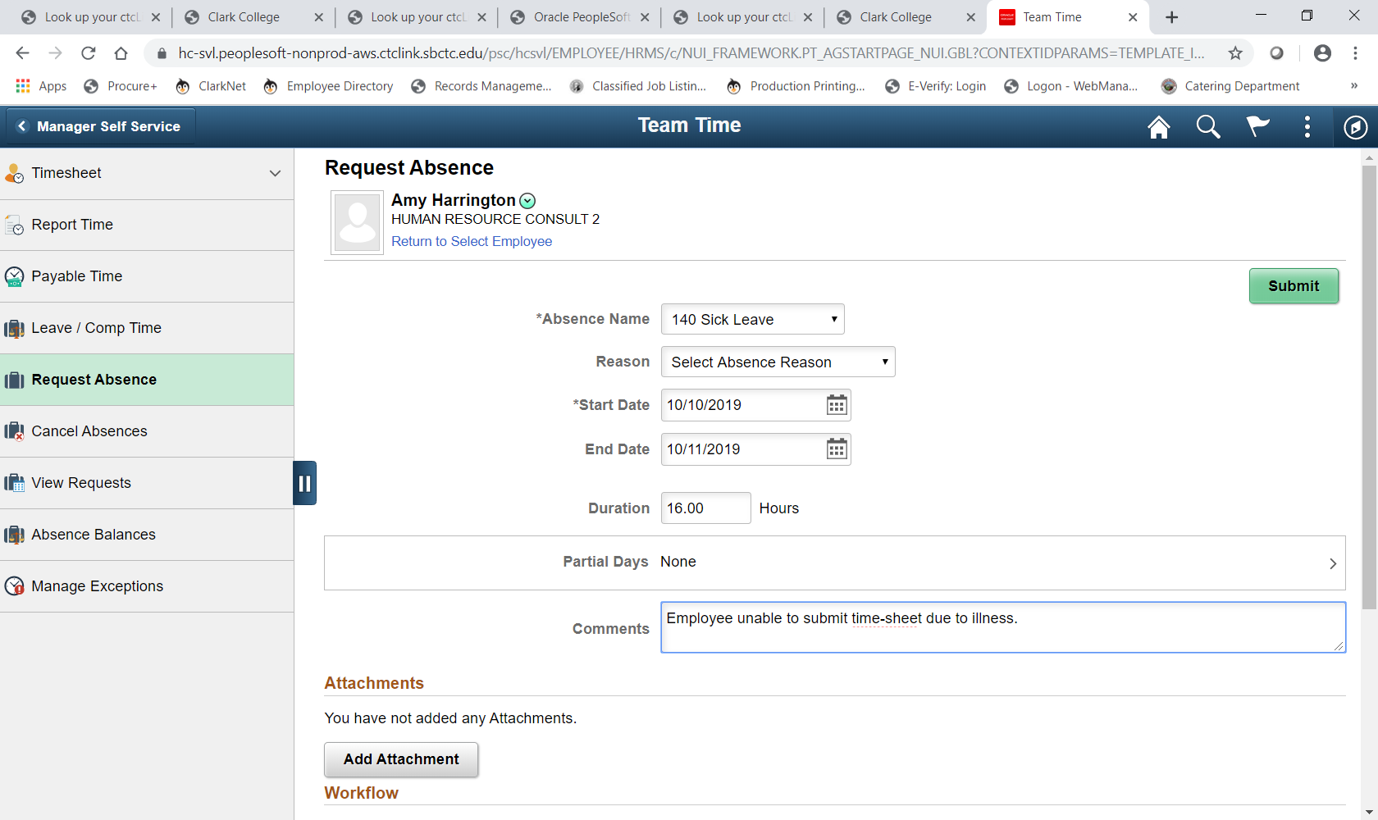

Slide 17
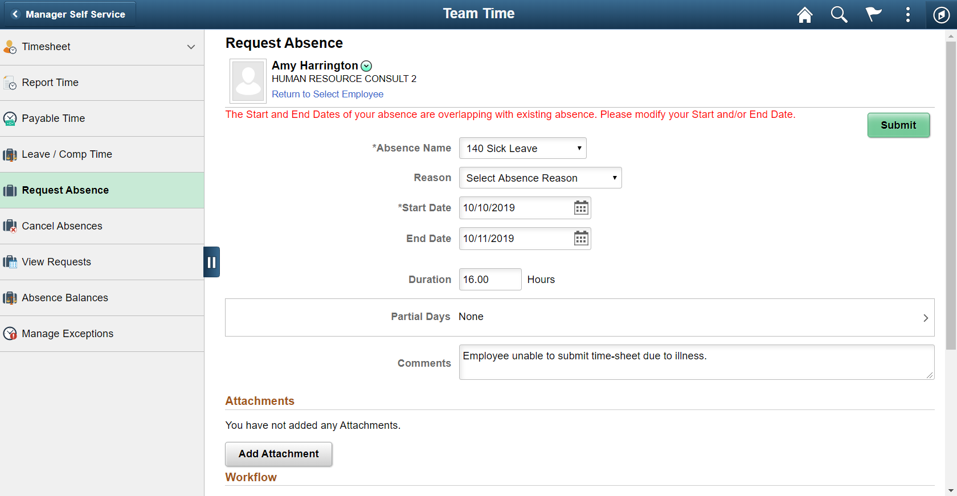
11

Slide 18
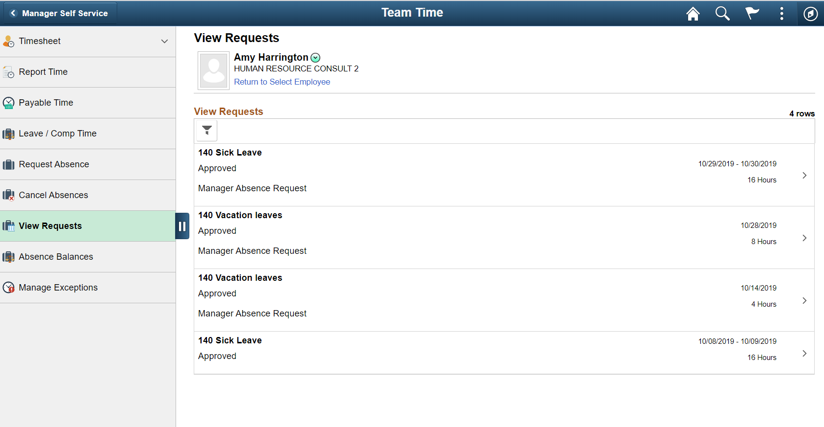

Slide 19
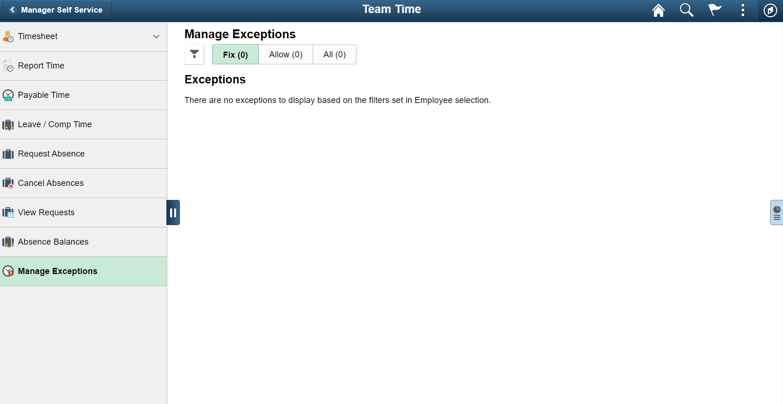

Slide 20
CTC Team Time Tile

Slide 21
Questions?

