Slide 2
10 – 28 – 2019
44 days to GoLive
Notes:
Susan: Calendar days – many of us are working evenings and weekends, overtime, meetings during lunch time

Slide 3
Dates & Deadlines
September 27 – Last day to issue fall work-study referrals.
September 30 – Last day for purchasing. No purchasing in October.
October 4 – Last Day for submission of travel advance requests.
October 15 – Time Sheets must be in on time. If you miss the deadline we will not be able to write a check. You will be paid with the Nov 10th pay.
October 15 – Last day for corrections to winter classes
October 16 to 31 – no new employees processed. November 1st will be start date.
October 17 – last day for student enrollment transactions.
October 22 – Business Services closes financial books

Slide 4
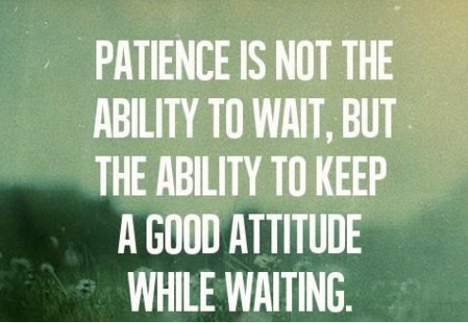

Slide 6
When do we have access to PeopleSoft?
Sunday 10/27 | Monday 10/28 | Tuesday 10/29 | Wednesday 10/31 | Thursday 10/31
SMES | Legacy Super Users | Self-Service Users (Non Legacy Users) |  | Students
EC | Supervisors | Faculty Advisors |  | ECD Students
IT Service Center | Administrative Support | Faculty
Tech Hub | Club Advisors
Notes:
Susan: Groups will receive an email with the link to be able to sign in as a new user. Reminder – write down that PS ID when you see it, or else you will need to call the help desk.
Students will not access the system until Thursday. This allows time for staff to review student records and enter any data as necessary.

Slide 7
Information www.clark.edu/myclark
Notes:
Susan – where to find information

Slide 8
How will I know what to do?
Start with the Fundamentals / Orientation
Clark led classes – scheduling at CTC and CCW
Tuesday September 17 at CCW; Room 102 from 2:30 to 4:00pm
Thursday September 19 at Main Campus; SHL Room 019 from 9:30 to 1:00am
Thursday September 19 at CTC; Room 206 from 11:30am to 1:00pm
Self-paced course in Canvas
We will be enrolling everyone
Expect an email invitation to the Canvas course
Notes:
Jennifer Ward is a our training lead. She is teaching the fundamentals classes and coordinating the other trainings. She can help you with canvas.
Jennifer: There are many ways available to you to learn about PeopleSoft. We are in the process of scheduling sessions.

Slide 9
How will I know what to do?
Self-paced course in Canvas
ctcLink Reference Center – Quick Reference Guides (QRG)
Videos
Open Labs
Clark led classes
Ask a SME

Slide 10
Canvas Self-Paced Courses
Fundamentals (available now)
ES100 HCM: Employee Self-Service (9/30 release)
MS100 HCM: Manager Self Service (9/30 release)
EX100 Travel & Expenses (10/7 release)
PU100 Purchasing – Creating Requisitions
CH100 CS Staff Self-Service (9/30 release)
CF100 Faculty Self-Service (9/30 release)

Slide 11
October 11th MyClark ctcLink Training
Travel requests & expense vouchers
Purchasing – Creating Requisitions
Employee Self-Service
Manager Self-Service

Slide 12
New General Ledger Structure
Sabra will meet with departments

Slide 13
What if I have a technology issue with ctcLink.
ITS Service Center
Icon on your desktop
Call x2425
Determine if it is a technology issue or a knowledge issue.
Technology – ITS Service Center will address or forward to SBCTC
Knowledge – will be forwarded to a SME at the college
May be escalated to SBCTC if necessary
Notes:
Susan

Slide 14
MyClark ctcLink Accessibility Plan
Documents
ctcLink Screen Reader Resource Guide
Overview of the Student Center
Student How To documents
Overview of Employee Self Service and Travel Expenses
Computer lab sessions focused on helping people using assistive technology
Enrollment Services and Advising will work with students to register
Notes:
Level Access testing. SBCTC log bugs with Oracle. Clark help prioritize.

Slide 15
I probably don’t have to say this for you to know, but you have such a great crew!
John Henry Whatley
ctcLink Project Manager - Campus Solutions
But please also make sure you give Cathy [Reynolds] special acknowledgement when you can. She is working very hard to learn something rather difficult and there are a lot of hurdles.... Her persistence and positive attitude mean a lot in those long UAT sessions this week.
The entire team working on FWL has been superlative.
Josie

Slide 16
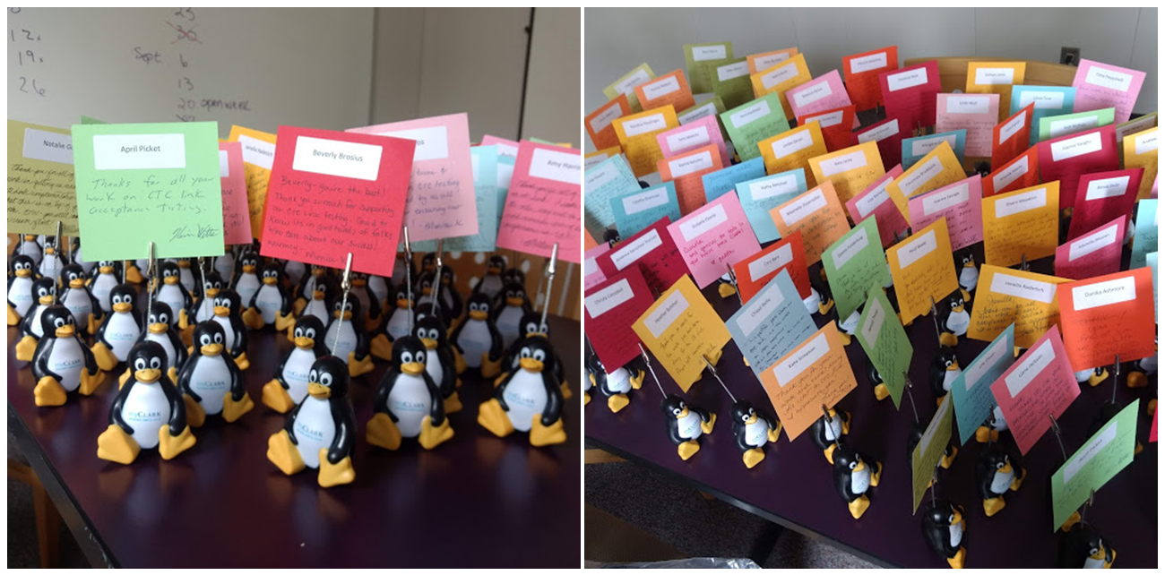

Slide 17
Questions?

