Slide 1

Project Management Office:
Susan Maxwell, Project Director (SBCTC Project Manager and Organizational Change Manager)
Jennifer Ward, Training Lead
Ryan Paulos, Testing & Reporting Lead

Slide 2

TCC
Clark
SBCTC
SCC
SF

Slide 3


Online Admissions Application
$
Accessibility
Continuing Ed
?
Asset Tracking
?
Budget Planning Tool

Slide 4
Online Admissions Application
Course Building
Classes for summer and fall built in two systems
Financial Aid – remain in FAM, then PS for 2020-21. Overlap
25 Live is upgrading
HighPoint mobile app
Accessibility
Continuing Ed
?
Asset Tracking
Budget Planning Tool

Slide 5
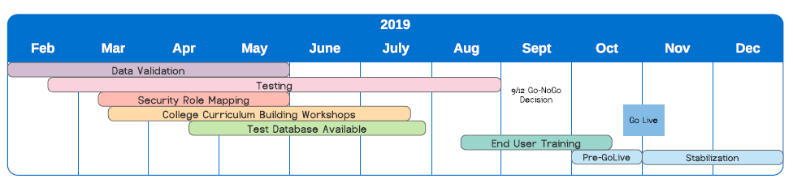
Timeline
Currently:
Building Course Catalog: OOI, ECD
Data Validation Cycle 4: Business Services, HR, Student Affairs, Financial Aid
User Acceptance Testing: Business Services, HR, ECD, Student Affairs – Enrollment Services
Course Requisite Building: OOI, Credentials

Slide 6

How can I help?
Be mindful of deadlines. Respect the deadlines set and ensure your staff respects these deadlines.
Understand what departments are heavily involved in ctcLink and set realistic expectations for response times.
Plan now for fall regarding hiring needs, purchasing and travel plans.

Slide 7


Slide 8

Bit.ly.eapweb
4/16/19 – Understanding Resilience

Slide 9
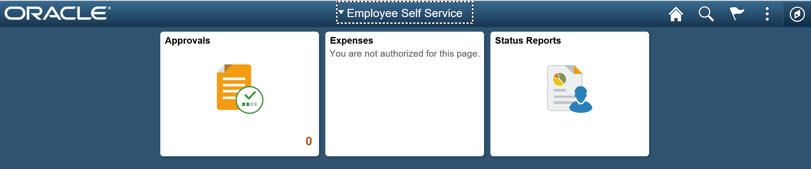
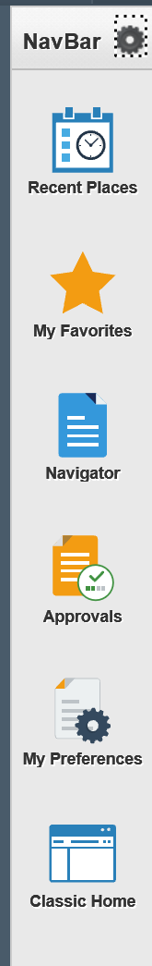
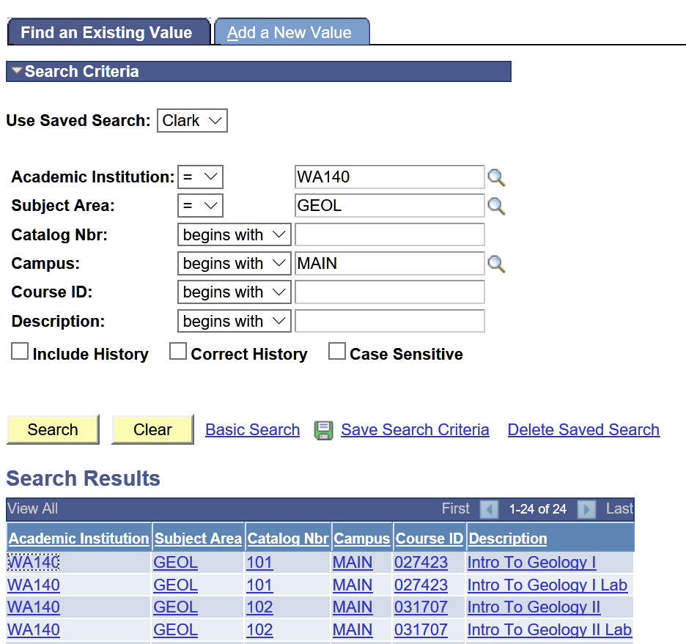
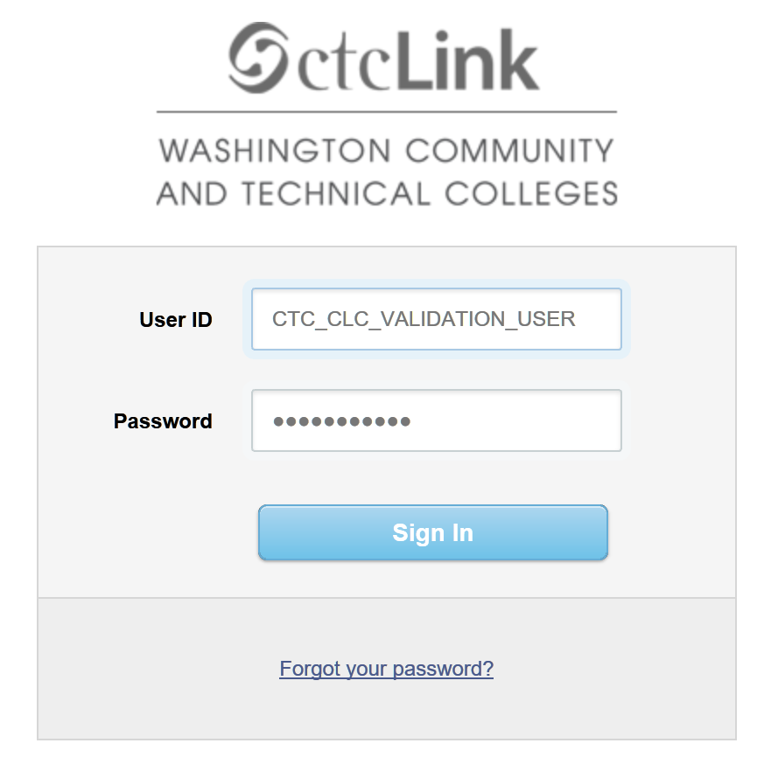

Slide 10
For More Information
Clark College website – basic information
  www.clark.edu/myclark
myCLARK connect team
  https://clarkcoll.sharepoint.com/sites/ctclink/SitePages/Home.aspx
SBCTC Reference Center
  http://ctclinkreferencecenter.ctclink.us/

