Slide 1
HCM – Employee Self-Service
Human Resources

Slide 2
Things that will be covered:
Time
How to Enter Time/Report Time
Exceptions
Request Absences
View Requests
Absence Balances/Cancel Absences
Payroll
Personal Details
Benefits

Slide 3
Things that will NOT be covered:
Career Tile - Clark College is not using the ctcLink/PeopleSoft Talent Acquisition Management (TAM) software, therefore, this tile will not be utilized.
CTC Delegation – This will not be available when we go live.
Travel Authorizations/Expense Reports – This will be covered by Lisa Hasart as it is part of the Financial Pillar.

Slide 4
Employee Self-Service Homepage

Slide 5
Time Tile

Slide 17
Payroll Tile

Slide 19
Click on “+” Sign to add Account

Slide 22
Personal Details Tile

Slide 26
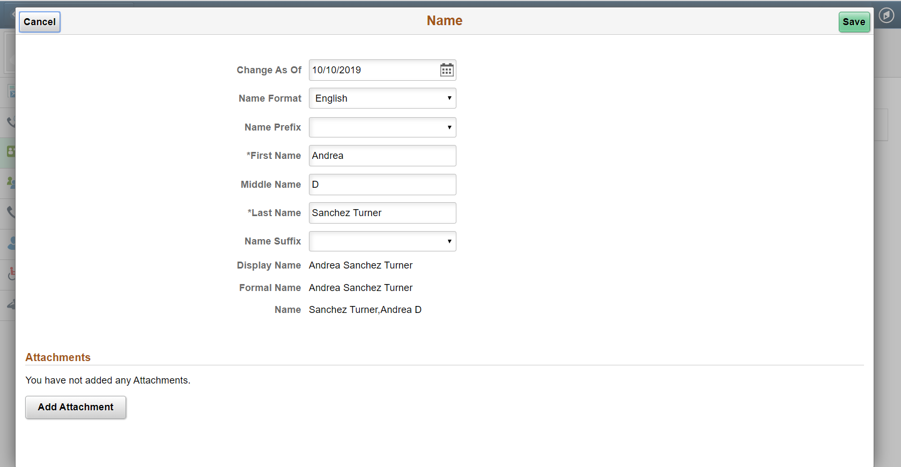

Slide 27
Click on “+” Sign to add Ethnic Group

Slide 28
Click on Magnifying Glass for Drop-down Menu

Slide 35
Benefits Tile

Slide 38
Questions?

