Slide 1
Vision Platinum Society
Platinum Society Network
Clark College
October 28, 2015
12:00-13:00 (60min.)
Beyond the Limits to Growth
－New Ideas for Sustainability from Japan－
Hiroshi Komiyama
President, Platinum Society Network
Chairman of the Institute, Mitsubishi Research Institute, Inc.
The 28th President, the University of Tokyo

Slide 2
Vision Platinum Society
Contents
1. What is the 21st century?
2. What is Japan?
3. Platinum Society as a Vision of 21st century
4. We need innovation!

Slide 3
21st century is a turning point
Platinum Society Network
Saturation of Industrial Revolution
Per-capita GDP of a country normalized by that of the world.
Platinum-Revolution
Industrial-Revolution
Japan
Agricultural-Revolution
source：Angus Maddison ：Statistics on World Population, GDP and Per Capita GDP, 1-2008 AD

Slide 4
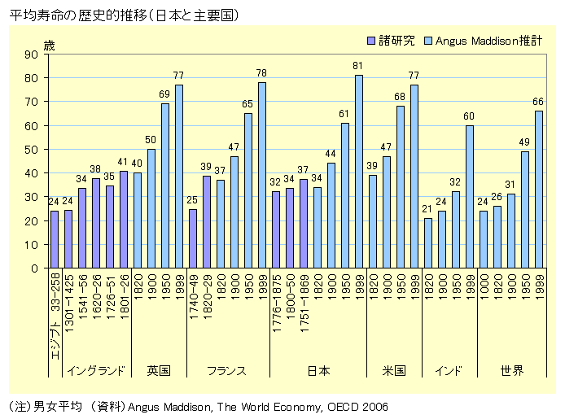
21st century is a turning point
Platinum Society Network
Majority of people enjoy Longevity
The change of life expectancy in the world
years
studies
Angus Maddison
estimated
80
82
83
79
70
65
2011
2011
2011
2011
2011
2011
Egypt
England
UK
France
Japan
USA
India
World
source: http://www2.ttcn.ne.jp/honkawa/1615.html
Data of 2011：World Health Statistics 2013 (WHO)

Slide 5
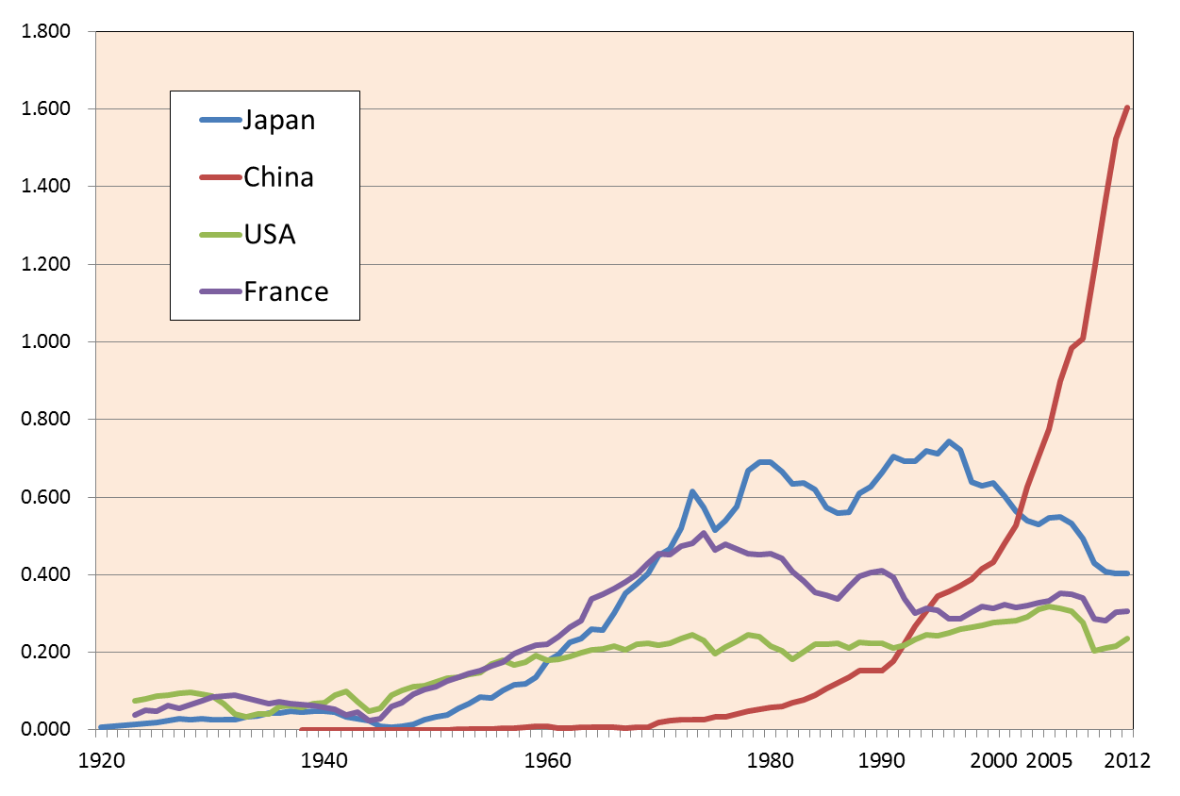
21st century is a turning point
Platinum Society Network
Saturation of artifacts: not so far
(ton/person)
Production of Cement per person
Data of Cement production volume：U.S. Geological Survey, Mineral Commodity Summaries, February 2014
Data of population：UNSD Demographic statistics, United Nations Statistical Yearbook

Slide 6
21st century is a turning point
Platinum Society Network
Saturation on the Finite Earth
example: car ownership
 | 2007 |  | 2010
 | No. of automobiles （million） | No. of automobiles per population | No. of automobiles （million） | No. of automobiles per population
Japan | ５８ | ０．４５ | ５８ | ０．４６
USA | １３８ | ０．４５ | １１９ | ０．３８
UK | ３１ | ０．５１ | ３１ | ０．５０
France | ３１ | ０．５０ | ３１ | ０．５０
Germany | ４１ | ０．４９ | ４２ | ０．５１
China | ３２ | ０．０２ | ６１ | ０．０５
India | １３ | ０．０１ | １３ | ０．０１
2014
0.10
(Data) Japan Automobile Manufacturers Association,
Ministry of Internal Affairs & Communications

Slide 7
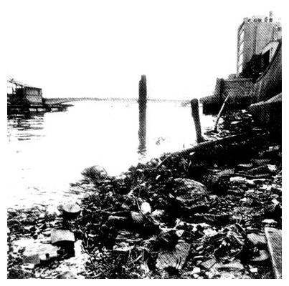
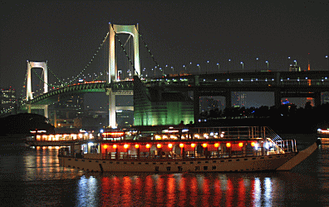
What is Japan?
Platinum Society Network
Japan overcame environmental pollution
1967
present
http://www.t-yakata.com/tyh_dkship.htm
http://www.env.go.jp/policy/hakusyo/zu/eav11/eav110000000000.html
Sumida river runs downtown Tokyo.

Slide 8
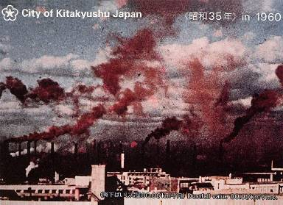
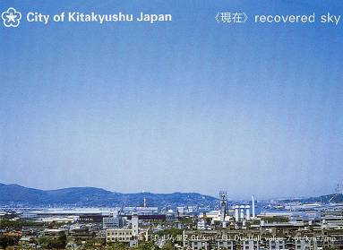
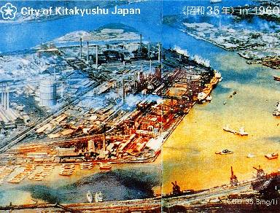
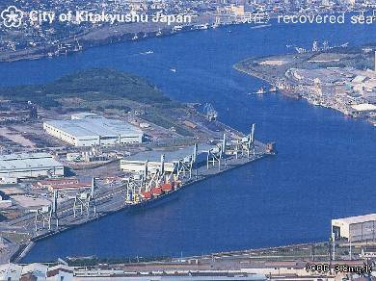
What is Japan?
Platinum Society Network
Japan overcame environmental pollution
出所：「課題先進国日本」P27（北九州市提供）

Slide 9
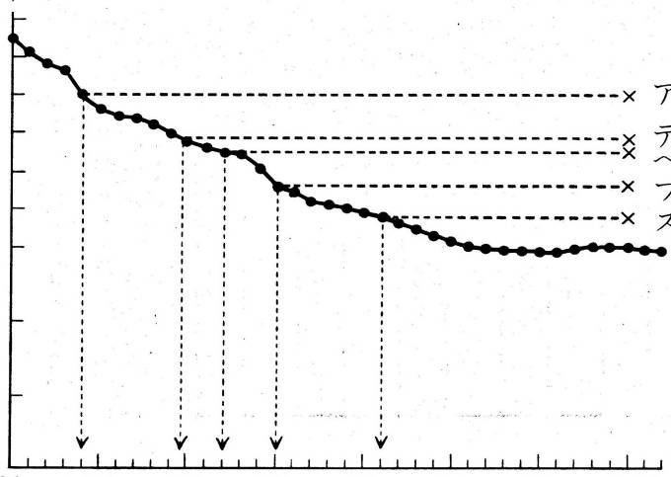
What is Japan?
Platinum Society Network
Japan overcame energy crises
by increasing energy efficiency.
6,000
(MJ/t)
5,000
US
Denmark
Belgium
4,000
France
Energy for production
Sweden
3,000
Japan
2,000
Theoretical
1,000
0
1960
1970
1980
1990
year
Source: Japan Cement Association
出所：「課題先進国日本」P114

Slide 10
What is Japan?
Platinum Society Network
What is Japan?
One of the peaks in the world
Closed in Edo
Ind. Revolution in Europe vs. Spirituality in Japan
Meiji restoration
Achieving high economic growth (1868~)
Answering pollutions (1960~)
Answering the energy crises (1970~)
Realizing the world longest lifespan (1970~)
2000
Energy and Resources
Aging of Society
Climate Change
Japan faces challenges ahead of the world
and needs innovations.

Slide 11
Vision Platinum Society
Platinum Society Network
Platinum Society as a Vision of 21st century
Now, majority of regular citizens in developed countries have
enough food, clothing, shelter, mobility, information, and longevity
It will not be later than mid 21st century that
majority of the people in the world will have them.
What do we want under this satisfaction?
“Quality of Life”
Together with Quantity
What is the quality that we desire ?

Slide 12
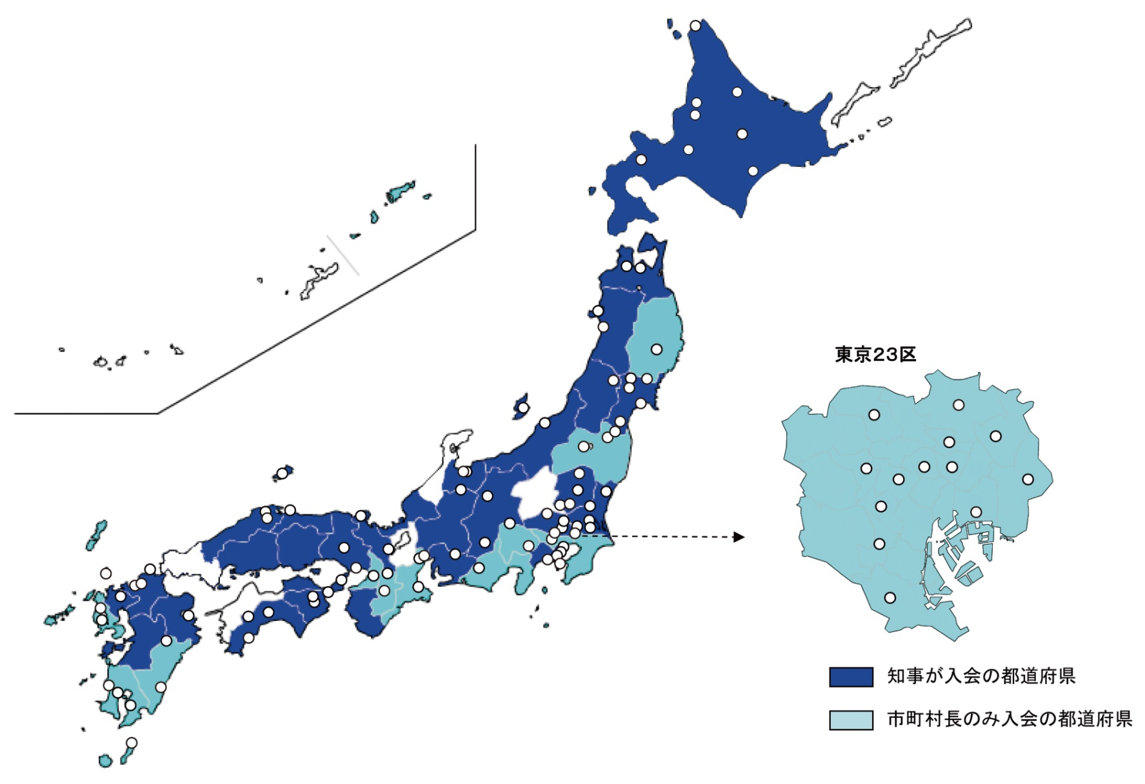
Vision Platinum Society
Platinum Society Network
Platinum Society Network
[Local Governments] 129
・Governor：29
・Mayor：100
[Corporate CEO’s] 77
[Individuals]52
Tokyo districts
governors
mayors
I started action for Platinum Society

Slide 13
Vision Platinum Society
Platinum Society Network
Necessary conditions for Platinum Society
Resources
・energy efficiency
・recycle
・agriculture, forestry
Ecology
・overcoming pollution
・bio-diversity
・global environment
Participation
・healthy aging
・lifelong learning
・multiple chances
Richness
・culture, arts, sports
・diversity
・GDP
Job opportunities
・new businesses
These are the seeds for new businesses

Slide 14
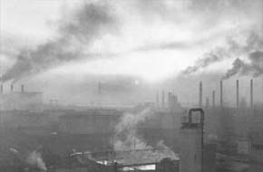
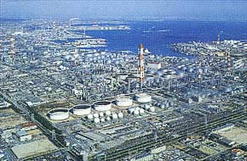
Vision Platinum Society
Platinum Society Network
Society in Harmony with Nature
Yokkaichi at 1950s
present
ⒸYokkaichi City
http://www.city.yokkaichi.mie.jp/kankyo/kogai.htm
Beyond pollution control

Slide 15
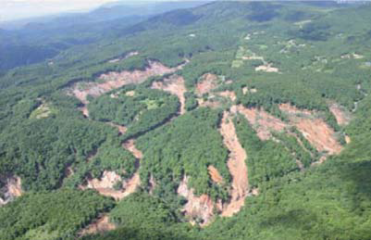
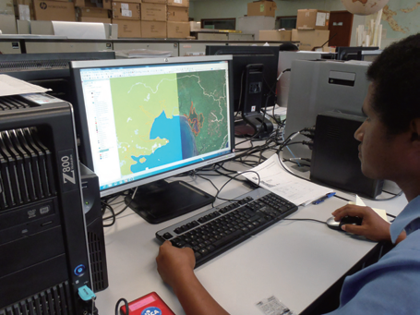
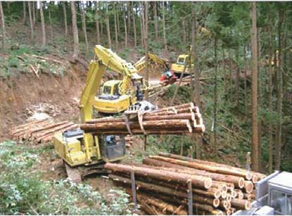
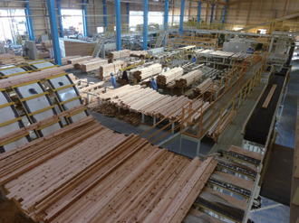
Vision Platinum Society
Platinum Society Network
Smart Forestry in Japan
Scale expansion
Mechanization
Supply chain restructuring
Self-sufficient
Environmental conservation
Job creation (50 b$, 0.5mjobs)
Land slide after heavy rain
(Photo)Annual Report on Trends in Forests and Forestry, The Ministry of Agriculture, Forestry and Fisheries of Japan

Slide 16
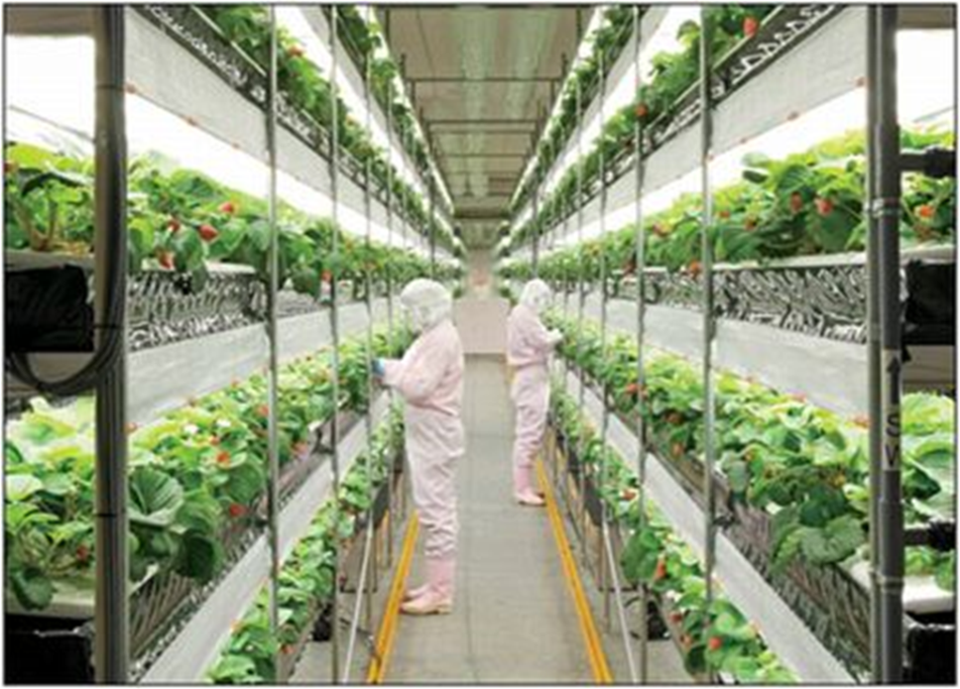
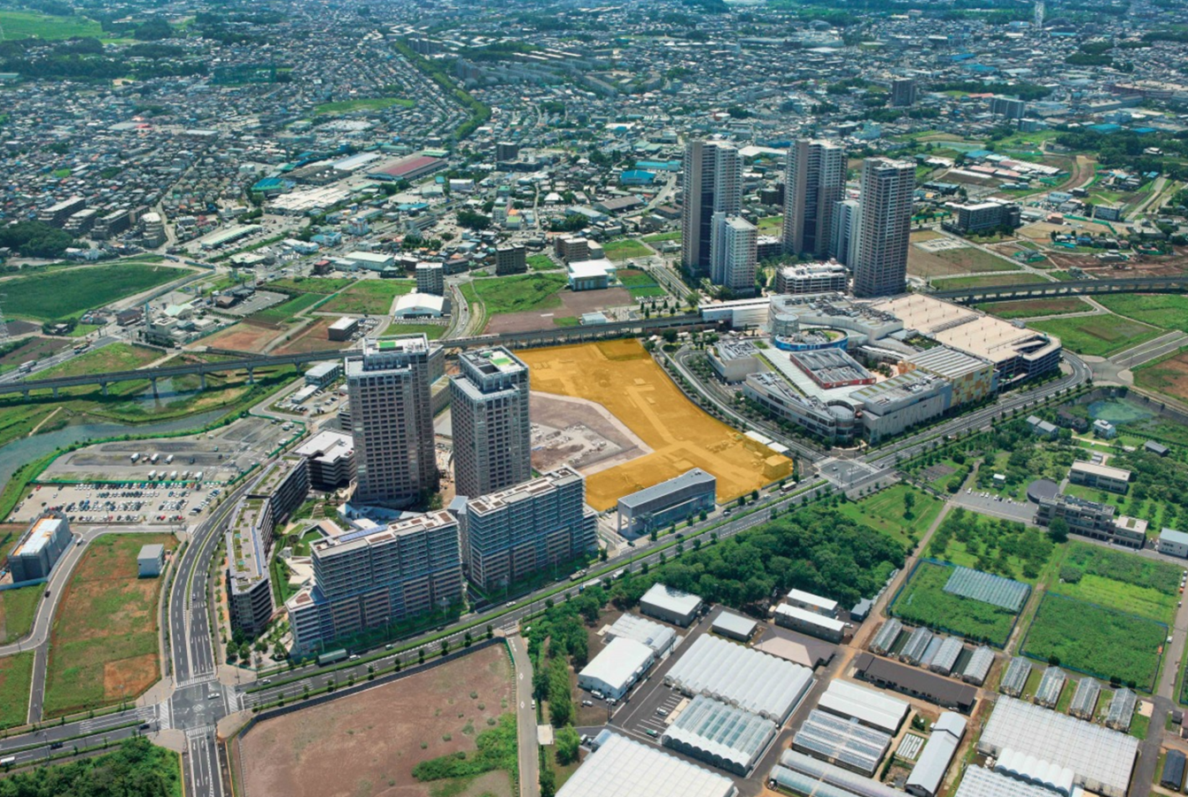
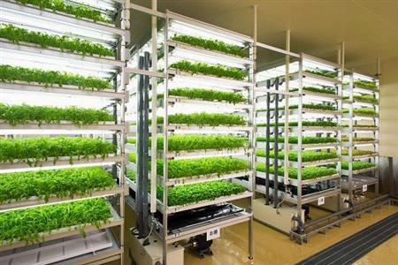
Vision Platinum Society
Platinum Society Network
Smart Agriculture in Japan
Innovative agriculture with
ICT, engineering, private company
Community Garden Area
Vegetable plant by textile company
Farm Field in
Chiba University
Vegetable Plants Area
Kashiwa-no-ha Smart City
Vegetable plant by convenience store company
(Photo)Plant Factory Association of Japan

Slide 17
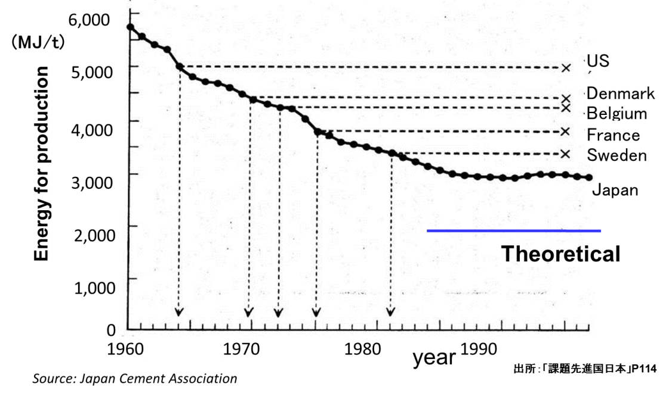
Vision Platinum Society
Platinum Society Network
Energy Efficiency was improved
in manufacturing in 1970s
Energy Efficiency should be improved in daily life now
FY1970
FY2010
Manufacturing
６６％
Daily Life
５７％

Slide 18
Vision Platinum Society
Platinum Society Network
Energy Efficiency of Automobiles to 8 times
Fuel Consumption [L/km]
Data Source: Yahoo! Japan Autos
Vehicle Weight [kg]

Slide 19
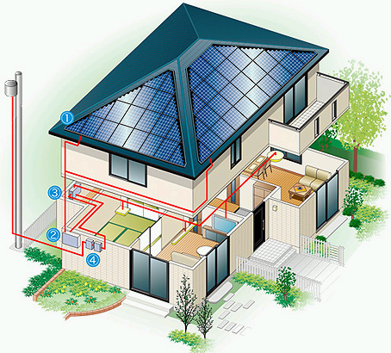
Vision Platinum Society
Platinum Society Network
Energy Efficiency as well as QOL
Komiyama Eco-House
Heat Pump Water Heater: COP=4
High Insulation: K=1.6 W/m²K
New air conditioners & refrigerator
LED & efficient fluorescent lamps
Solar Power Generation: 3.6kW
81 % Energy Reduction
refundable in 12 years

Slide 20
Vision Platinum Society
Platinum Society Network
Energy: Renewable energy is abundant
Solar
Wind
Hydro
Biomass
Geothermal
Invest Now and Enjoy Later

Slide 21

Vision of Platinum Society
Platinum Society Network
Japan : GDP increases but energy decreases
Final energy consumption
Electricity consumption
Real GDP
Real GDP (left scale, trillion yen, 1973 prices)
Electricity consumption (left scale, 100ktoe)
Final energy consumption (right scale, 100ktoe)

Slide 22
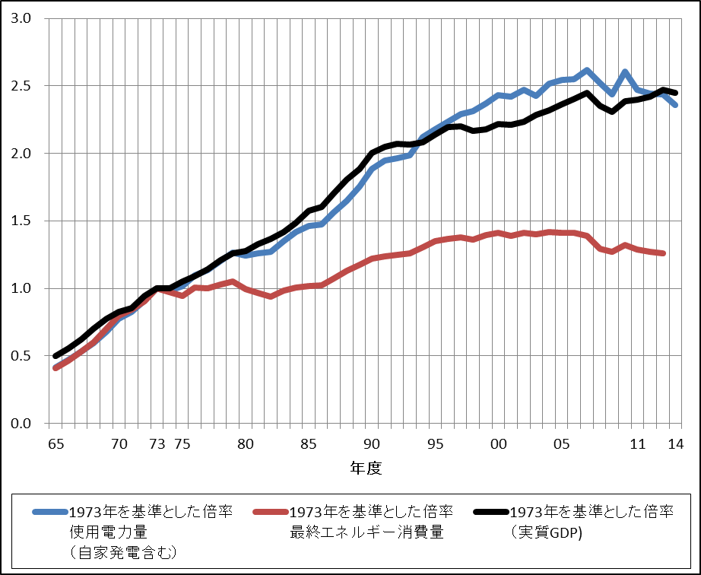
Vision Platinum Society
Platinum Society Network
Japan: Structuring knowledge tells the future
Service/
efficiency
Saturation/
efficiency
industry
Industry/
efficiency
Normalized Data : 1973=1
Copyright Japan Science and Technology Agency, Center for Low Carbon Society Strategy

Slide 23
Vision Platinum Society
Platinum Society Network
USA : GDP increases but energy decreases
Final energy consumption
Real GDP
Real GDP (left scale, billion 2005 USD, The World bank)
Electricity consumption (right scale, 100ktoe, IEA)
Final energy consumption (left scale, 100ktoe, IEA)

Slide 24
Vision Platinum Society
Platinum Society Network
China: GDP and energy increase
Final energy consumption
Real GDP
Real GDP (left scale, billion 2005 USD, The World bank)
Electricity consumption (right scale,100ktoe, IEA)
Final energy consumption (right scale, 100ktoe, IEA)

Slide 25
Vision Platinum Society
Platinum Society Network
China: Normalized at 2012
Final energy consumption
Real GDP
Real GDP (2012 minus 1978 and divided by 2012)
Electricity consumption (2012 minus 1990 and divided by 2012)
Final energy consumption (2012 minus 1978 and divided by 2012)

Slide 26
Necessary condition for platinum society
Energy will be Self-Sufficient in 2050 in Japan
artifacts be saturated and efficiencies be improved
Decrease by Efficiency improvement
32/45 = 0.7
renewable（solar・wind
geo・biomass・hydro）
32%
18%
domestic
import

Slide 27
Vision Platinum Society
Platinum Society Network
Renewable energy is getting cheaper and cheaper and huge potential exists
 | Cost（yen/kWh） |  | Generation potential（TWh/y）
 | Present | 2030
Solar | 16 | 6 | >400
Wind (on shore) | 16 | 8 | >500
Geothermal | 12 | <12 | 70^{*1} , 500^{*2}
Small hydro | 30（12*³） | <12 | 70
Biogas※ | 25（15） | 13(5) | 20
Biomass（wood） | 31(8) | 12(4) | 40
Intermit-tent
Stable
Numbers in ( ) are fuel costs, *1:hydrothermal system of over 150℃ *2:hot dry rock of over 300℃ *3:Data under implementation
Copyright Japan Science and Technology Agency, Center for Low Carbon Society Strategy

Slide 28
Vision Platinum Society
Platinum Society Network
Urban mines from Natural mines
artifacts saturated and energy saved
ratio of energy for
reduction and melting
Iron 27 times
Aluminum 83 times
ratio of concentration of
mines and mobile phones
Gold 50 times
Human will become free from excavation.

Slide 29
Vision Platinum Society
Platinum Society Network
Resource Self-Sufficient Japan at 2050
Energy 70%
Mineral 70%
Food 70%
Wood 100%
Water 100%
In 20th century industry was monopolized by 10%

Slide 30
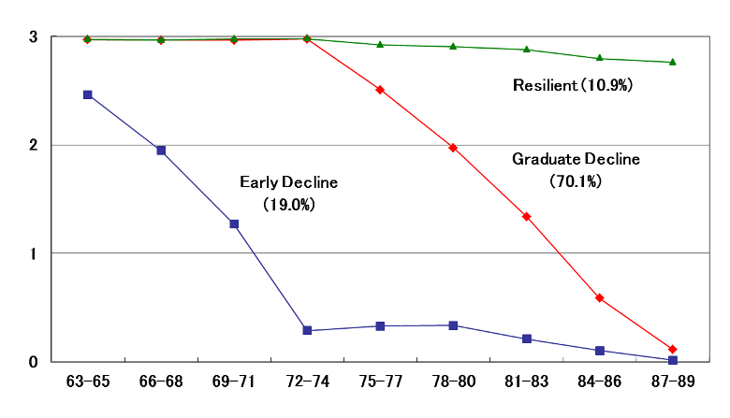
Vision Platinum Society
Platinum Society Network
Aging: Most seniors can be independent
until 2~3 months before death
self-support
resilient
(11%)
early decline
(19%)
gradual decline
(70%)
death
male
age
出典）Akiyama et al. (2008) アメリカ老年学会2008年年次大会

Slide 31
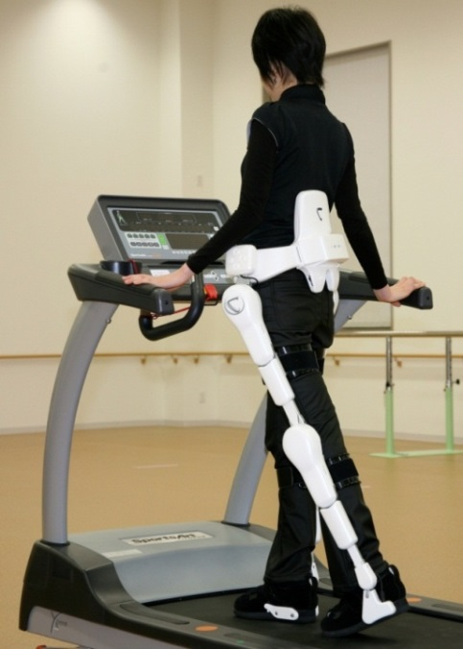
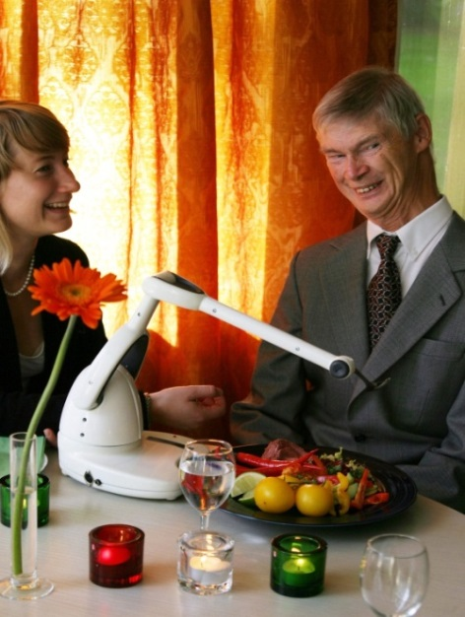
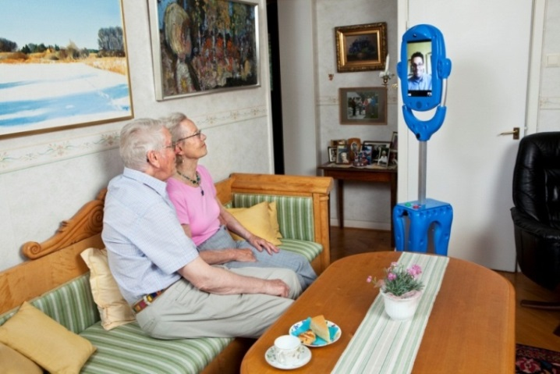
Vision Platinum Society
Platinum Society Network
We can be independent only if brain survives
Human can be independent
Only if brain is alive
HAL(for care）
Produced by
CYBERDYNE （JAPAN）
Assistive eating device - Bestic
Produced by
Robot Dalen（Sweden）
Communication Robot - Giraffe
Produced by Robot Dalen（Sweden）

Slide 32
Vision Platinum Society
Platinum Society Network
Business Opportunities for Health and Independence
Utilization of ICT in daily life
Housing for Health
Innovative evolution of ICT
Urban Development for Healthy life
Food Service
Vehicle, transportation
Ｐｒｅｓｃｒｉｐｔｉｏｎ
Body-Care
dietary education, physical exercise, intellectual education, forest bathing, recreation, medication, molecular target treatment, etc.
tourism
sports
relaxation
industrial promotion
Device, tool
industrial promotion
Entertainment
ICT
Education
Body
Smart Wellness
System
symptom
Eco-money
R&D
Life-style,
medical biography,
biological information,
gene information, etc.
back problem, migraine, cardiac disease, atopy,
depression, allergy,
dependence,
tranquilization
Advanced ICT utilization medical-care
Conventional
medical care
Treatment
insurance
industrial promotion
nursing-care robot
PHR service
regeneration medicine
Cause
Disease
drug
Preventive health-care
32
ICT: Information and Communication Technology

Slide 33
Vision Platinum Society
Platinum Society Network
Two Crucial Demands for Economic Growth
Diffusive Demand
Demands for quantitative wealth to saturate
Car/TV/house/appliances/・・/Present Industry
Creative Demand
Wants for QOL to create new industries
Health Care/New Energy/Eco-House/・・/Platinum Industry
Create businesses from potential demand for QOL

Slide 34
Vision Platinum Society
Platinum Society Network
From Industry to Life
Industrial revolution → Platinum revolution
Quantity → Quality
Standardization → Diversification
Supply side → Demand side
Big company → Venture
Education → Learning society
We need innovation for change.

Slide 35

Action with Vision is inevitable NOW!
Contents:
Preface
1. “Diffusive Demand” and “Creative Demand”
2. The 21st Century Paradigm and the Role of Information Technology
3. “Vision 2050” as the Rescue of a “Limited Earth”
4. Finding a Way Out Through Creative Demand, I
5. Finding a Way Out Through Creative Demand, II
6. Toward the Realization of a “Platinum Society”
Thank you!

