Slide 1
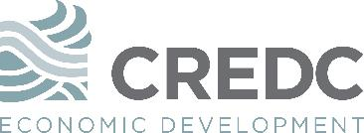
Columbia River Economic Development Council
The Power of Completion
May 19, 2017
Presented by Mike Bomar, President

Slide 2
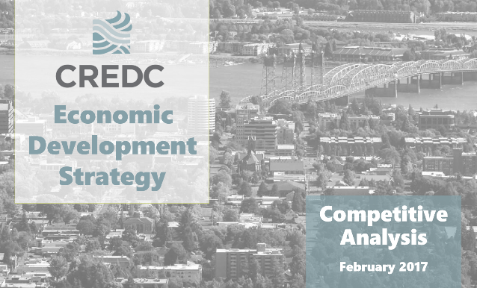
Economic Development Plan Update
239273
2017 Strategic Plan
PHASE I
Approved by Board of Directors April 2017
Initial Stakeholder Interviews: Conducted by WSUV
Guiding Principles:
Industry Driven
Existing Businesses First
People and Business
Inclusive Community
Value of Place
PHASE II
Target completion Q3 2017
Develop implementation plan to achieve strategic goals

Slide 3
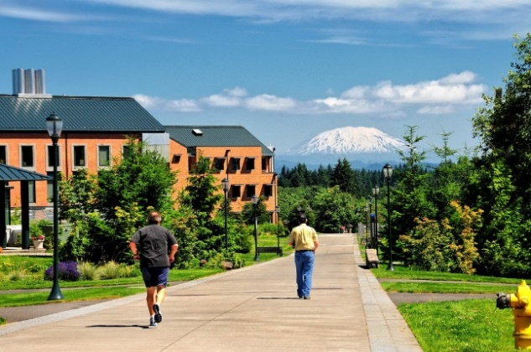
Economic Development Plan Update
239273
Vision Statement
Clark County is one of the most inclusive, healthy, and amenity rich communities in the country. With a continued focus to grow a diverse base of community-minded employers, talent (inside and outside the region) sees greater opportunity here than anywhere else in the country.

Slide 4
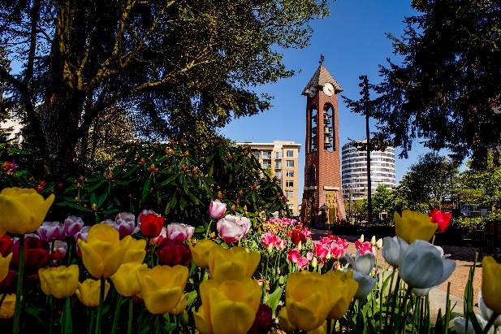
Economic Development Plan Update
Takeaways
ECONOMIC DEVELOPMENT PRINCIPLES
Companies want TALENT
Talent wants JOBS and PLACE
Across all industries, the national economy is becoming increasingly more talent/knowledge-based
People are the most important asset to a company’s value and growth
Notes:
The national economy is becoming increasingly more talent/knowledge-based than resource-based, meaning that people, rather than raw materials, are the most important asset to a company’s value and prospects for growth. This applies to all industries, including manufacturing, professional services, and technology.
This is not to suggest that Clark County needs to focus their industrial base entirely on technology companies, but to understand that the modern economy thrives more on highly skilled people . For this reason, a company’s number one priority today is attracting talent. And talent wants to go to a great place with jobs.
When planning for a future economy, it is important to understand that all industries are dependent on a talented workforce that has technical skills and/or degree attainment. Clark County’s future economy requires a skilled workforce with training in career technical education (CTE) and access to higher education science, technology, engineering, and mathematics (STEM) degrees.
CTE training is targeted toward middle-skill jobs, which require education and training beyond high school but less than a bachelor's degree, and are a significant part of the economy. Of the 55 million job openings created by 2020, 30 percent will require some college or a two-year associate degree. Association for Career and Technical Education, 2016.
Increasingly, employers are demanding a workforce that has technical skills, including manufacturing jobs that involve the operation of sophisticated machinery requiring some advanced training beyond high school. Science, technology, engineering, and mathematics (STEM) workers are increasingly in demand and in short supply, especially in the private sector which needs software developers, data scientists, and those in skilled trades.

Slide 5
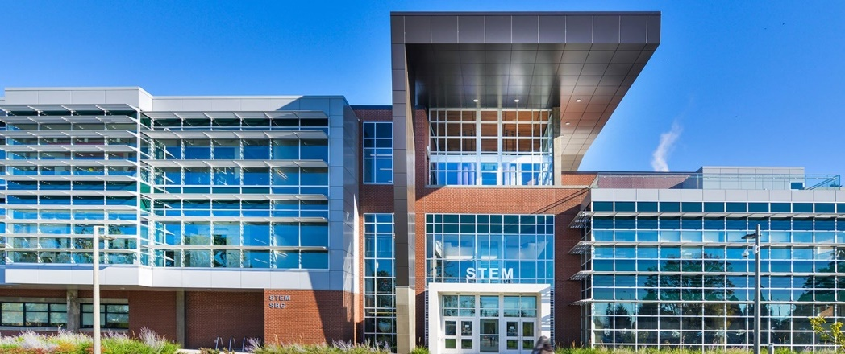
Economic Development Plan Update
Overarching Goals
Expand the Existing Base
Support People
Create Place

Slide 6
Economic Development Plan Update
239273
Clark County Educational Attainment
2015
U.S. Census American Community Survey 2011-2015
Notes:
Data Points
Clark County's educational attainment levels are lower than benchmarks and the region, presenting a potential challenge;
Clark County has a higher share of adults with an Associates Degree compared to Washington State, Portland MSA, and the US;
18,503 residents were enrolled in Undergraduate Programs in 2015, which declined from over 21,000 residents in 2011;
3,402 residents were enrolled in Graduate Programs in 2015, which declined only slightly since 2011

Slide 7
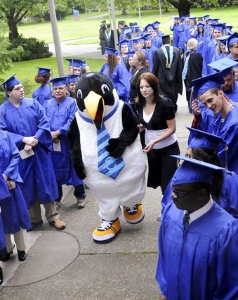
Demand for Skilled Workforce
Why Completion Matters
INCREASED EARNINGS
On average, having some postsecondary education increases lifetime earnings by nearly $250,000 over having just a high school diploma
Associate degree = nearly 1/3 more
Bachelor’s degree = 74% more
Graduate degree = at least 2x
Some studies show graduates with technical or applied science associate degrees out-earn bachelor's degree holders by $2,000 to $11,000;
Over ¼ of people with a technical license or certificate (but less than an associate degree) earn more than the average bachelor’s degree recipient
According to the Georgetown University Center on Education and the Workforce; Association for Career & Technical Education
Notes:
Carnevale, Anthony P., Stephen J. Rose, and Ban Cheah. "The college payoff: Education, occupations, lifetime earnings." (2011). (Georgetown University Center on Education and the Workforce: https://cew.georgetown.edu/wp-content/uploads/2014/11/collegepayoff-complete.pdf)
Having some postsecondary education, even without earning a degree, adds nearly one quarter of a million dollars to lifetime earnings. Annual earnings rise to $38,700 ($18.69 per hour). Getting an Associate’s degree adds another bump of nearly $200,000 in lifetime earnings. At $43,200 a year ($20.77 per hour), those with Associate’s degrees earn nearly one-third more than those with just a high school diploma.
Getting a Bachelor’s degree adds another large increase in lifetime earnings. With median earnings of $56,700 ($27.26 per hour), or $2.3 million over a lifetime, Bachelor’s degree holders earn 31 percent more than workers with an Associate’s degree and 74 percent more than those with just a high school diploma.
All graduate degree holders can expect lifetime earnings at least double that of those with only a high school diploma. For those with a Master’s degree (which includes those with Master’s degrees in elementary teaching and in business administration), typical lifetime earnings are $2.7 million ($66,800 a year or $32 per hour). Moreover, earnings rise substantially for those with Doctoral and Professional degrees: Doctoral degree holders have lifetime earnings of $3.3 million ($81,300 per year; $39 per hour) while those with Professional degrees (mainly doctors and lawyers) have the highest earnings, making over $3.6 million over the course of a lifetime ($91,200 per year; $44 per hour). This is a 61 percent increase (nearly 1.4 million) over Bachelor’s degree holders.
ASSOCIATION FOR CAREER & TECHNICAL EDUCATION:
According to research in Texas, Colorado and Virginia, graduates with technical or applied science associate degrees out-earn bachelor's degree holders by $2,000 to $11,000.
27 percent of people with less than an associate degree, including licenses and certificates, earn more than the average bachelor’s degree recipient.

Slide 8
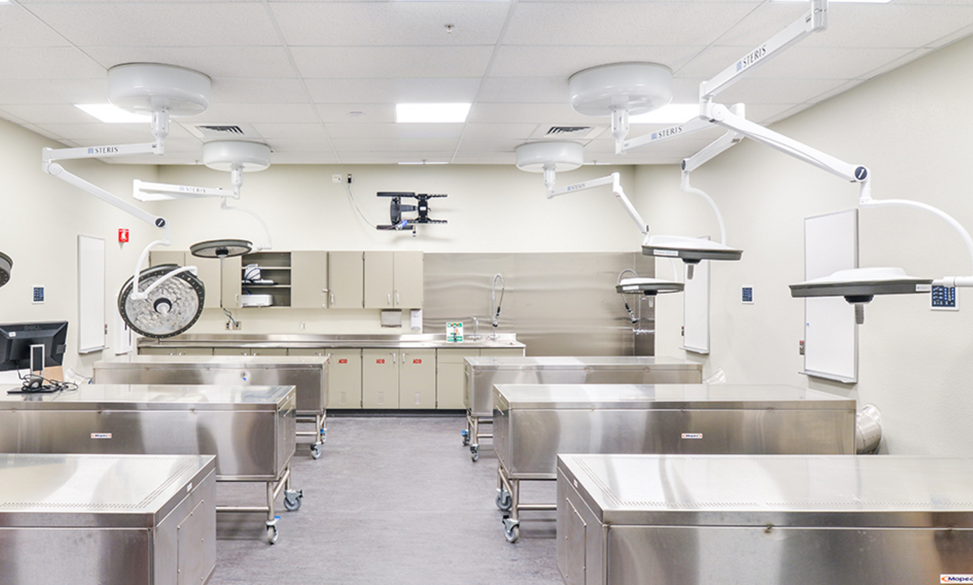
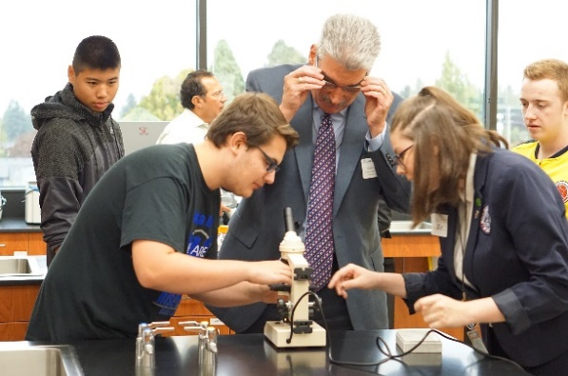
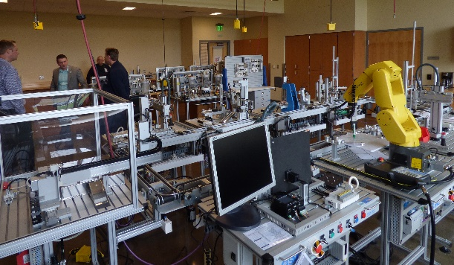
Demand for Skilled Workforce
Local Workforce Needs
WA ranks 2nd in the nation in the concentration of STEM jobs
Expected to grow by another 24% by 2018
Growth rate is 7 points higher than the national average
94% of these jobs will require some post-secondary education
25% of jobs in Southwest WA are STEM jobs
5x higher than the national average
Nearly half of Southwest WA STEM jobs require an AA degree or less
According to the Southwest WA STEM Network; Washington STEM
Notes:
Data is from the Southwest WA STEM Network and WA STEM
Great Jobs Within Our Reach: Solving the Problem of Washington state’s growing job skills gap. The Boston Consultancy Group and the Washington Roundtable. March 2013. https:// www.bcgperspectives.com/content/articles/education_public_sector_opportunity_all_investing_ washington_state_stem_education/>

Slide 9
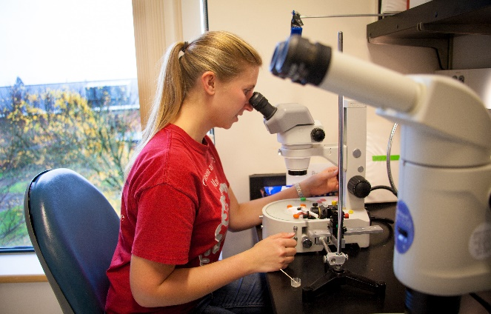
Demand for Skilled Workforce
The Importance of Technical Skills
SKILLS GAP
64% of all jobs nationally are expected to require some postsecondary education or training by 2020
45,000 jobs in the state are expected to go unfilled in the next four years due to lack of qualified candidates
Filling the job skills gap would generate an additional 110,000 jobs, creating $720 million in state tax revenue and $80 million in local tax revenues by 2017
According to the Georgetown University Center on Education and the Workforce; Washington STEM
Notes:
“Recovery: Job Growth and Education Requirements through 2020.” https://cew.georgetown.edu/wp-content/uploads/2014/11/Recovery2020.ES_.Web_.pdf

Slide 10
Thank You!
239273
Questions?
Mike Bomar
President
mbomar@credc.org
Phone: 360-694-5006

