Slide 1
Computer Support and Information Tech Advisory
Date: May 15 2016
Time: 8:30—10:00 am
Location: GHL 205

Slide 2
Your Advisory Committee
Computer Support and Information Technology Advisory
Currently providing oversight for
CTEC Computer Support AAT
CTEC Computer Support CP
In addition providing advisement oversight and input on
Transfer options
Software Development Service courses for BTEC, Web Development and Campus at large
Possible new options in Database Admin or Microsoft

Slide 3
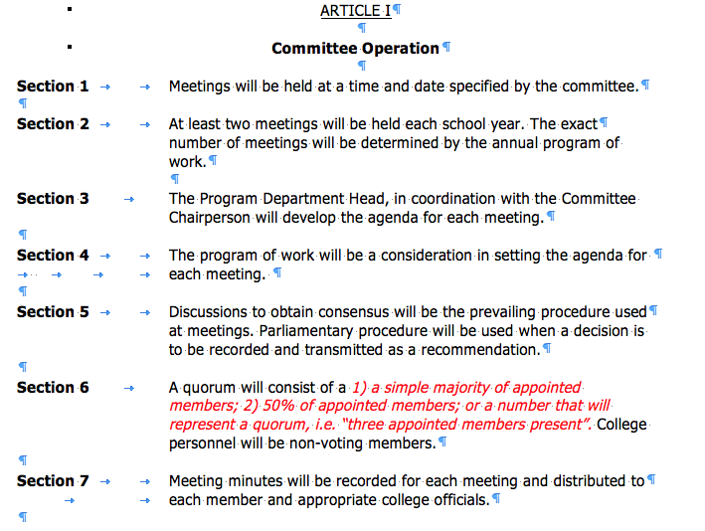
Membership and By Laws

Slide 4
Making A Decision RE: Quorum
a simple majority of appointed members or
50% of appointed members or
a number that will represent a quorum, i.e. “three appointed members present”

Slide 5
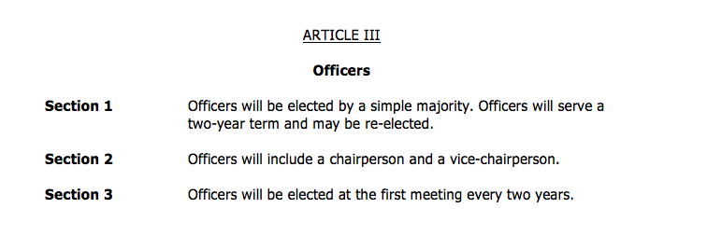
Membership and By Laws II

Slide 6
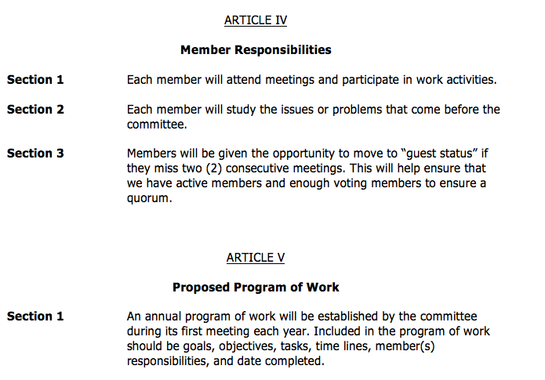
Membership and By Laws

Slide 7
Current Membership
John Jenkins
Aaron Mark Johnson
Paul Yee
Jeff Hoy
Bruno George
Tom Strobehn (new member)
Two other Members who have not attended or RSVPd

Slide 8
Cathy Sherick and other news from the Office of Instruction
General updates on Advisory
Academic Plan
Guided Pathways
Budget Cut Implementation

Slide 9
Current: Spring 2015 75 Students
Last Meeting: Fall 2015 80 Students
Last Year at this time Spring 2015 92 Students
Pipeline means student is enrolled or has completed CTEC 104 PC Support Customer Service Skills

Slide 10
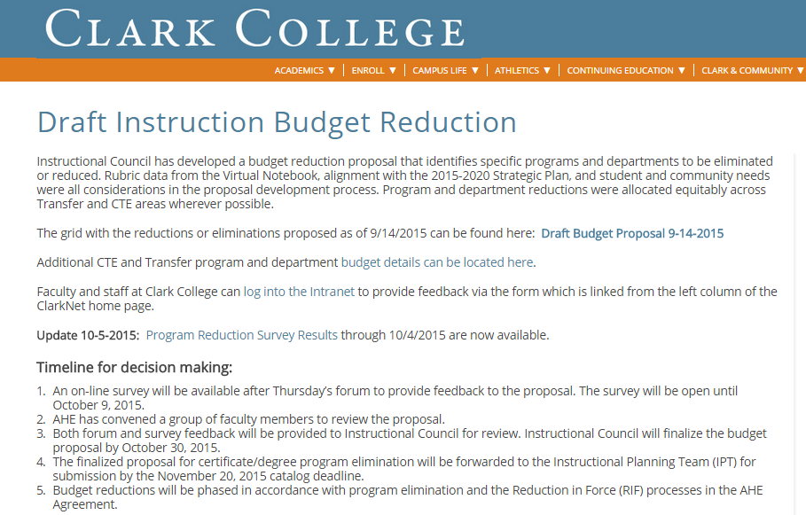

Slide 11
Fall 2016 Instructional Budget Cuts
Status since the last Meeting
Bob Hughes and Dwight Hughes Met with Tim Cook and agreed to
$53 ,912 of savings with CTEC 100 and CCNP classes
Summer and Fall quarter cuts already implemented.
Less overall sections
Less elective offerings
Less general computing options

Slide 12
Review: New Curriculum for 2016-17 CTEC 106 IT Fundamentals
CompTIA Certification class replaces role of general computing survey class CTEC 100 and replaces CompTIA Strata
More focused Introduction to professional IT practices
Less of a general intro to Computing
Our program becomes aligned with another Industry certification

Slide 13
Review: New Curriculum for 2016-17 CTEC 112 Programming Essentials
Reintroduces Programming into the Computer Support curriculum beginning next year
Course prerequisite aligned with our program
Hands on with a focus on programming awareness and literacy
Can serve as a pathway to explore web and Microsoft software development

Slide 14
Review: New Curriculum for 2016-17 MTA Software Development w/C#
CTEC 135 Microsoft MTA Software Development with C#
Can be an elective option for Networking and Computer Support programs at Clark
Can be used as launching pad for additional MTA Development offerings at Clark
Requires CTEC 112 or 112 and CTEC 134 MTA Database Administrator

Slide 15
Review: New Curriculum for 2016-17 MTA Software Development w/C#
CTEC 135 Microsoft MTA Software Development with C#
Can be an elective option for Networking and Computer Support programs at Clark
Can be used as launching pad for additional MTA Development offerings at Clark
Requires CTEC 112 or 112 and CTEC 134 MTA Database Administrator

Slide 16
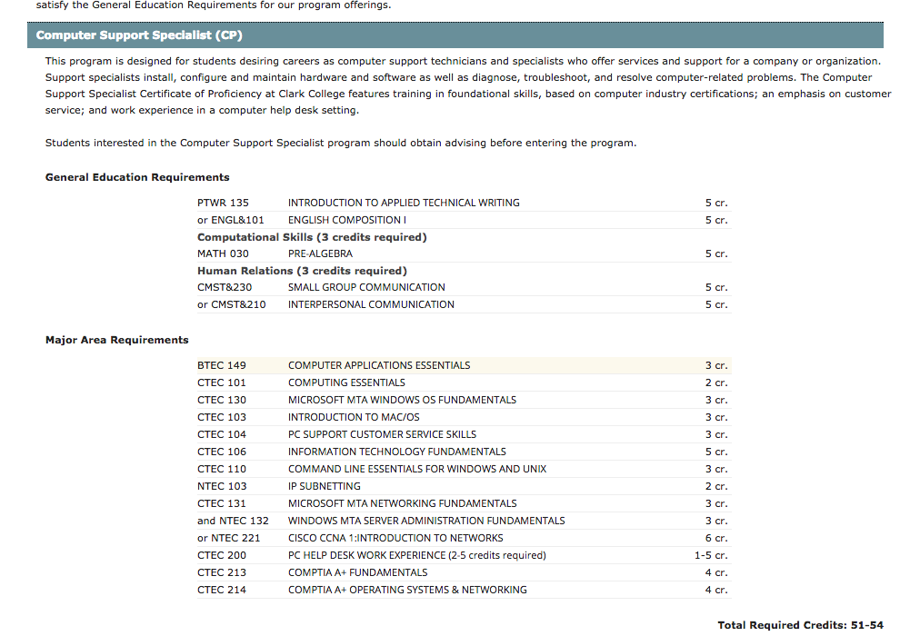

Slide 17
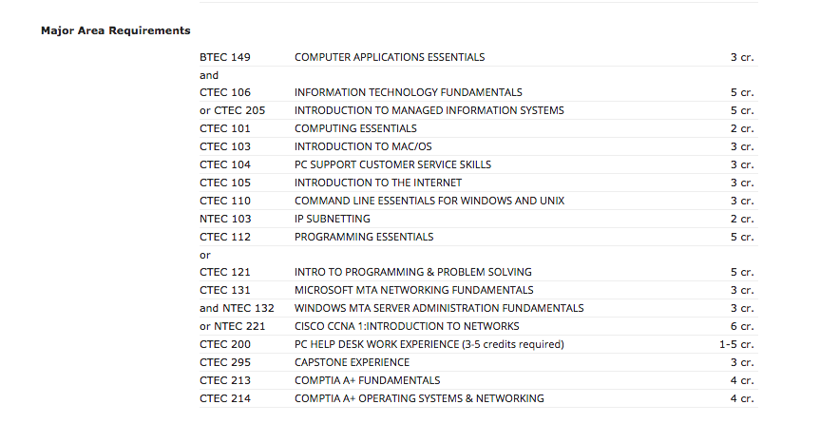

Slide 18
Other Curriculum Changes for 2016-17
CTEC 200 PC Help Desk is now a Permission Only Class
CTEC 140 Introduction to Unix prerequisite change allows for greater Computer Support enrollment

Slide 19
Refining Our 2015-16 Work Plan
Suggested Goals for discussion and considering strategies, timelines and extent of Advisory committee role
Areas Addressed
Curriculum
Institutional Quality and Effectiveness
Marketing/Public Relations

Slide 20
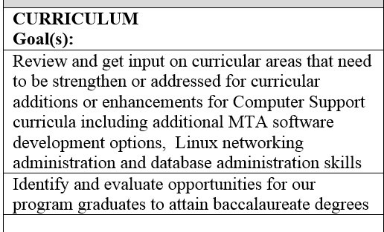
Our 2015-16 Work Plan Proposed Goals I

Slide 21
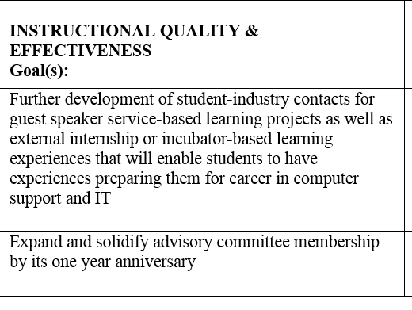
Our 2015-16 Work Plan Proposed Goals II

Slide 22
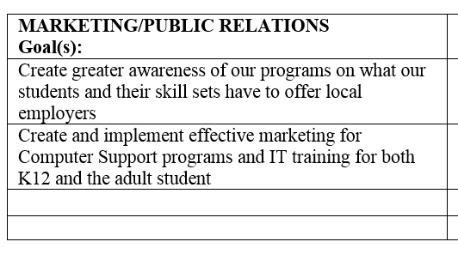
Our 2015-16 Work Plan Proposed Goals III

Slide 23
Cath Keane, Career Services
HDEV 200 Professional Development
“Soft Skills” content by professionals focused on this area
Service Role for CTEC 199 Co-op Internship (Allows reduced manageable hours for internship experiences)
Can allow Capstone to focus on tech related skillsets
Opportunity for learning communities & linked classes

Slide 24
Questions we need you for regarding our future direction
More Database?
Role of a Linux-related skill set in our curriculum
More MS MTA Software Development after the initial CTEC 135 MTA C# class?
Technologies/Skills/Trends we are missing?
How can we better work together for marketing, internship, job placement?

Slide 25
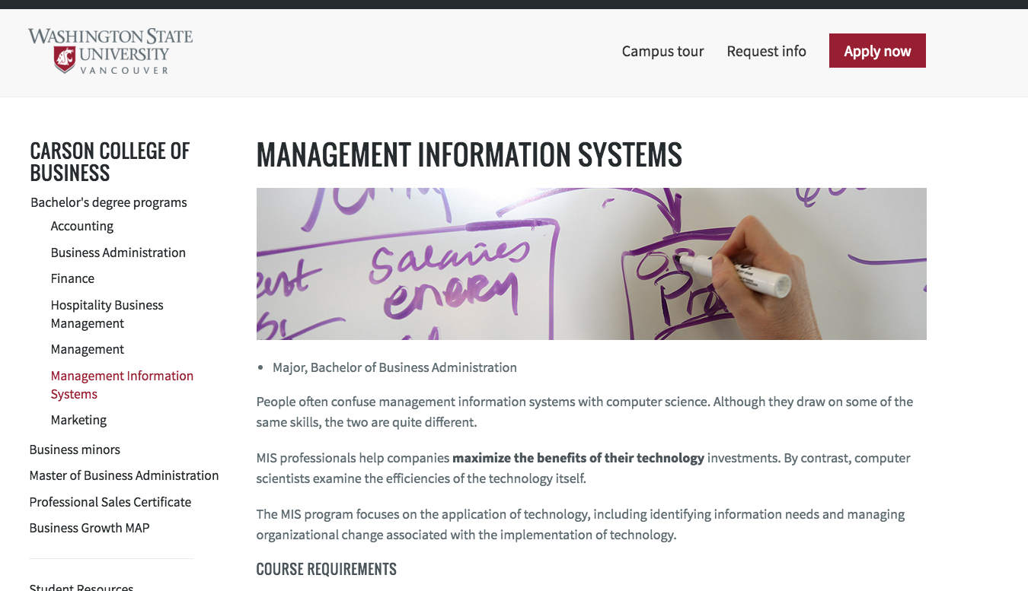
CTEC 205 Intro to MIS

Slide 26
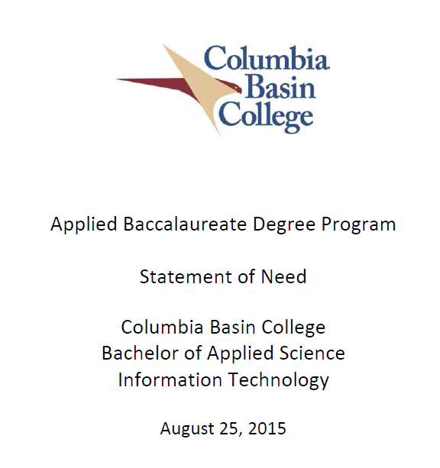
Opportunity: CBC IT BAS

