Slide 1

Computer Support & Information Technology (CSIT)
Advisory Committee
Meeting Agenda
Date: Wednesday, May 13, 2015, 6pm
Meeting Location: Joan Stout Hall, Room 248

Slide 2
Your Advisory Committee
Computer Support and Information Technology Advisory
Currently providing oversight for
  CTEC Computer Support AAT
  CTEC Computer Support CP
In addition providing advisement oversight and input on
  HIIT Transfer with Bellevue
  Transfer options to the WSUV Business and MIS programs
  Possible new Database Admin or Microsoft Software Developer program
  Service courses for BTEC, Web Development and Campus at large

Slide 3
The Networking Advisory Committee
CISCO and Advanced Networking Advisory
providing oversight for
  NTEC Cisco Technologies AAT and CA
  Microsoft Technologies AAT and CA
  NTEC Datacenter Technician CA
  NTEC Networking Technologies AAT
In addition providing advisement oversight and input on
  Input on other CISCO activities associated at Clark College
  Exploring Future IT BAS transfer opportunities and agreements
  Exploring Future IT BAS degrees at Clark College
  Expansion of Networking program to NTEC Datacenter Technician
  Unix Network Administration

Slide 4
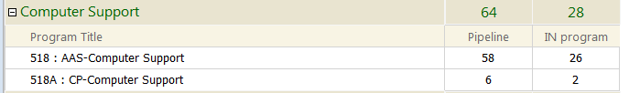
Pipeline means student is enrolled or has completed
CTEC 104 PC Support Customer Service Skills

Slide 5
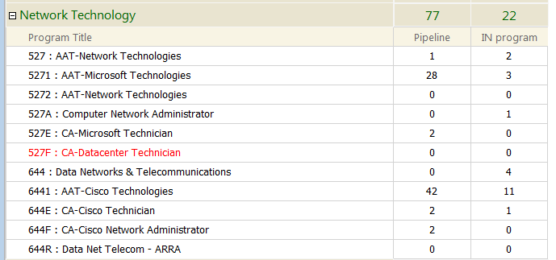

Slide 6
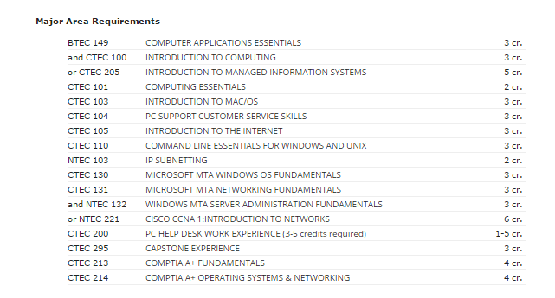
2015-16 Catalog
Computer Support AAS

Slide 7
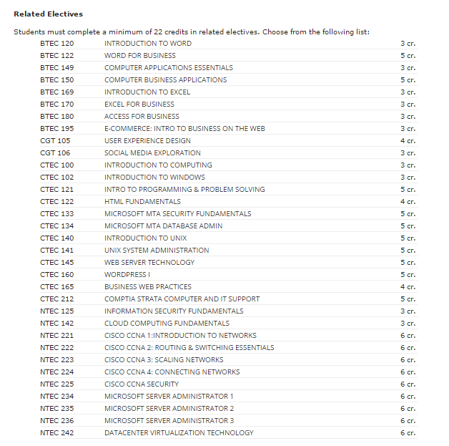
2015-16 Catalog
Computer Support AAS

Slide 8
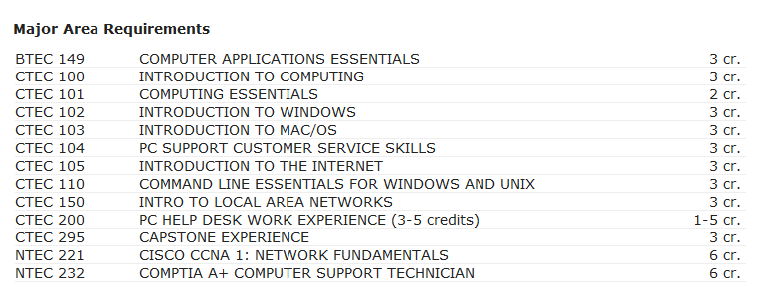
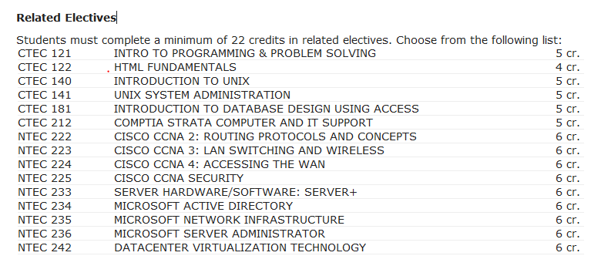
2013-14 Catalog
Computer Support AAS

Slide 9
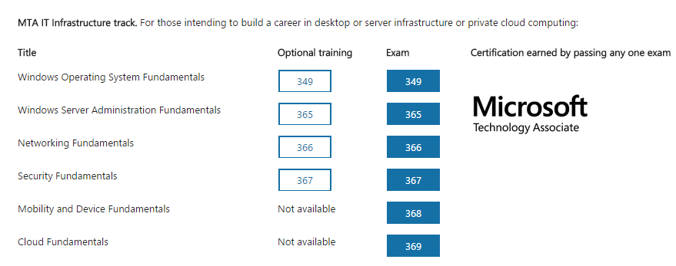

Slide 10
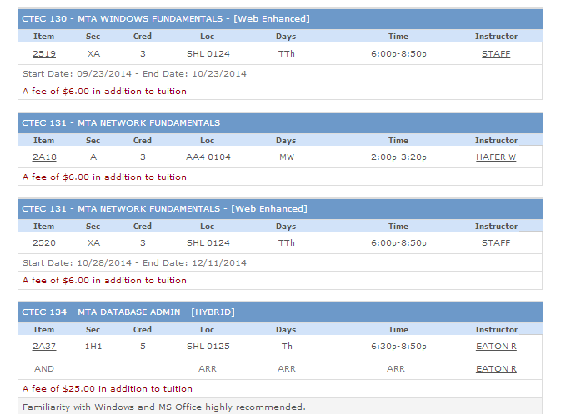

Slide 11
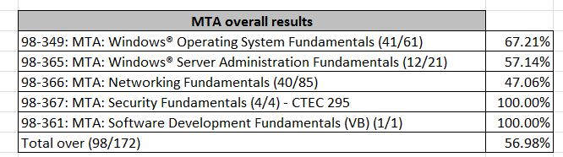
MTA Awards in 2014

Slide 12
CTEC 200 Penguin Help Desk
100-150 Computers Serviced per quarter
Serves both Clark students, staff & |
local community
6-8 students working average 10-12
hours per week
Service outreach doing educational programs for Fort Vancouver Regional Library Tech Talks

Slide 13
CTEC Serves
Foundational Computing classes for the College (Intro to Computing, Windows, Networking)
Elective classes for the NTEC and BTEC program
Program prerequisites for Allied Health programs (Pharmacy and Radiology)

Slide 14
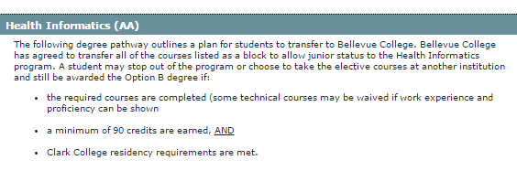
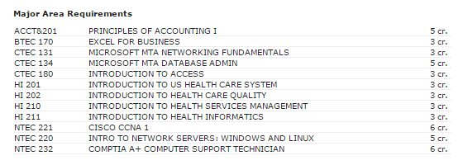
Health Informatics

Slide 15
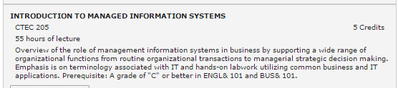
CTEC 205: Direct Transfer Class
Circa 650 Business Administration students are potentially in the pipeline to take this class
Replaced CTEC 100 and BTEC 150 transfer req
Offered F2F, Hybrid and Online
New partnering with WSUV

Slide 16

Articulation with K12
CTEC 104 Customer Service
CTEC 130 and 131 MTA OS and Networking
TestFest
More to follow…

Slide 17
For 2014-15 ??
CTEC 112 Programming Essentials
  A programming class without a prerequisite that will be some hands on but long on literacy and awareness. Possible articulation with new VPS game curriculum

Slide 18
For 2014-15??
CTEC 135 Microsoft MTA
  Can be an elective option for Networking and Computer Support programs at Clark
  Can be used as launching pad for additional MTA Development offerings at Clark

Slide 19
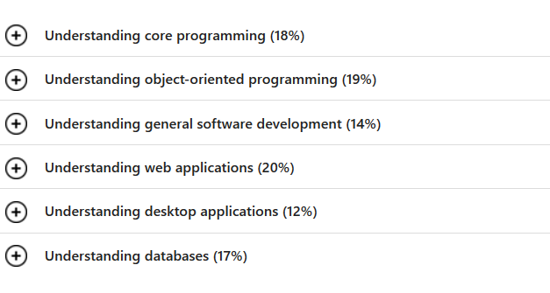
CTEC 135: MTA Software Developer

Slide 20
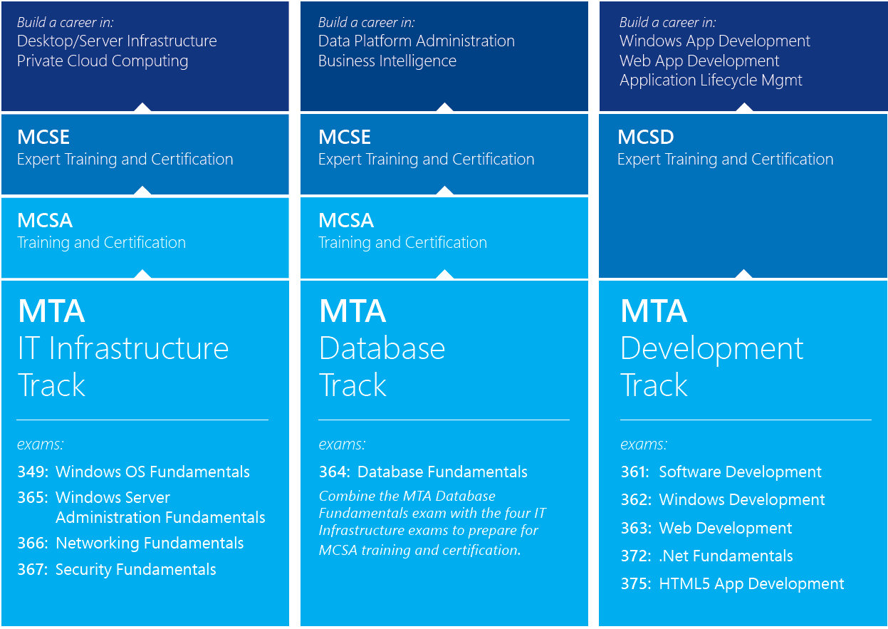

Slide 21
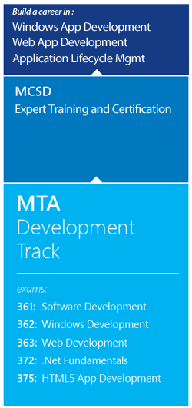

Slide 22
Other Options to Explore
  Possible new IT program options such as
  Database Admin or Microsoft Software Developer
New Certificate for HIIT to support transfer agreement

