Slide 1
Computer Support and Information Tech Advisory
Date: Wednesday, October 14, 2015
Time: 8:30—10:00 am
Location: Joan Stout, room 244

Slide 2
Your Advisory Committee
Computer Support and Information Technology Advisory
Currently providing oversight for
CTEC Computer Support AAT
CTEC Computer Support CP
In addition providing advisement oversight and input on
Transfer options to the WSUV Business and MIS programs
Possible new options in Database Admin or Microsoft
Software Develoment Service courses for BTEC, Web Development and Campus at large

Slide 3
Cathy Sherick: Office of Instruction
Ethics training
General updates

Slide 4
Current: Fall 2015
Last Meeting Spring 2015
Pipeline means student is enrolled or has completed CTEC 104 PC Support Customer Service Skills

Slide 5
MTA Awards in 2014

Slide 6
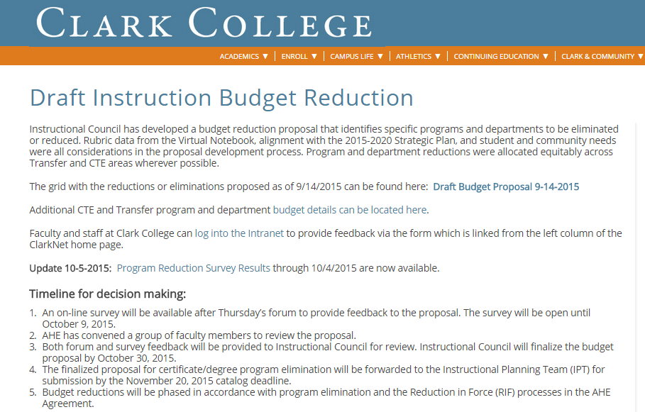

Slide 7
Proposed Instructional Budget Cut of Interest
Official Comment Period is closed
Several CTEC faculty members responded to comments
Bob Hughes meets Dr Tim Cook on Thursday 10.15 afternoon.
Supply him with your concerns by tomorrow morning

Slide 8
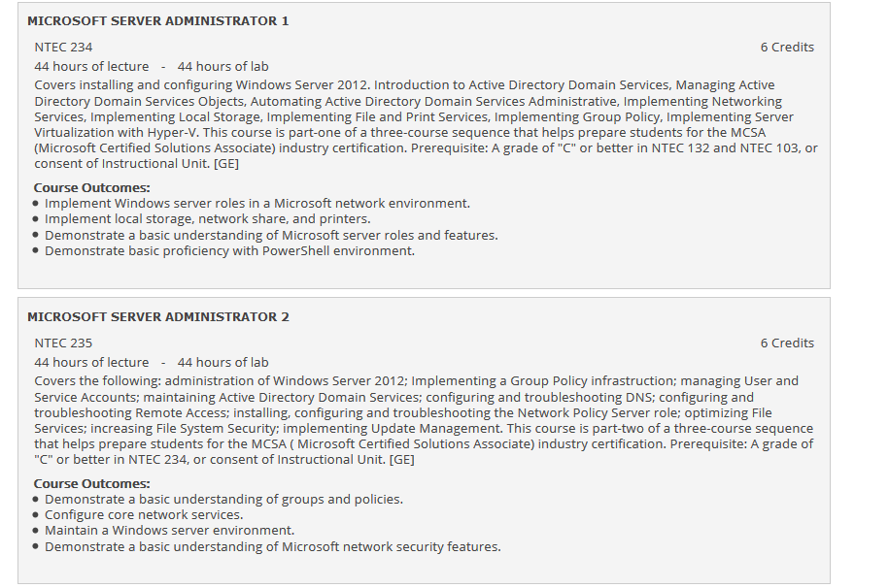

Slide 9
Our 2015-16 Work Plan
Suggested Goals for discussion and considering strategies, timelines and extent of Advisory committee role
Areas Addressed
Curriculum
Institutional Quality and Effectiveness
Marketing/Public Relations

Slide 10
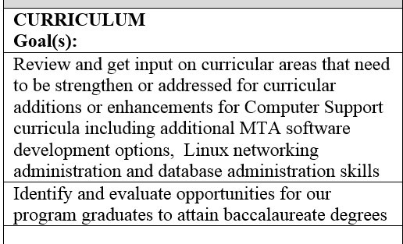
Our 2015-16 Work Plan Proposed Goals I

Slide 11
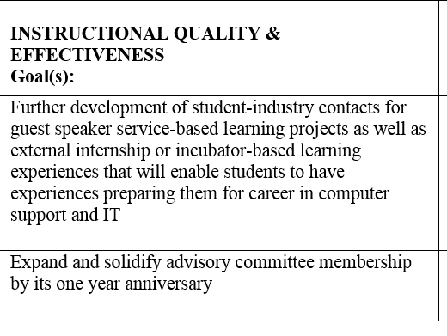
Our 2015-16 Work Plan Proposed Goals II

Slide 12
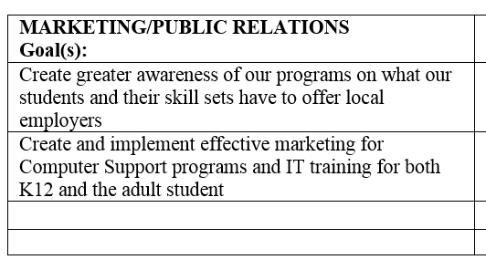
Our 2015-16 Work Plan Proposed Goals III

Slide 13
Brianna Lisenbee
Career Services
Best Practices for discussing Internships and other partnerships with Industry Partners

Slide 14
For 2016-17 Catalog: CTEC 112 Programming Essentials
A programming class without a low computational prerequisite that will feature hands on but lots on literacy and programming awareness.
Initial Text and tools are the Fluency with Information Technology Model of the National Research Council emphasizing skills, concepts and capabilities and problem solving

Slide 15
For 2016-17 Catalog: CTEC 112 Programming Essentials
Course Description: Course provides a participatory overview of essential foundational information technology and computer programming concepts. Topics include computing as a creative activity, abstraction, principles of computer operations, debugging, algorithmic thinking and problem solving, programming functions and operations, iteration principles, ethics in computing and the limitations of computing. Students will design and code simple programs

Slide 16
Roles of CTEC 112 Programming Essentials
Serve as a required class for the Computer Support AAT program
Will serve as another prerequisite option for
CTEC 126 JavaScript
CTEC 127 PHP with SQL I
New CTEC 135 MTA Software Development
Giving more students opportunity to get access to learn coding and programming

Slide 17
For 2016-17 Catalog: CTEC 135 MTA Software Development w/C#
CTEC 135 Microsoft MTA Software Development with C#
Can be an elective option for Networking and Computer Support programs at Clark
Can be used as launching pad for additional MTA Development offerings at Clark
Requires CTEC 112 or 112 and CTEC 134 MTA Database Administrator

Slide 18
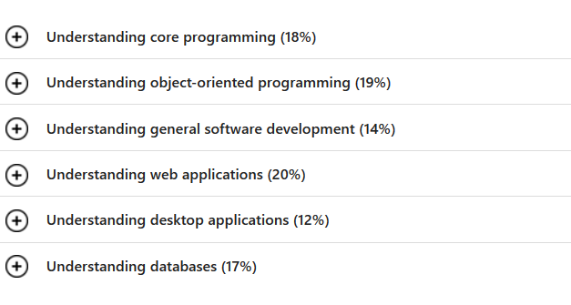
MTA Software Development w/C#

Slide 19
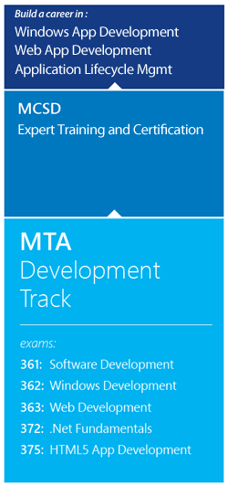

Slide 20
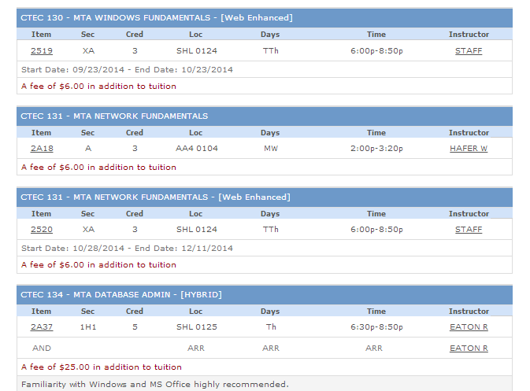

Slide 21
For 2016-17 Catalog: CTEC 106 IT Fundamentals
CTEC 106 IT Fundamentals replaces the CTEC 213 CompTIA Strata New Certificate Update
Description: Course provides foundational skills utilized in information and computer technology and a functional understanding of information technology-related careers. Topics include hardware and software technologies, configuring and setting up workstations, network fundamentals and computer security. Course is based on CompTIA IT Fundamentals certification.

Slide 22
Replace CTEC 100 with new CTEC 106
CTEC 106 IT Fundamentals replaces the CTEC 213 CompTIA Strata New Certificate Update
Advantages
More focused introduction on professional IT practices
Gives students a more professional focus
Aligned with another Industry certification

Slide 23
Eliminating CTEC 100 Intro to Computing
No longer serves as a General Ed AAT requirement
Advantages to CTEC 106 in its place
More focused introduction to professional IT practices
Less of a general intro to Computing
Our program becomes aligned with another Industry certification

Slide 24
Proposed Role for CTEC 106 in the CS Program
Current Requirement for CS AAS:
BTEC 149 and CTEC 100 or CTEC 205
Revision in CS AAS:
CTEC 149 and CTEC 106 or CTEC 205
Revision for CS Certificate of Proficiency
CTEC 106 will replace CTEC 100

Slide 25
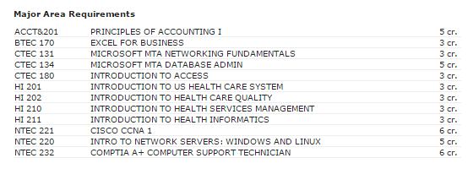
Health Informatics Transfer
Bellevue College online Bachelor of Applied Science transfer will become more streamlined

Slide 26
Health Informatics Transfer
Bellevue College online Bachelor of Applied Science transfer will become more streamlined

Slide 27
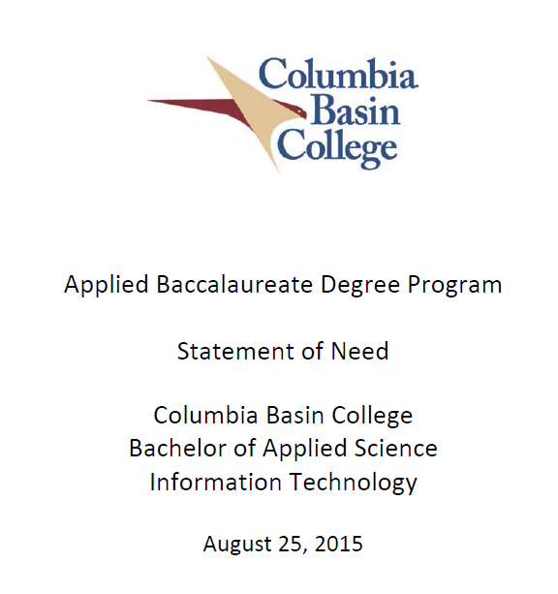
Opportunity: CBC IT BAS

