Slide 1
Larch Corrections Center
Yacolt, WA
Notes:
Many of you know someone who is or was incarcerated. This could have been:
A relative
A friend
A neighbor
A neighborhood friend you grew up with, or that your son or daughter grew up with.
Some interesting statistics:
The Average offender is incarcerated for 23 months, and
a total of 7683 prisoners were released during FY 2013. (http://www.doc.wa.gov/aboutdoc/docs/msPrisonReleases_002.pdf, retrieved 3/2/2014)
The point is that many of these prisoners will be released into our communities, many without employable skills. Without employable skills, many offenders return to prison.

Slide 2
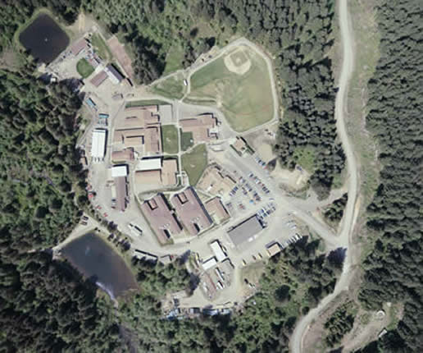
The Facility
Minimum to Medium
Located in Yacolt, WA
40 minute drive from Clark College
Opened in 1956
Capacity: 480 offenders
40 acre site
Superintendent:
Dona Zavislan

Slide 3
The Staff
Rhianna Johnson– Program Director
Doug Helmer – Small Business Instructor
Bruce Music – Automotive Instructor
Steve Smith – General Education Instructor
TBA – Program Assistant

Slide 4
Clark Programs
ABE/GED
Vocational Programs
Adult Basic Education
Small Business Basics
Life Skills Computing
Automotive Service and Brakes Technician
Offender Change
Job Seeking Skills

Slide 5
Small Business Overview
Intro to Business
Creative Problem Solving
Management, HRM, Marketing
Law, Accounting & Finance
International Trade
Hindrances to thinking and ideas
The role of criticism and effective communication of solutions.
Computer Application Essentials
Small Business Management
OS, Word, Excel, and PowerPoint.
Small business organizational structure and development
Entrepreneurship
Franchising
Basic Accounting Principles
Basic accounting equation
Recording and posting business transactions
Adjusting and closing entries
Preparing financial statements
Business Math
Mathematical operations, Markup/down , trade/cash discounts, and payroll.
Loan interest payment calculations
Notes:
BUS 101 Introduction to Business
Management, HRM, social responsibility and ethics, marketing, accounting, law, finance, small business management, production and international trade.
BTEC 149 Computer Applications Essentials
Create Word, Excel and PowerPoint documents
MGMT 110 Creative Problem Solving
Left/right brain thinking, stages in the creative process, habits that hinder thinking and producing ideas, the role of criticism, and effective communication of solutions.
BUS 115 Small Business Management
Elements of small business management, entrepreneurship, franchising, small business structure, organization and development.

Slide 6
What does the RAND Corp have to say?
According to a 2013 RAND Corp study:
“Prisoners who participated in education programs where 43% less likely to return to prison within three years of release”
“Every dollar spent on inmate education translated to $4 to $5 saved on re-incarceration.”
Source: Long, Katherine, 2015. Seattle Times, Behind bars, college is back in session in some Washington prisons. Retrieved on January 20, 2015 from: http://o.seattletimes.nwsource.com/html/localnews/2025481425_prisoneducationxml.html.

Slide 7
What students say about the SBB program…
“I believe that any education that one receives is important and very helpful. Small business has been very interesting. I feel better about myself and what I’ve learned.”
“I own a business and will be returning to it and have found the class both helpful and informative.”
“I’ve always wanted to start up my own business and I believe this information will help me with the social interactions involved with running a business.”

Slide 8
What does BAC say?
What advise can you offer regarding:
What jobs/careers have you seen former offenders be successful with?
What jobs/careers should former offenders avoid?
Have opinions changed about hiring former offenders? If so, in what ways?
How can we be more responsive?

Slide 9
Thank you!

