Slide 1
Clark College
Bachelor of Applied Science in Applied Management
Program Proposal
Presentation to
Business Administration Advisory Committee
Fall 2015

Slide 2
Bachelor of Applied Science in Applied Management (BASAM)
BASAM Update:
  Spring 2015
  The Statement of Need (proposal A and B) was reviewed and approved by the SBCTC
  Started the development of BASAM program courses
  Fall 2015 – Seek BASAM program proposal approval from the following:
  - Business Administration Advisory Committee
  Instructional Planning Team
  Outcomes Assessment Team
  Instructional Council
  Executive Cabinet
  College Council
  Winter/Spring 2016 – Seek BASAM program proposal approval from the following:
  - Curriculum Committee
  Board of Trustees
  The State Board for Community and Technical Colleges (SBCTC) for final approval
  The Northwest Commission on Colleges and Universities (NWCCU) for Accreditation
Draft

Slide 3
Criteria 1:
Demonstrates Baccalaureate Rigor
Program Learning Outcomes
Describe the complexity of forces that affect trading in domestic and global markets in relationship to business survival
and success.
2. Recognize and implement effective communication strategies, appropriate to organizational settings.
Analyze and apply managerial functions, roles, and styles to be used in various managerial/supervisory and leadership
situations.
4. Analyze the dynamic internal and external factors that affect small to large organizations to create effective strategies
for stability and/or change.
5. Recognize and explore the challenges of conscientiously managing diversity, ethics, and social responsibility.
Research information, data, and technologies to support effective decision making.
7. Analyze legal issues for risk management and responsible oversight.
Interpret financial models for business decision-making, and to explore funding options to support organizational needs.
Evaluate and develop organizational structures and operating procedures to foster continuous improvement, innovation, and quality results.
10. Balance theoretical and practical strategies and policies for a productive and motivated workforce.
Develop and apply a marketing strategy, based on an integrated marketing plan, to produce and distribute products at
optimum operational levels.
Generate an electronics portfolio that has specific segment portions from each BASAM course that can be used to promote the outcomes achieved in the BASAM Program.
Draft

Slide 4
Criteria 1:
Demonstrates Baccalaureate Rigor (continued)
Program Evaluation Process
Clark College has a systematic, internal process for evaluating programs. In the case of BASAM, the program director, the faculty lead, and the BASAM faculty will work with specialized staff from the Office of Instruction to expand this process for the BASAM degree program.
The first step: An evaluation process, initiated by the program director, to prepare a report, addressing the following criteria:
Strengths and weaknesses in the program.
Recommendations for improvements.
Initial findings to internal stakeholders for feedback – BASAM Advisory Committee, which consists of local employers, employees, college administrators (instruction and student services); BASAM faculty members; and other departments that are related to BASAM.
The second step: a formal report, prepared by the BASAM program director:
Receive feedback from the internal participants and discuss and include all the comments and recommendations that have been forwarded.
Summarize resources in a formal report that will go to external parties, such as current and potential employers, local community organizations, and other key stakeholders in the community.
The third step: faculty evaluations - faculty evaluations by students and administrators in terms of quality pedagogy and rigorous, relevant courses.
Draft

Slide 5
Criteria 1:
Demonstrates Baccalaureate Rigor (continued)
General Education Requirements for BASAM
A total of 60 general education credits is required for the BASAM degree program completion.
To be considered in the BASAM program:
Students must have completed 30 credits of general education courses in the following areas: English composition, social science, natural science, quantitative skills, and humanities.
These courses must be numbered at a 100 level or above.
Program advisors will work with students to help them chart their educational plans
The remaining 30 general education credits will be part of the BASAM course work.
Draft

Slide 6
Criteria 1:
Demonstrates Baccalaureate Rigor (continued)
Course Work Needed at Junior and Senior Levels
The courses at the junior and senior levels were selected and designed to reflect the following:
A sequence of courses, allowing students to progress from a foundation level of key concepts, covered in the first year, to an intermediate level, requiring analytical and critical thinking skills in the second year.
The last two courses of advanced application-A capstone course requires students to apply theories and concepts leaned in the foundation and intermediate levels to apply to a comprehensive project that reflects the students’ areas of interest. The last course is an internship course that will allow opportunities for students to work with government, profits, and non-profit organizations.
BASAM courses will be offered in face-to-face, hybrid, and online modalities.
Draft

Slide 7



Bachelor of Applied Science in Applied Management
Educational Plan
Draft, 8/04/2015
Required Course Schedule
Two-year Track
Year 1
Fall Quarter |  |  |  | Winter Quarter |  |  |  | Spring Quarter
BAS 301 | Foundations of Management | 5 |  | BAS 315 | Organizational Behavior | 5 |  | BAS 330 | Accounting Principles for Managers | 5
BAS 305 | Social Media and Internet Commerce | 5 |  | BAS 320 | Managerial Statistics | 5 |  | BAS 335 | Legal Issues in Management | 5
BAS 310 | Professional and Organizational Communications | 5 |  | BAS 325 | Business Principles | 5 |  | BAS 340 | Marketing for Managers | 5
 |  | 15 |  |  |  | 15 |  |  |  | 15
 |  |  |  |  |  |  |  |  | Year Total | 45
Year 2
Fall Quarter |  |  |  | Winter Quarter |  |  |  | Spring Quarter
BAS 400 | Human Resource Management | 5 |  | BAS 415 | Financial Management | 5 |  | BAS 430 | Sustainability and Environmental Practices | 5
BAS 405 | Managerial and Global Economics | 5 |  | BAS 420 | Ethics in Management | 5 |  | BAS 440 | Capstone: Strategic Management & Policy | 5
BAS 410 | Project Management | 5 |  | BAS 425 | Operations and Logistics | 5 |  | BAS 450 | Applied Management Internship | 5
 |  | 15 |  |  |  | 15 |  |  |  | 15
 |  |  |  |  |  |  |  |  | Year Total | 45
 |  |  |  |  |  |  |  |  | BAS in Management Total | 90

Slide 8
Sample Course: BASAM 325 - Business Principles
5 credits, Online
Course Description
This course provides a study of various facets of business from economic systems to forms of business ownership to considerations for running a business. Students will learn various aspects of business, management, and leadership functions; organizational considerations; and decision-making processes. Financial topics are introduced including accounting, money and banking, and securities markets. Also included are discussions of business challenges in the legal and regulatory environment, business ethics, social responsibility, and international business.
Course Outcomes
Analyze internal and external factors which make up a dynamic business environment
Evaluate stakeholders and the impact on an organization
Explain the impact globalization has on business
Demonstrate the ability to assess business cycles
Evaluate the best legal forms for a business.
Create a reflective component on the necessity to understand business models and practices.
Assess the environment of an organization including political, economic, and social factors.
Program Outcomes
1 | Global /Domestic trade |  | 7 | Legal issues | X
2 | Communication skills |  | 8 | Financial models
3 | Leadership and Managerial functions | X | 9 | Organizational structures/ Operating procedures | X
4 | Strategic Management |  | 10 | Motivation | X
5 | Ethics and Social responsibility | X | 11 | Marketing strategies
6 | Research and Decision making |  | 12 | Electronic portfolio | X
Draft

Slide 9
Criteria 2:
Qualified Faculty
Faculty teaching in the BASAM degree program must have the following:
A minimum of a master’s degree in business or management or with professional certification, such as a Certified Public Accountant (CPA) Juris Doctor (JD).
Junior and senior-level teaching experience in a college or a university.
A minimum of three years of managerial/business work experience.
Qualification standards, as established in WAC 131-16-80 and WAC 131-16-91, set by the State of Washington for hiring teaching personnel.
Draft

Slide 10
Criteria 3:
Selective Admissions Process
Clark College is using a cohort model, accepting as many as 35 students into the program each fall quarter.
Students will be on target to complete their programs within two years.
Applications are accepted early spring term, with forms available in the Program Director’s office and on the college Business Division website.
The final cohort selection will be determined by the end of the spring term, for the fall term start.
Draft

Slide 11
Criteria 3:
Selective Admissions Process (continued)
Associate’s degree or higher from an accredited domestic college or university or international equivalent, with a minimum cumulative GPA of 2.5.
Completion of the following courses:
  English composition (5 credits) at a 100 college-level or higher
  College-level math (5 credits) at a 100 college-level or higher
  BTEC 150 or an equivalent computer literacy course (5 credits)
  A minimum of 30 credits (Quarter credits) of general education requirements to include communications, quantitative skills, humanities, social science, or natural science.
Clark College Application form for Admission and the BASAM Application and non-refundable fee of $75.
A letter of intent.
Resume or vita.
Official transcripts.
Draft

Slide 12
Criteria 4:
Appropriate Student Services Plan
Registration Financial Aid
Advising/Educational Planning Career Services
Disability Support Services Veterans Affairs Office
Student Success Programs International Programs
Tutoring Library Services
eLearning Office Computer Labs
Draft

Slide 13
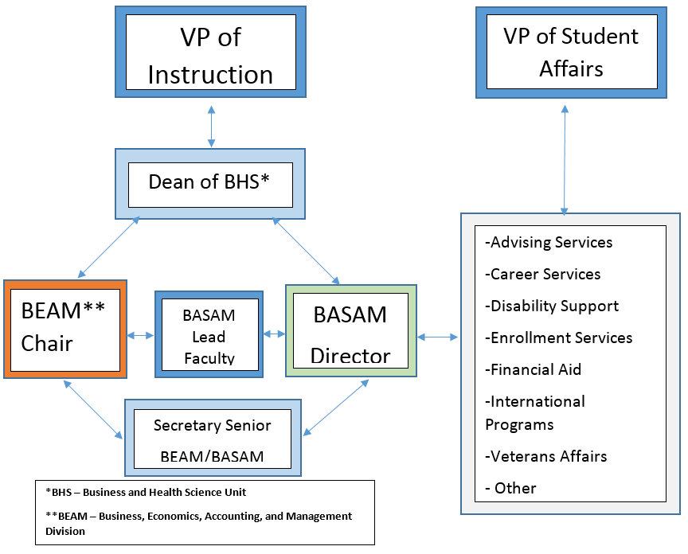
Proposal – BAS in Applied Management Organizational Chart

Slide 14
Criteria 5:
Commitment to build and sustain a high-quality program
Funds to Support the Program
The financial forecast is for the BASAM program to be self-supporting, at the end of the second year of its launch.
The start-up costs will be covered by the college. These costs are detailed in the projected program budget.
Student tuition will be the main source of revenue and will be sufficient to sustain the program and to provide extra income, after all expenses are paid.
Draft

Slide 15
Criteria 5:
Commitment to build and sustain a high-quality program (continued)
Projected Program Expenses
The budget worksheet projects the revenue and expenses from year 0 to year 5, or five years from date of operation of the program. This budget is based on the following assumptions:
1. The program will start with one cohort of 35 students in the first year. A cohort of 35 students will start every Fall term.
2. A faculty lead will be hired in the second year. The lead faculty will have partial release time to assist the program director with academic issues.
Draft

Slide 16
Criteria 5:
Commitment to build and sustain a high-quality program (continued)
Draft

Slide 17
Criteria 6:
Program specific Accreditation
Accreditation from the Northwest Commission on Colleges and Universities (NWCCU) is required. The application for this accreditation will be submitted in Spring 2016.
There are no other accreditation requirements.
Draft

Slide 18
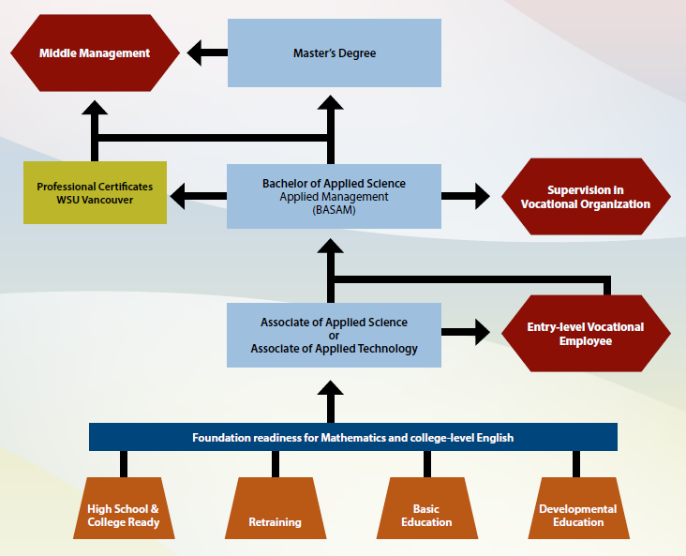
Criteria 7:
Pathway option beyond baccalaureate degree
Draft

Slide 19
Criteria 8:
External expert evaluation of program
Two experts from WSU-Vancouver will be asked to review the BASAM program proposal and to submit their recommendations to Clark College.
A summary of Clark’s responses and subsequent modifications, based on the recommendations of the external evaluators, will be attached to the program proposal that will be sent to the SBCTC.
Draft

Slide 20
Questions?

