Slide 1
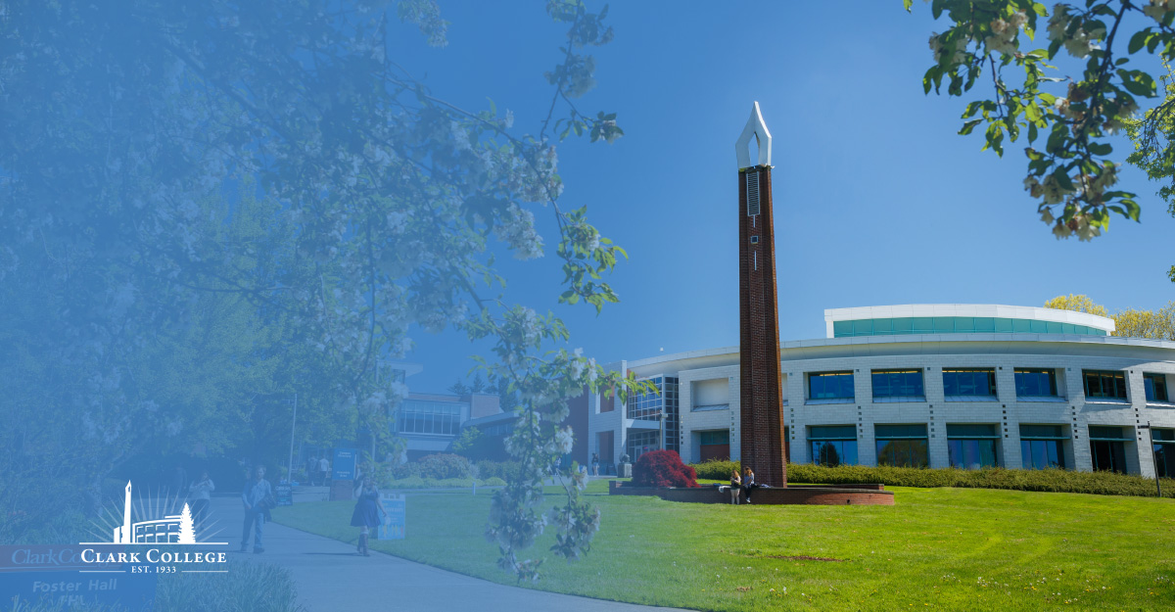
Clark College at Boschma Farm
Project Update
December 7, 2021

Slide 2
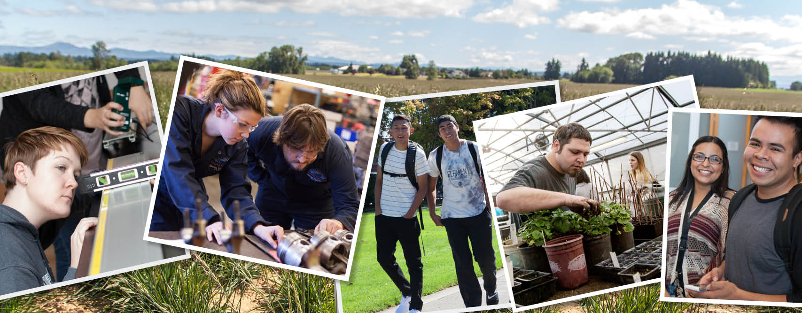
Planning Process
Visioning process
Business planning committee and plan
Project management team
Budget needs
Path forward

Slide 3
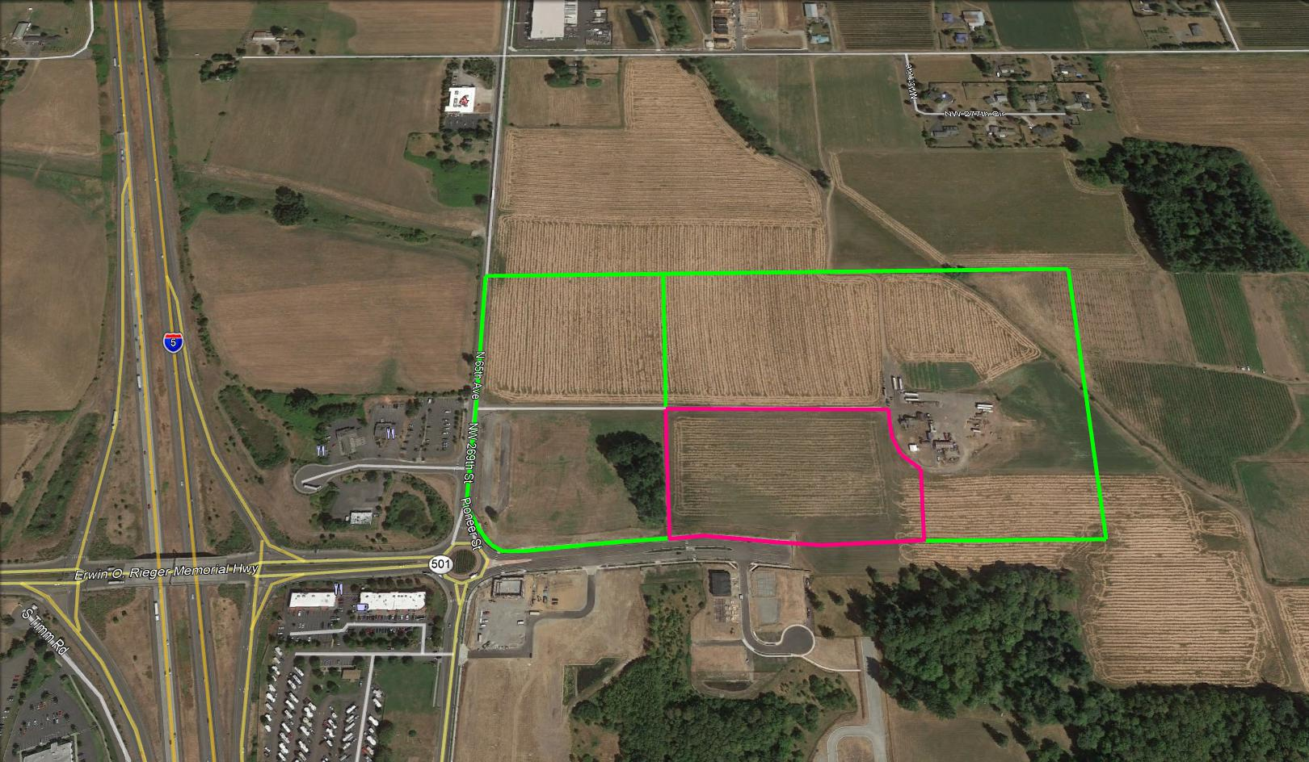
Ariel View of Property

Slide 4
Boschma Farms proposed site planning with the Foundation
Partnership with the Foundation
Interaction between properties and services
Sewer and road easements
Wetlands

Slide 5
Pioneer Street frontage
Pioneer St. completed to end of highlighted extent
City of Ridgefield expects to bid roundabout around April 2022
City requesting ROW shown for extending north roundabout artery into Clark property
City is also asking for stormwater easements Pioneer

Slide 6
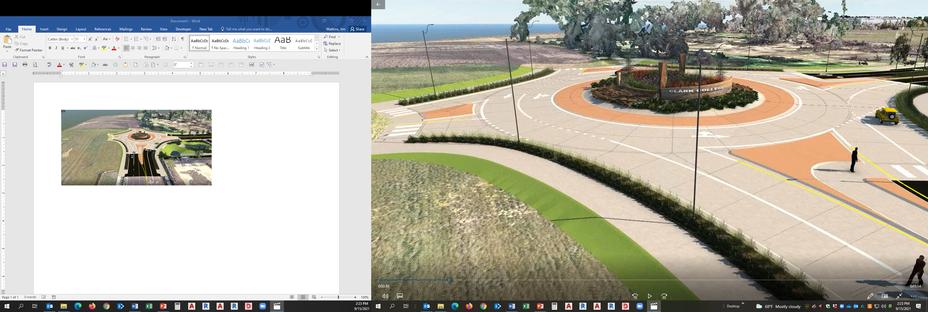
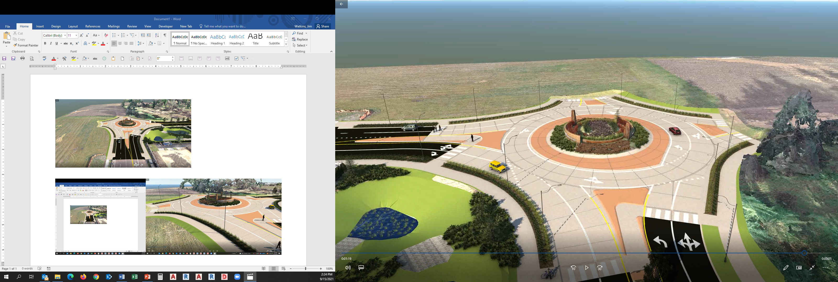
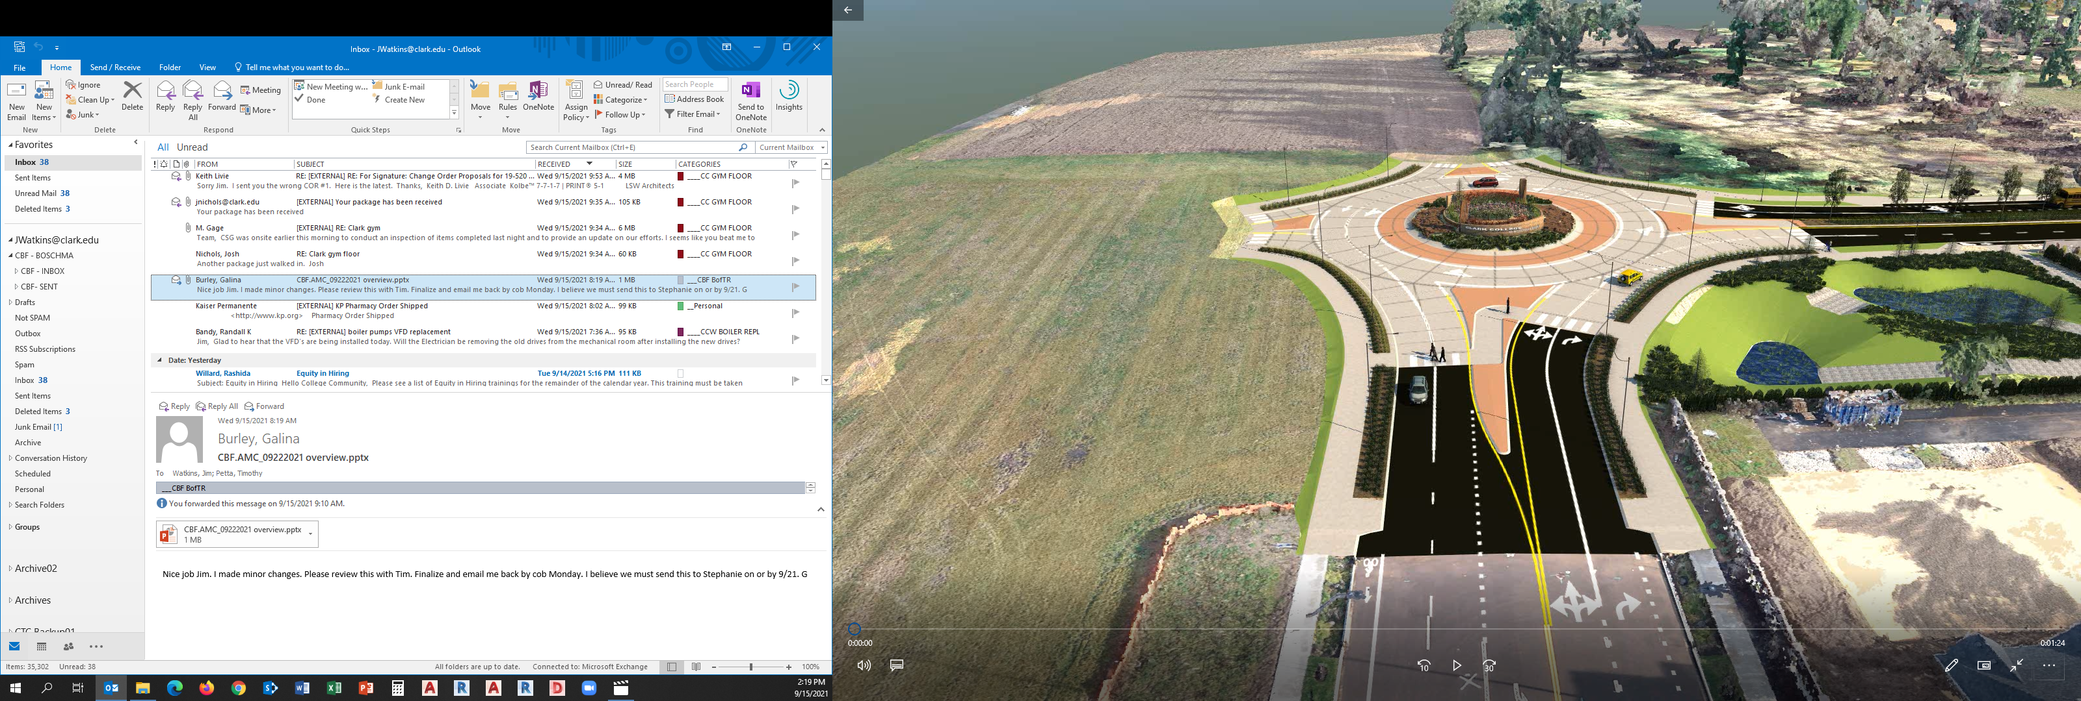
Pioneer St. Roundabout
Design at 90% completion stage; out to bid around April 2022

Slide 7
Original Concept Floor Plan

Slide 8
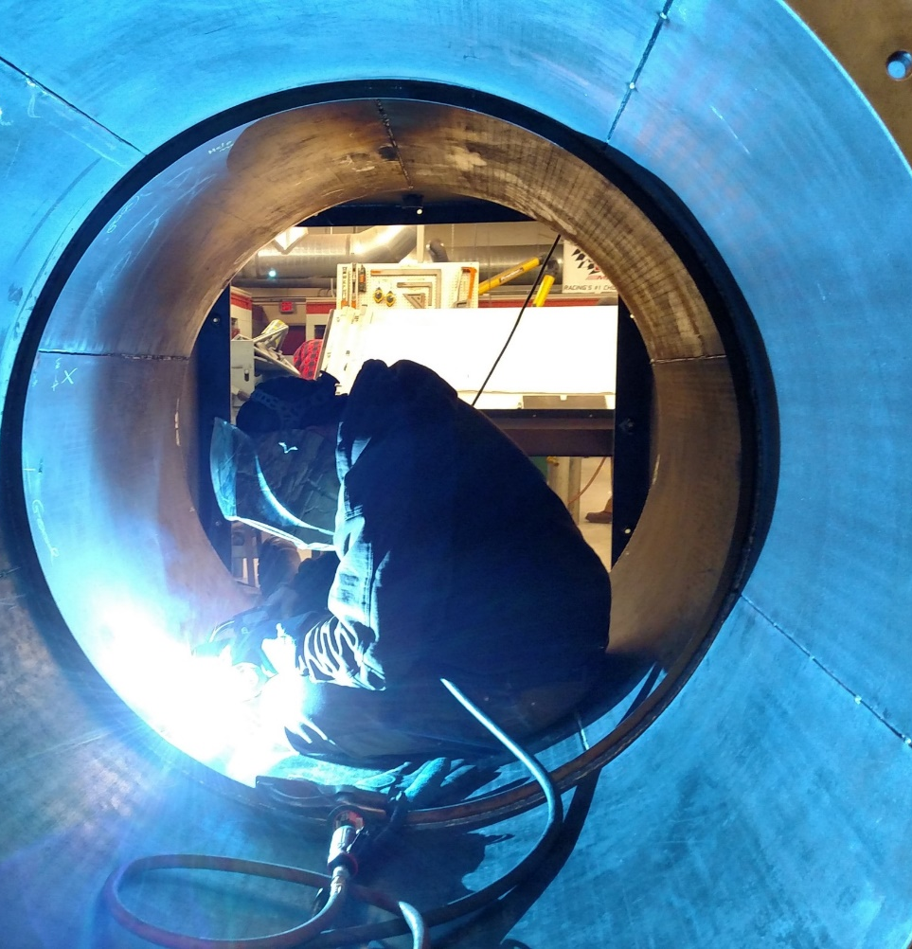
CCBM – Advanced Manufacturing Center Program Plan
Subtractive Manufacturing
Robotics
Additive Manufacturing
Metrology
Computer Science
Material Science
Future Programs
Gen Ed
Computer Labs
Running Start

Slide 9
Proposed Progressive DB High-Level Schedule

Slide 10
Thank you to our partners and supporters!
Senator Cantwell
Clark College Foundation
Donors and Alumni
City of Ridgefield
Cowlitz Tribe
Port of Ridgefield
Workforce SW Washington
CREDC
Department of Enterprise Services
And many others!

Slide 11
Request
Continue to support and promote the project
Receive regular updates on project logistics
Ask questions!

Slide 12
Q & A

