Slide 1
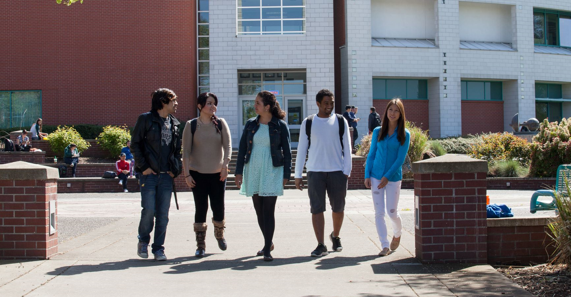
Student Success | Student Affairs
Clark College

Slide 2
Advancing Justice
Clark College
Clark College leads with racial equity as a holistic approach to identify barriers & best practices relating to the enrollment, retention, & completion of historically underrepresented racial and ethnic groups. Using data to guide us, we proactively seek out best practices and eliminate barriers to ensure equitable outcomes for students and employees.

Slide 3
CWSEM & Guided Pathways
Clark College
Year 2: CWSEM: 3 -year plan that leads with social equity to achieve a 5% increase in enrollment to identify, recruit, enroll, retain, close equity gaps, and graduate the student body.
Guided Pathways – College-wide effort to identify and close equity gaps by ensuring a transparent and student-centered structured experience for students that contributes to student's academic success or obtainment of career/living wage jobs.

Slide 4
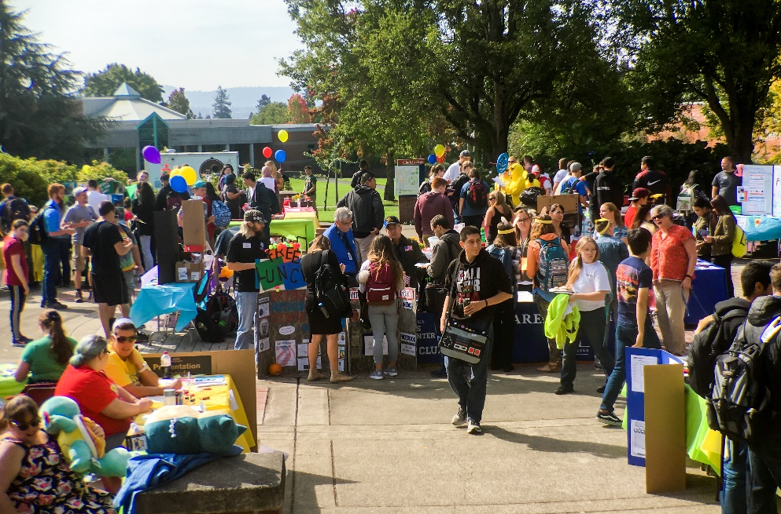
Stabilize & Increase Enrollment by 5%
Clark College
By 2024, increase prospect pool by 20%, increase conversion from prospect to applicant by 10%, increase applicant to enroll students by 5%, and experience flat enrollment.
Prospect Pool – 20%
Prospect Conversion – 10%
Applicant to Enrollment - 5%

Slide 5
Stabilize & Increase Enrollment by 5% – Highlights
Clark College
Outcomes
Entry Services implemented the Prospect function in ctcLink -3,000 prospects in the enrollment funnel
Running Start calling and EV enrollment campaign - 858 or 44% increase in received EV forms. 254 Running Start students received ESSER grant funds providing tuition to support high school seniors to graduate with AA and HS diploma.
CBO partnerships support BIPOC student awareness, enrollment FASFA/WASFA applications - STEMoWeen - iUrban Teen; Portfolio Project United Negro College Fund, Odyssey World International, Fourth Plain Forward, MESD 112, NAACP Vancouver ACT-SO
International Programs exceeded enrollment budget target all of AY22/23 supported 55 International student FTES, represented 26 different countries Utilization of enrollment funnel for new applicants & yield data, refined outreach, marketing, & recruitment populations
Notes:
Heather added to this page 1.18.23

Slide 6
Stabilize & Increase Enrollment by 5%
Clark College
Fall, Winter, Spring exceeded budgeted enrollment targets
DATA SOURCE: State Board for Community and Technical Colleges (SBCTC) Enrollment Data Dashboard. Does not include BAS or R/S
*** SPRING DATA IN PROGRESS FOR 2023
Notes:
As of 7/7 spring 23 not on sbctc data
Notes: FTE % changes
3 year cycle change From Academic Year 2020-2021 to PRESENT Academic year 22-23
Summer -9%
Fall 2%
Winter 6%
Spring in progress
From Academic Year 2021-2022 to PRESENT Academic year 22-23
Summer 10%
Fall 6%
Winter 16%
Spring in progress

Slide 7
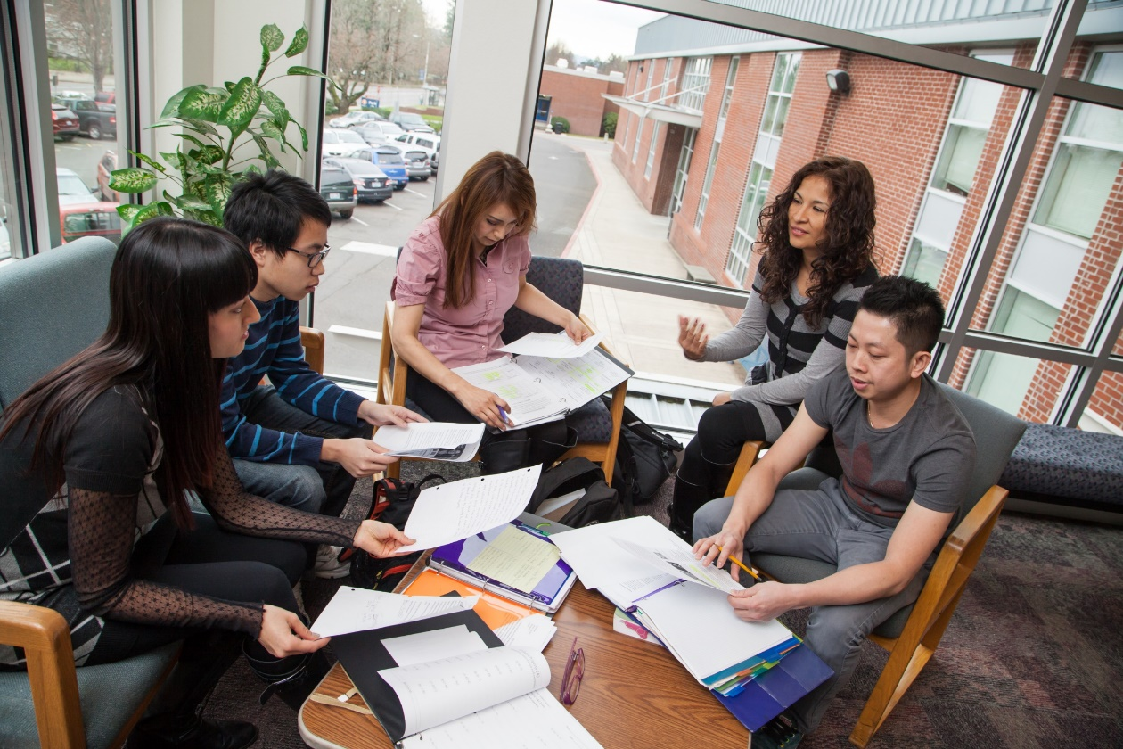
Increase Retention by 10%
Clark College
By 2024, increase fall-to-fall retention of all students by 10%.
10%

Slide 8
Increase Retention by 10% - Highlights
Clark College
Strategies/Outcomes
Increased user adoption of Early Alert System. AY 22-23: 1154 unduplicated Students referred by 110 unduplicated faculty members.
Dispersed $24mil in aid in FY22-23. In increase from $19mil (FY21/22 excludes HEERF funds) to $21mil (FY22/23). Implemented Mass Packaging
DSS had 416 students who actively used the class accommodations equated to 2,265 total accommodation letters across 1,624 unique Clark classes (25% of all Clark classes.
Penguin Welcome Days retained students at 84% from fall to Winter and at 81% from Fall to Spring.
Implemented Clark Cares – 4 behavioral Commitments, video presented at Opening day, Clark Cares stories are agenized and shared weekly SAC meetings, LEAD meetings, @ EC. Clark Cares presented at NCORE. SA quarterly recognition
WES enrolled & identified current and emerging barriers to student success for 1,241 students. students connected to Basic Food and Employment Training (BFET) Program. BFET served 394 students - received SNAP benefits.

Slide 9
Increase Retention by 10% - Highlights
Clark College
Outcomes
Collaboration with Julie Robertson - data for Student Achievement outcomes -mid-term accreditation report
Implemented Culture of Evidence & collaboration with Donna Larson - 2-year cycle of assessment for non-instructional service areas.
Area or Study caseload advising implemented, faculty advising training provided, case management implemented (checkpoints, mandatory advising), direct advisor communication.
Created base line data for Complaints, Conduct & CARE referrals. This data will be used to: provide support, coaching, resources for campus stakeholders that are providing referrals; to review policies and practices for complaints, conduct & CARE referrals; and to determine the impact of our student interventions.

Slide 10
Increase Retention by 10% - Highlights
Clark College
Outcomes
Athletics # of Student Athletes & Average term GPA | Break down of Student Athletes and GPA
174 Fall 2022 Student Athletes earned an average GPA of 2.83 | 21 -GPA of 4.0; 34 – GPA of 3.5 – 3.99; 44 –GPA of 3.0 – 3.49
159 Winter 2023 Student Athletes earned an average GPA of 3.06 | 22 – GPA of 4.0 41 – GPA of 3.5 – 3.99; 36 – GPA 3.0 – 3.49
147 Spring 2023 Student Athletes earned an average GPA 3.03 | 22 – GPA of 4.0 30 – GPA of 3.5 – 3.99 37 – GPA of 3.0 – 3.49

Slide 11
Increase Retention by 10% - Highlights
Clark College
“I have been working with a business student since 2017. Due to understandable life circumstances as well as the tumultuous period during the height of the COVID-19 global pandemic, he has taken several prolonged breaks in his education.
Because I know firsthand how much time and effort he has put into his progress, I am sure to check in with him when I see he has not registered for a quarter and offer support and assistance. Most recently, due to facing financial aid suspension for max timeframe, he withdrew from his courses and expressed he would not be continuing. I responded immediately with information about financial aid extensions, opportunities for funding through WES, and the instructor contact information to add his courses back onto his schedule. After reconsidering, he did re-enroll in his courses.
He is now on track to complete all 4 Business AAS degrees and their corresponding certificates this spring. He is also planning to apply to the BASAM program for fall 2023”

Slide 12
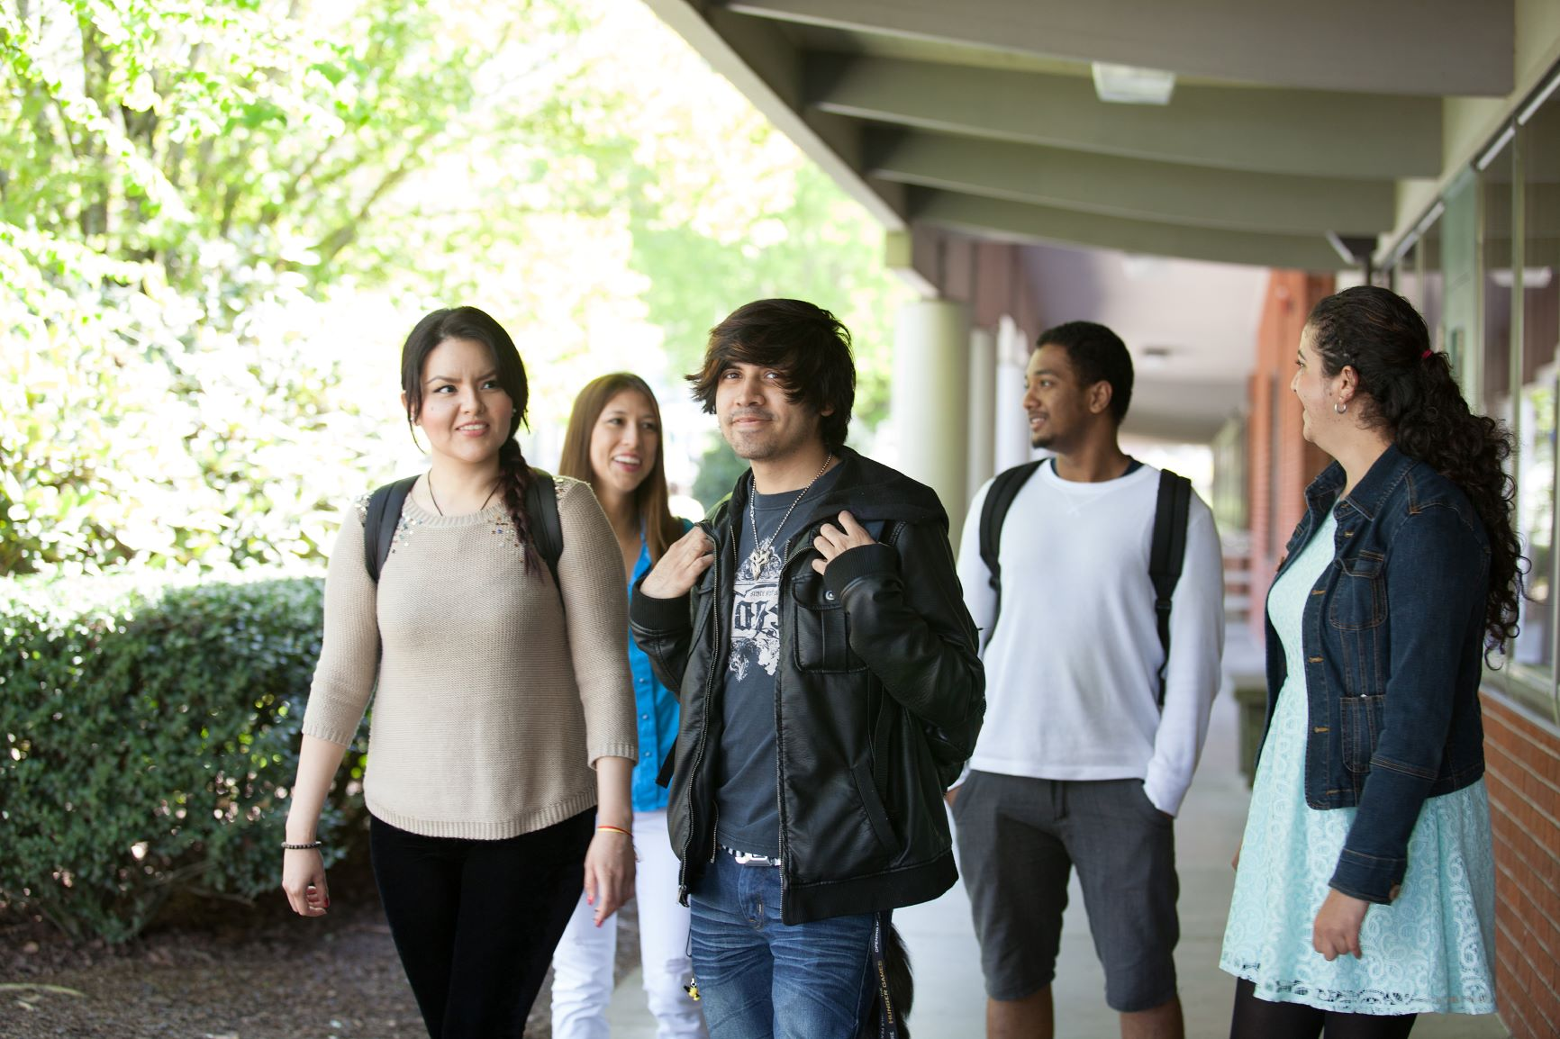
Reduce Equity Gaps by 50%
Clark College
By 2024, reduce the equity gap by 50% for non-dominant historically underrepresented students in retention, progression, and completion.
50%

Slide 13
Reduce Equity Gaps by 50% - Highlights
Clark College
Outcomes
SAC leaders worked to increase IDI scores · Participated in PPI trainings · focused and intentional outreach strategies to enroll HUSOC · monthly EDI - SAC Presentations · participation & presented at NCORE, NWREC, & other DEI professional development opportunities · participation in NWCCU Fellowship & Clark NWCCU Data equity task force · collaboration with ODEI to support BIPOC students through student Identity Clubs, Black student transfer initiative

Slide 14
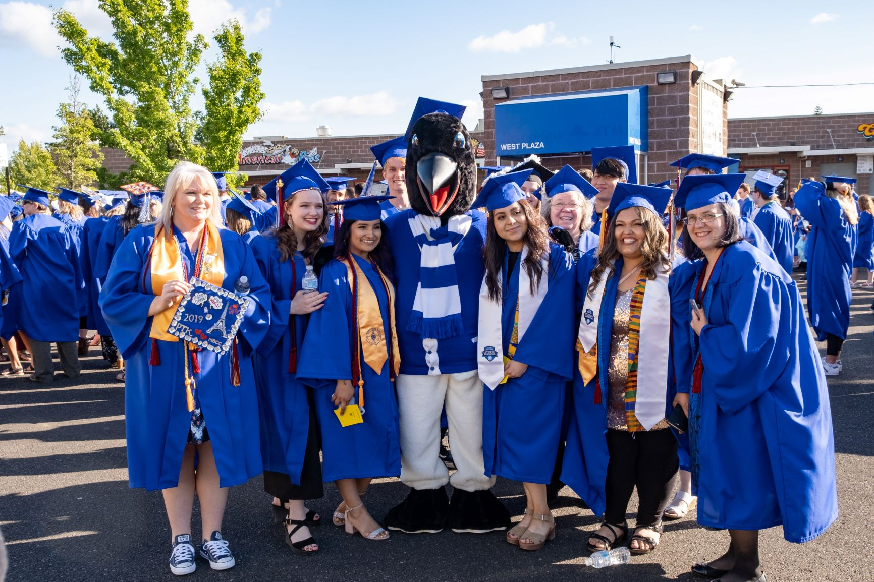
Increase Student Success by 5%
Clark College
By 2024, increase student success outcomes by 5%.
5%

Slide 15
Increase Student Success by 5%
Clark College
Outcomes
Aspen AASCU Transfer Intensive – Clark College & WSUV student transfer agreement
Next Level Leaders – Student Success Committee Purpose: Ensure Student Success is infused in everything we do at Clark College Outcomes: 1.Administered Student Success Survey 2.Develop of the Student Success Charter 3.Codify student success into policy; Define Equitable Student success: Student Success is a proxy for transfer, completion; obtaining a living wage job •Ensure there are clear & agreed upon definitions for Equitable Student Success & Student Experience •Ensure alignment with the 2023-2028 Strategic Plan theme, priorities, & KPI’s for Equitable Student Experience •Ask our students to define what Student Success means to them - Quantitative & Qualitative feedback

Slide 16
Increase Student Success by 5%
Clark College
Outcomes
Aspen AASCU Transfer Intensive – Clark College & WSUV student transfer agreement
In collaboration with the Next Level Leader Student Success Committee, Support operationalization of Student Success Model

