Slide 1
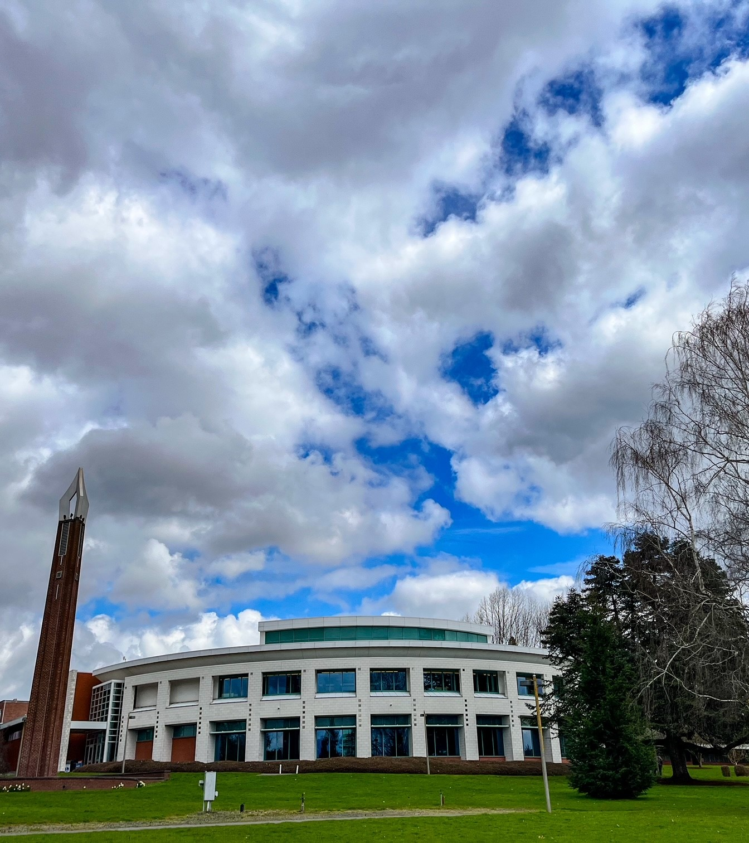
Rhianna Johnson, Director of Guided Pathways and Partnerships

Slide 2
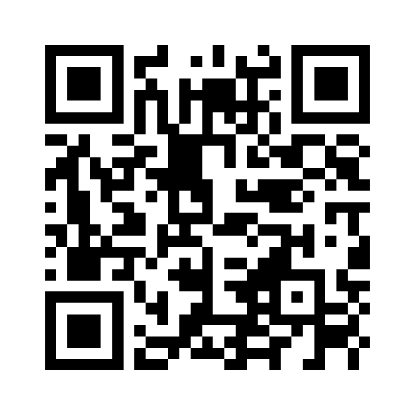
What is Guided Pathways?
https://www.menti.com/
Enter code 4527 8647

Slide 3
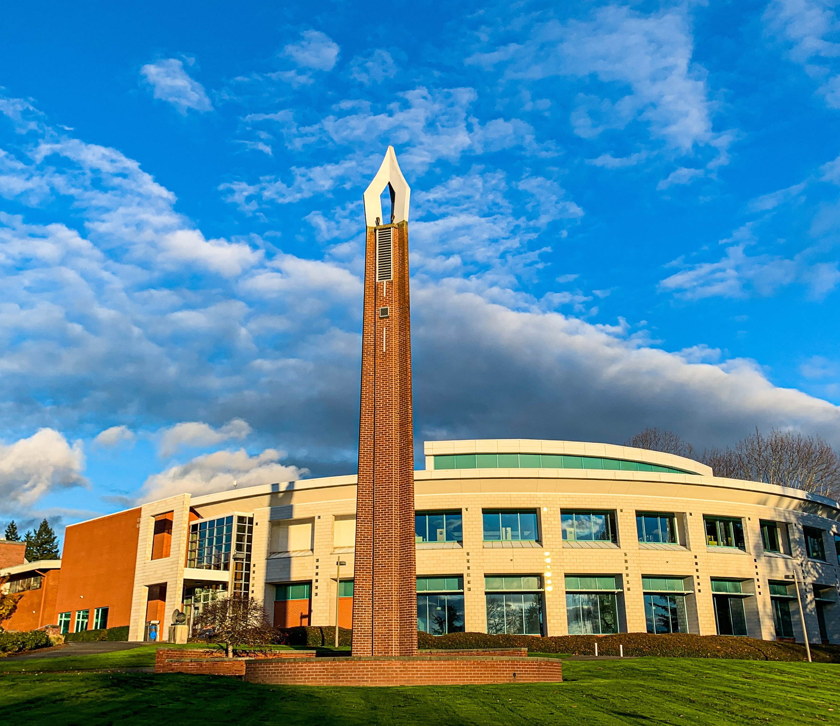
Meeting Goals
Refresh staff on the Guided Pathways model at Clark College
Review the phenomenal GP work from last year
Hear from you about your good work related to student success
Discuss plans for next year
Gather your feedback about Guided Pathways moving forward

Slide 4
Four Pillar of Guided Pathways

Slide 5
Guided Pathways: Where have we been and where are we going?
Highlights of 2022-2023
Supporting in-person outreach events, including specific focus on systemically excluded students
Reengagement of the campus community around Guided Pathways via the Penguin Pathways Podcast, 24/7 news articles, and Guided Pathways and Strategic Enrollment Management Open House
Review of data and identification of priorities in Guided Pathways Advisory Council (GPAC)
More comprehensive and structured budget and project planning process
https://www.clark.edu/guided-pathways/penguin-pathways-podcast/

Slide 6
Guided Pathways: Where have we been and where are we going?
Highlights of 2022-2023
Positive feedback from campus and external partners related to awareness of Guided Pathways, including participation in multiple community spaces
Positive recognition from accreditation visit
Full assessment of all pillars completed, including feedback opportunities from Guided Pathways Advisory Council
WSIPP survey completed and submitted to capture progression of Guided Pathways at Clark College

Slide 7
Winter Retreat Guiding Question
What are the components that need to be added or changed to the onboarding structure at Clark College to set all students up for long-term success, meaning higher retention, completion and employment outcomes with lower equity gaps?
What are your thoughts?

Slide 8
Essential Practice: Building Meta-Majors
Clark College has made significant progress in the area of program mapping.
Meta major promotional videos have been developed to showcase career pathways in each of the “Areas of Study” at Clark College, along with the Caring Campus video that highlights the Caring Campus initiative
https://www.clark.edu/academics/programs/
Clark College is the first college in the state of Washington to offer live program maps via Concentric Sky software
Employment outcome data was recently added to program pages via Lightcast software to highlight data about job options in the various programs. See MTX example:
https://www.clark.edu/academics/programs/advanced-manufacturing-and-mechanical/mechatronics/
Guided Pathways funding has been utilized to develop a new B.S. in Computer Science, and programming related to clean energy

Slide 9
Essential Practice: Structured Exploration
Guided Pathways funding supports strategies and initiatives in several departments to improve structured exploration. Examples include:
Funding for the STEM Strategic Plan
Improved placement processes in English
Contextualized and corequisite math courses
Development of the “My Plan” student onboarding modules
Funding support for Penguin Welcome Days

Slide 10
Essential Practice: Student Advisement
Guided Pathways funding supports several services associated with student advisement/coaching including the following:
Success coaches that are housed in the Office of Diversity, Equity and Inclusion
The student retention and communication office
New student ambassador program
Faculty advising
Support for transfer student credit evaluations and access to Academic Advising Reports
Coaching and mentoring for targeted populations including those participating in specific programs such as Disability Support Services, MESA, and other programs

Slide 11
Essential Practice: Faculty Engagement
Guided Pathways funds have been utilized to pay faculty for:
Professional development related to anti-racist pedagogy, teaching from a Universal Design for Learning (UDL) perspective, trauma informed teaching, Open Education Resources (OER), and several other areas associated with dynamic classroom environments
Guided Pathways funded the revitalization of the Teaching and Learning Center in 2022-2023 AY, which provides physical space and robust programming for faculty professional development
Curriculum and program design
Community outreach
Undergraduate research and other student activities related to academic enrichment

Slide 12
Essential Practice: Data Analytics and Student Tracking
Data informed planning continues to be a primary focus of Guided Pathways.
Guided Pathways funds HelioCampus software, Qualtrics, and Rapid Insight
Plans for next year include exploration of additional student tracking software to better identify students in danger of drop-out and progression toward completion
Guided Pathways funding has been utilized for several consultants to enhance and build out specific ctcLink processes and procedures

Slide 13
Essential Practice: Research and Assessment
Assessment efforts were strong in 2022-2023 and continue to be a critical component of measuring effectiveness.
Funds research associate, survey staff, and consulting related to the Assessment and Institutional Research Department
Funding has supported four NWCCU fellowship participants and plans for next year include funding for faculty participation in assessment workshops
Operations in the Teaching and Learning Center that includes topics related to course level outcomes assessment and evaluations

Slide 14
Additional Focus Area: Outreach and Recruitment
The college is highly focused on increasing enrollment and Guided Pathways strategies are integral.
Several outreach and recruitment events including the two-week “Level Up” math and college readiness seminar, Noche de Familia events for outreach to Latinx communities, Black Student and Family Day, STEM Camp, Career and Technical Education Showcase Day, and Healthcare Pathways Camp
Funding supports Penguin Welcome Days and other events provided by the Entry Services Department
Guided Pathways is funding two positions geared toward improving the website and user experience, along with other spending related to outreach and recruitment

Slide 15
Pillar Papers
What are some other things that have been happening in your area to support the Guided Pathways model and increase student success?

Slide 16
2023-2024: Pillar I
Work will continue to complete development of the new BSCS degree
New written processes and training will be provided to faculty from the Office of Instruction to ensure yearly review and updating of program maps to align with catalog information for accuracy
Reviewing workforce data reports to determine next steps to align with industry needs

Slide 17
2023-2024: Pillar II
Navigating Career Paths​, Conversations on Networking: Intended for Students of Color, Queer Students, and Students with Disabilities, to be provided by Career Services and ODEI
Improvements in the Running Start physical space as well as programming for new and continuing students
Continued support for CTE Showcase Day, Noche de Familia, STEM Camp, and STEM Family Outreach
Area of Study focused career exploration events

Slide 18
Pillar II continued…
First-generation PTK conference and training
Continued support for My Plan and student communication resources
Refinement of “Level Up” college preparation seminar
Support for equitable English placement practices and faculty training
Support for Entry Services outreach and welcome events

Slide 19
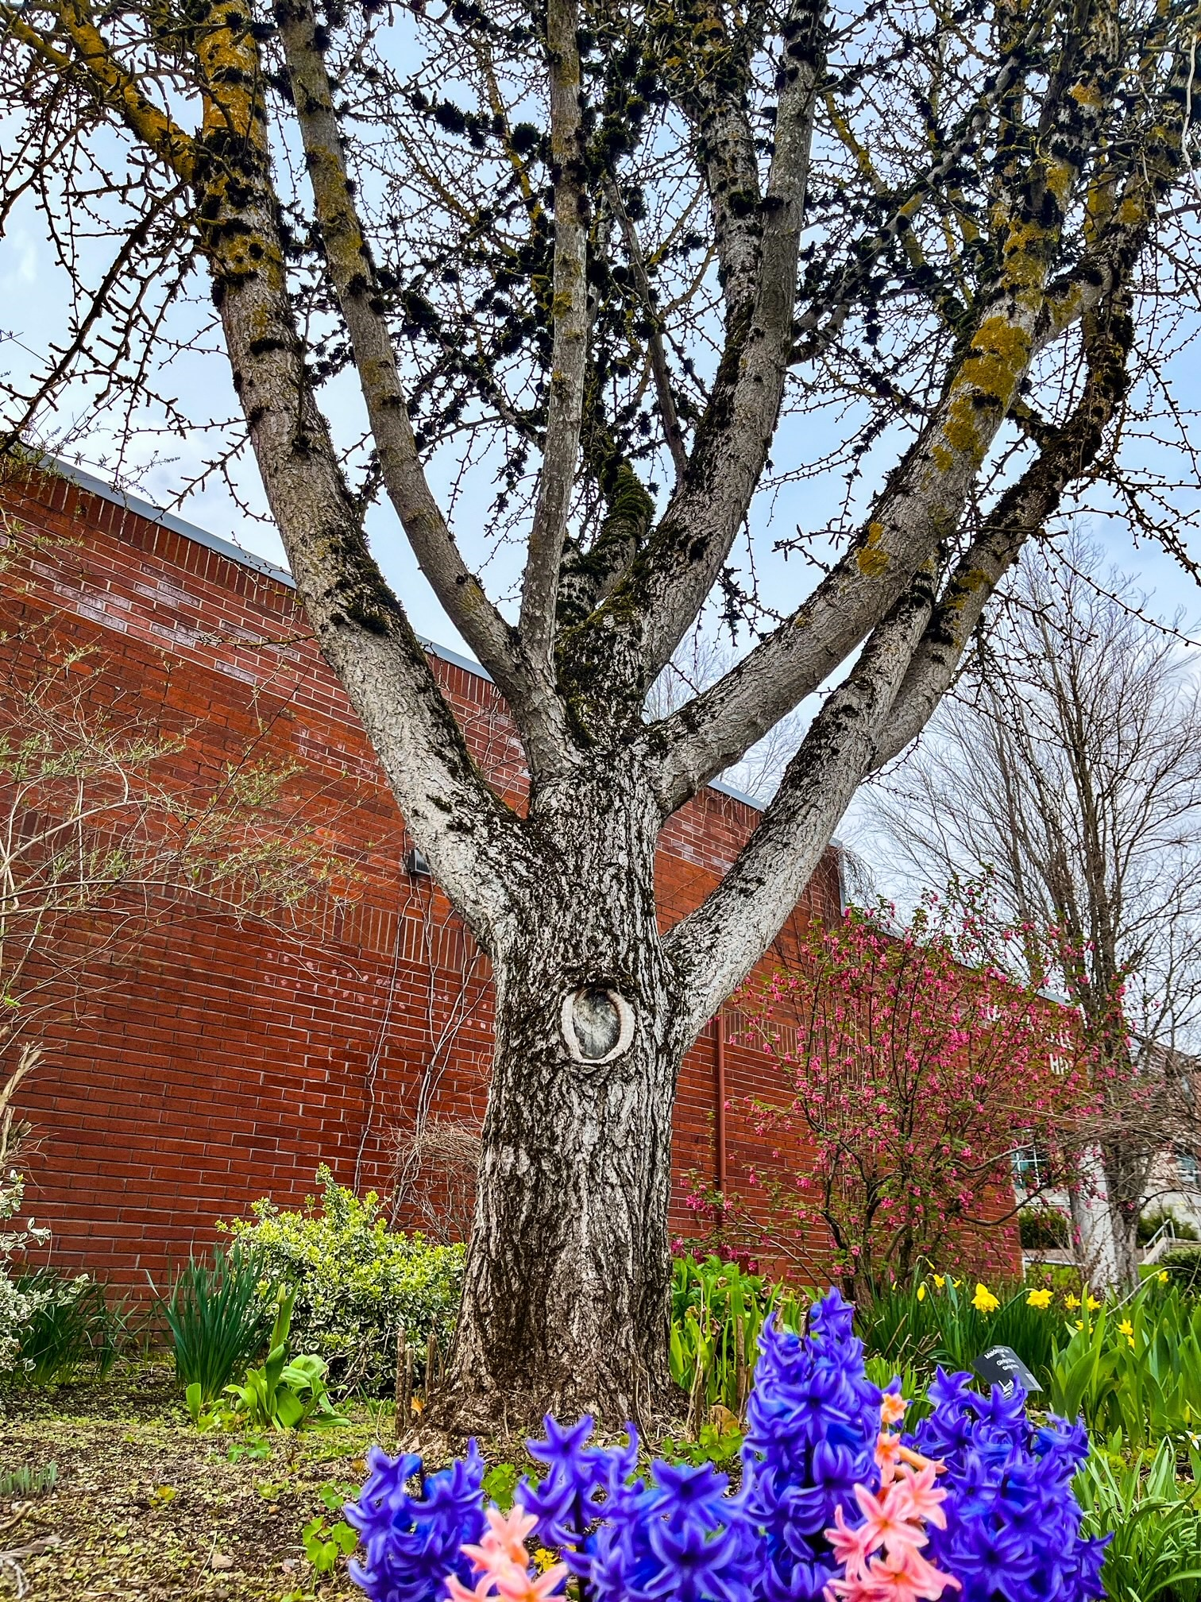
2023-2024: Pillar III
Continued support for OER, including enhancements to college level math materials to increase completion rates
Funding for WSUV Guaranteed Admissions partnership activities
Increased surveys to provide data for adjusting Advising Department student advisement strategies
Juneteenth celebration and Black Student and Family Fair
Development of robust HBCU pathways

Slide 20
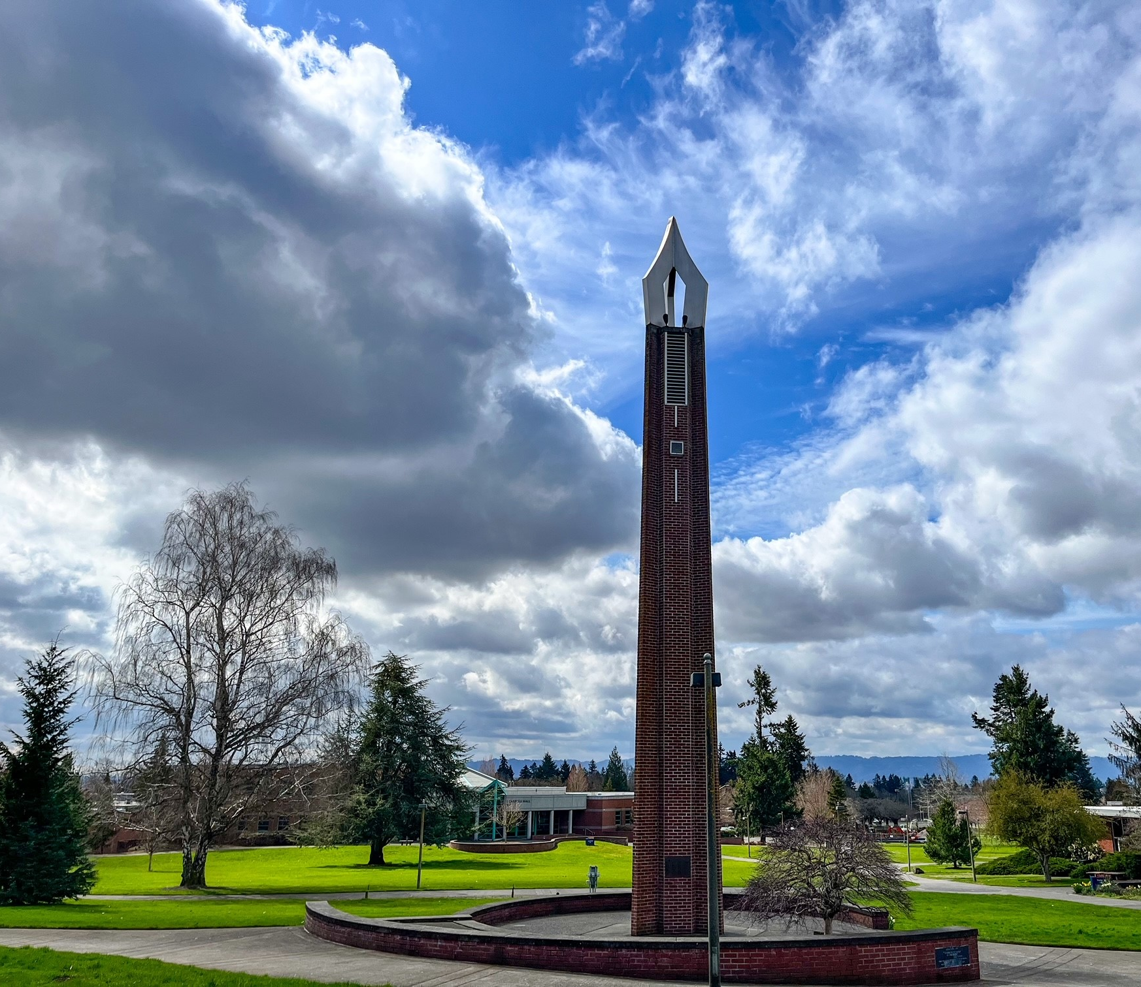
Pillar III continued…
Multiple events and training in the Teaching and Learning Center, with a specific focus on culturally inclusive teaching and trauma responsive education
Peer support and evaluations for students receiving/pursuing disability accommodations
Expansion of the MESA Program to increase number of students served
Funding support for the STEM Strategic Plan: A Braided River Approach (chemistry corequisites, biology transfer pathways, CURE projects, and engineering student mentors)

Slide 21
2023-2024: Pillar IV
Assessment workshops to train faculty on effective strategies
Continued funding for HelioCampus
Faculty support for course level assessment techniques
FYE conference attendance and NWCCU Data Equity team funding
Alignment with Strategic Plan KPIs as they are developed

Slide 22
What’s Missing?
Do you see any major missing pieces?

Slide 23
Questions?
Feel free to contact me! rjohnson@clark.edu

