Slide 1
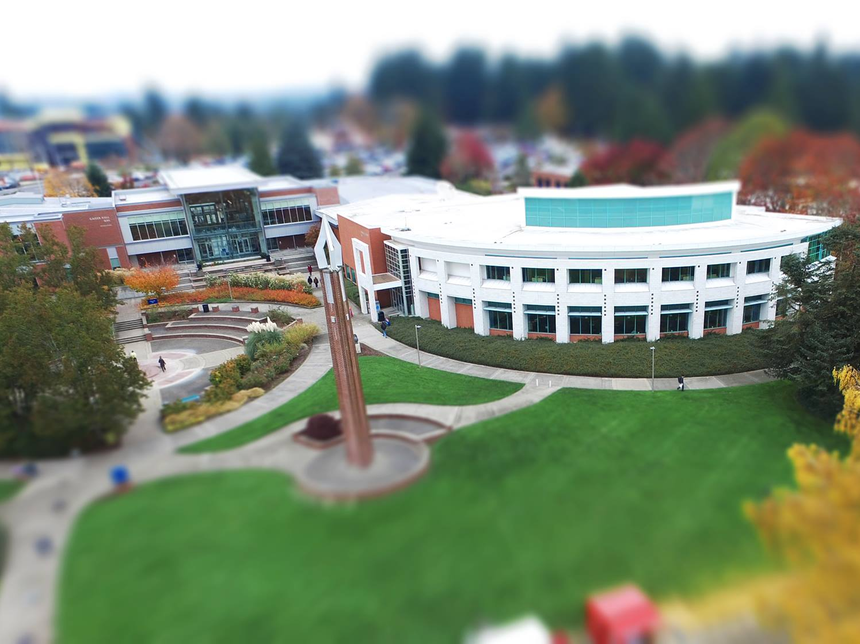
Guided Pathways
July 2022
Rhianna Johnson, Guided Pathways Program Director

Slide 2
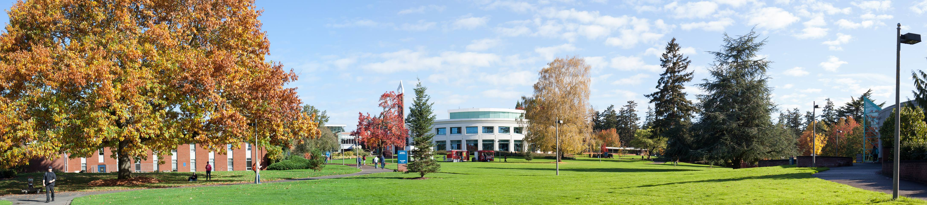
21-22 Guided Pathways Highlights
Rashida Willard
Director hired to provide administrative support and leadership
Comprehensive Guided Pathways plan was developed collaboratively and submitted to SBCTC to cover 2022-2024 focus areas and activities
Alignment of Guided Pathways plan with SEM plan
Several faculty, staff and students attended SBCTC Guided Pathways retreats and work sessions, producing valuable insights and feedback

Slide 3
21-22 Guided Pathways Highlights, SEM + GP Alignment
Rashida Willard
Generate knowledge of pathways
  Increase CTC and CCW enrollment by 5%
Clarify the path
  Increase prospect pool and conversions
Enter the path
  Increase overall enrollment by 5%
Stay on the path
  Increase fall to fall retention by 10%
Support learning
  Reduce equity gap by 50%
Intentional assessment and ongoing review
  Improve student success outcomes by 5%

Slide 4
21-22 Guided Pathways Highlights (continued)
Rashida Willard
Information about Guided Pathways activities and direction was shared in multiple spaces including LEAD, IC, Student Affairs, EC, GPAC and BOT meetings
Teams collaborated to create a project tracking plan to operationalize focus areas of the 22-24 state plan
A new budget project proposal process was instituted to allow campus stakeholders an opportunity to clearly articulate Guided Pathways ideas and initiatives for 22-23
  Over 30 proposals received in multiple functional areas

Slide 5
21-22 Guided Pathways Highlights (continued)
Rashida Willard
The Guided Pathways Advisory Council was reestablished with a new group charter, including a member of the Board of Trustees
New Guided Pathways informational materials were developed and shared with campus constituencies, including a new shared document repository
Another year of coaching was completed with positive feedback about the direction of Guided Pathways at Clark College
Student consultants participated in multiple GP projects and the winter retreat

Slide 6
Guided Pathways Advisory Council
Rashida Willard
Purpose Statement | An advisory council to inform the priorities of Guided Pathways at Clark College to ensure equitable strategies and initiatives that align with Senate Bill 5194.
Mission and Objectives | Bring forward ideas and areas of focus from departments Provide recommendations regarding budget priorities Serve as a Guided Pathways ambassador and proponent at the department level Promote equity centered strategies and initiatives
Team Members | Cross-section of the college (Instruction, AIR, Student Affairs, Communications and Marketing)
Stakeholder Groups | Campus faculty and staff External workforce development partners K-12 partners Students
Meeting Deliverables | Written proposals and ideas
Operational Details | Initial kick-off retreat Review of last year and current status Meets monthly for 2 hours (large group and small groups) Capstone project?
In Scope | Ideas, suggestions, recommendations
Out of Scope | Final budget approval

Slide 7
Themes from GPAC, retreats, coaching and reports
Rashida Willard
Great progress made this year
Several documents and materials created to guide students; work remains to ensure students can navigate information systems
  Addressing the "fire hose" method
Focus on equity and eliminating gaps, meaningful connections and sense of belonging
Need to adapt to changing workforce landscape and student needs
Need to have more prominent presence in the community related to career pathways

Slide 8
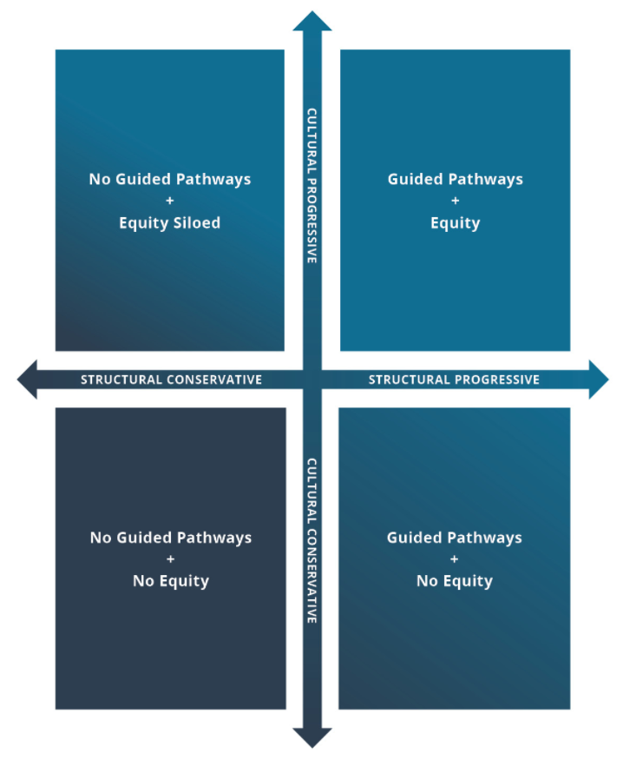
Themes from GPAC, retreats, coaching and reports
Rashida Willard
Most participants indicated that Clark is in the upper left or bottom right
Desire to eliminate continued siloes
Continued desire to utilize disaggregated data for strategic planning purposes

Slide 9
21-22 SBCTC Guided Pathways Plan
Rashida Willard
Student Experience
Intake
Equity Competent Ed Planning
Math and English - Year One
Progress Monitoring
Student Engagement/Completion
Classroom Environment/Course Design
Pathway Design
Pathways/Program Maps
Outcomes Alignment
Structured Exploratory Experience
Predictive Courses
Math Pathways
Scheduling
*Work also continued in several areas outside of those targeted for the plan

Slide 10
21-22 SBCTC Guided Pathways Plan Focus Areas
Rashida Willard
Outcomes Alignment: Course outcomes are aligned with program and pathway outcomes, and those learning outcomes inform a default course taking framework.
Scheduling: Schedules are consistent and predictable and are organized in a way that makes it possible for a full-time student to complete a two-year degree in two years. Courses are scheduled to ensure students are able to enroll in the courses they need when they need them and can plan their lives around school from one term to the next (considering course conflicts, complementary and toxic course combinations, etc.).

Slide 11
21-22 SBCTC Guided Pathways Plan Focus Areas
Rashida Willard
Intake: Every new credential seeking student is provided structured exploratory experiences (through orientation, entry advising, college success course, ethnographic experience, etc.) informed by labor market information and designed to support their choice of a pathway upon enrollment and confirm a major within the first two quarters. Orientation and intake activities are mandatory and designed to build a sense of belonging, clarify student career and college goals, and to create a comprehensive individual education and financial plan based on program/degree maps.
Student Engagement/Completion: The college identifies when students are losing momentum in progress toward completion and has communication tools, policies and supports in place to work with students to address their identified barriers.

Slide 12
Outcomes Alignment
Year-End Accomplishments
High level Microsoft Power BI data dashboards established
Several department level data dashboards created
HEDS survey completed
Development and maturation of Clark College program outcome assessment and support of the Equity-Based Strategic Plan and the Strategic Enrollment Plan
Reengagement with EMSI data including plans for impact reports, employment outlook, alumni outcomes, and program gap demand analysis
Rapid Insight software purchased

Slide 13
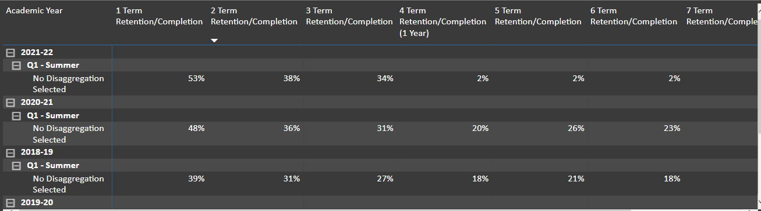
Outcomes Alignment
Year-End Accomplishments
Power BI data dashboard

Slide 14
Scheduling
Year-End Accomplishments
Academic Advising Reports completed, vetted, and available for use (with ongoing fixes as needed)
OER group was established, including discussions around designating OER courses in the schedule. Professional development around OER "backward course design," SBCTC OER 101, and virtual conference to learn and share information about OER best practices.
Multiple discussions regarding the process of aligning catalog, AARs, advising worksheets and other educational planning materials
Improved process flow for course and program changes to ensure information is communicated amongst all departments

Slide 15
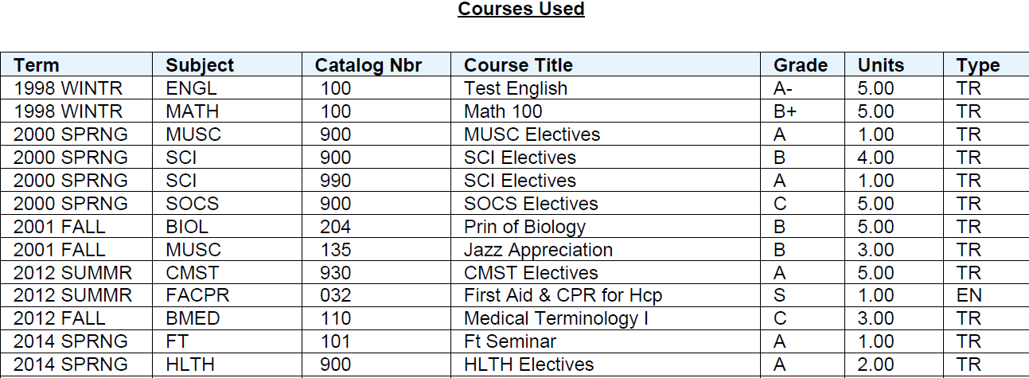
Scheduling
Year-End Accomplishments-Academic Advising Reports

Slide 16
Intake
Year-End Accomplishments
Nearly 2,000 students served at the One-Stop location
Video assets developed to highlight Areas of Study, healthcare programs, AoS Success Coaching program and student explainer videos including Running Start
Developed new Areas of Study webpage templates to provide better access to information about programs at Clark College, improved user experience, and connection to contact forms
Communications and Marketing increased presence in the virtual Columbian space and completed marketing and outreach projects related to systemically excluded student groups

Slide 17
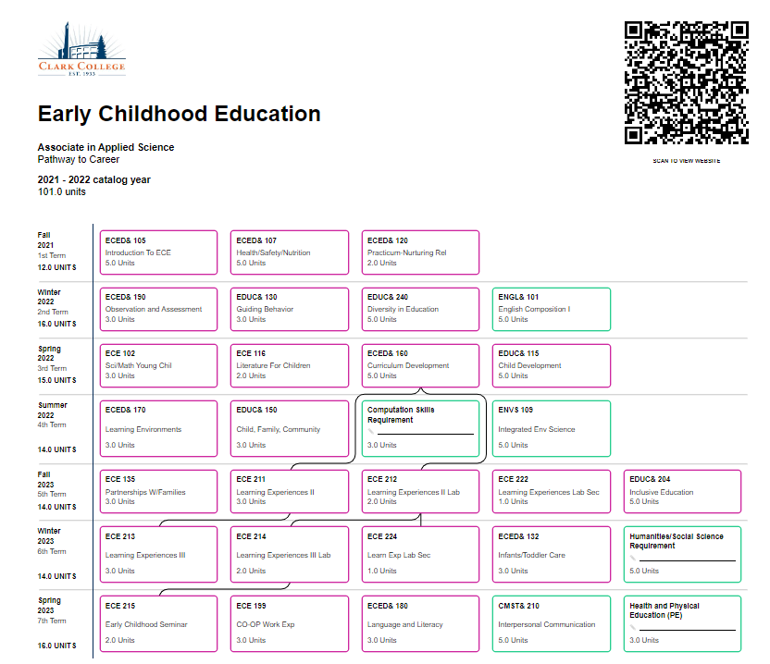
Intake
Dr. Cruse
Year-End Accomplishments
https://www.clark.edu/academics/programs/public-service-society-and-education/index.php

Slide 18
Intake (continued)
Dr. Cruse
Year-End Accomplishments
Adding a new credentials evaluator improved timely evaluation of incoming transcripts, resulting in 1 week turn-around time
Supported Adult Reengagement activities planned for the 22-23 academic year through accurate and timely assessment of credits, coursework, life experience in Academic Credit for Prior Learning and other non-traditional credit options
Guided Pathways funded ctcLink analysts in Credentials and Financial Aid to provide structural support for intake functions

Slide 19
Engaging Students in Support of Completion
Dr. Howard
Year-End Accomplishments
Glean notetaking tool was added to resource suite in Disability Support Services
Project completed to provide more accessibility and universal design in BIOL&100
Nearly 60 students recruited for STEM pathway camp
Project completed to identify skills and outcomes for a new Clean Energy and Advanced Manufacturing degree pathway
PPI coursework and/or outcomes have been embedded into all degree programs except three AAT degrees in health occupations, which will be addressed next year
Coll 101 outcomes have been embedded into all programs except ACED and ECE AAS and those will be addressed next year

Slide 20
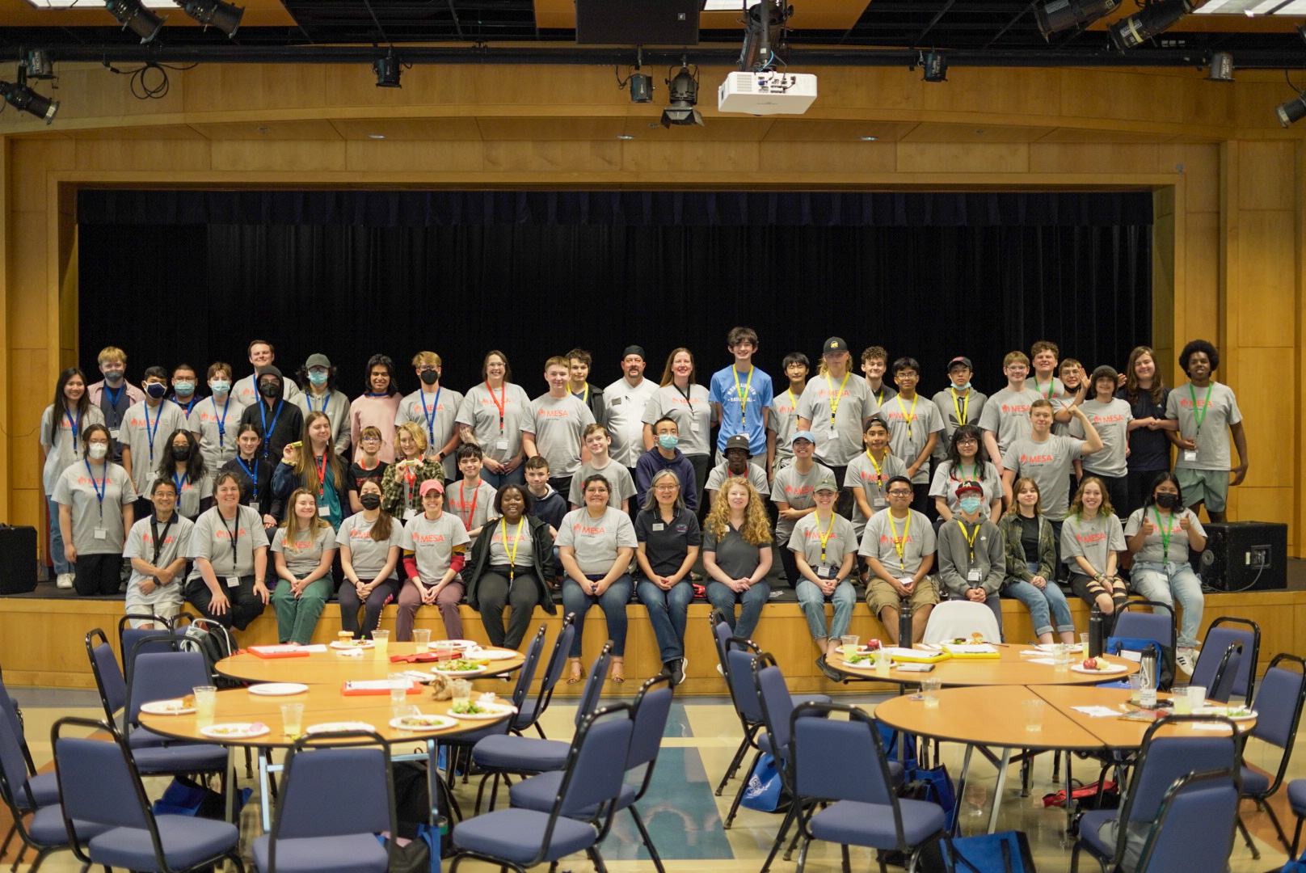
STEM Camp
Rashida Willard

Slide 21
Engaging Students in Support of Completion (continued)
Dr. Howard
Year-End Accomplishments
MESA program provided financial assistance for participants related to school costs and also emergency needs
MESA students obtained internships and reported increased success skills after receiving mentoring in topics such as time management, communication, social connections, and assignment planning
Over 60 students received AoS Success Coaching services and data tracking tools were established to report on program outcomes. Students reported increased efficacy as a result of meeting with coaches.
The DSS pilot mentoring program indicated that students reported improved sense of belonging and course success strategies

Slide 22
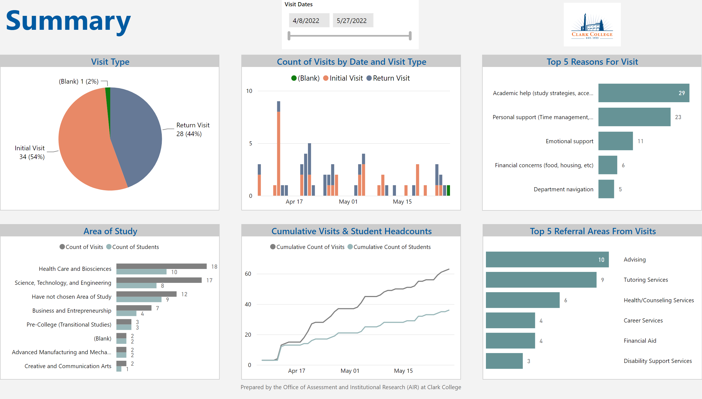
Areas of Study Success Coaching
Notes:
Visit Type
No alt text provided
Area of Study
No alt text provided
columnChart
No alt text provided
actionButton
No alt text provided
actionButton
No alt text provided
Visit Dates
No alt text provided
image
No alt text provided
Cumulative Visits & Student Headcounts
No alt text provided
Top 5 Reasons For Visit
No alt text provided
Top 5 Referral Areas From Visits
No alt text provided

Slide 23
Math and English in Year One
Dr Howard
Most students (including basic skills/ transitional studies students) earn pathway/ program appropriate college-level English and degree math credit within one year of enrollment (for part time students, within 45 credits).
Year-End Accomplishments
Math and English utilized Guided Pathways funds to continue to develop alternative placement processes to reduce time to completion and enhance high school placement matrices
PPI curriculum and learning communities were developed in multiple departments
Trainings around culturally relevant pedagogy and corequisite course designs took place throughout the year
English department instituted required trainings for all instructors in ENGL& 101
Creative writing pathways and articulations were developed
Project completed to develop corequisite math courses in Math 107, and Math 146; course practices revised for equity in Math 110 and 104

Slide 24

Focus on Power, Privilege, Inequity and Culturally Relevant Pedagogy
Dr Howard
Year-End Accomplishments
HPE department example of PPI and culturally relevant course practices:
  HPE CSTL praxis plan 2.0 - examples split by instructor.pdf

Slide 25
Professional Development & Partnerships
Rashida Willard
Year-End Accomplishments
High-Wage, In-Demand "mini-conference" held on May 3rd, highlighting MESA, Business, Health and Info Management, Education, Engineering, Network Technology, Surveying & Geomatics, and Welding
Health Occupations completed the crisis scene simulation video to highlight career pathways in the industry and included several student actors and consultants
Focus group sessions were held to gain insight about perceptions of Clark College in the community
25 staff and faculty attended NCORE conference
Level Up program developed to provide systemically excluded students an opportunity to refresh math skills and gain exposure to Clark via Coll 101 content

Slide 26
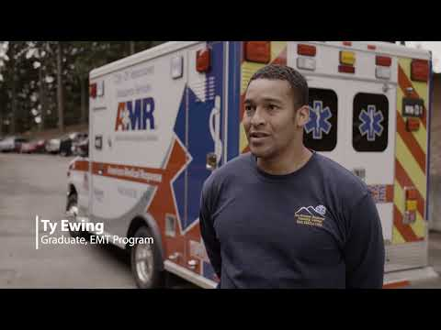
Professional Development & Partnerships
Rashida Willard
Year-End Accomplishments

Slide 27
22-23 Focus Areas
Rashida Willard
Retention=Stay on the Path
22-23 SBCTC Work Plan Focus Areas
  Programs of Study (clustered into Pathways) are well-designed with clearly defined learning outcomes aligned with industry identified needs and transfer pathways and are clearly mapped to guide and prepare students to enter employment and/or further education regardless of point of entry and course load.
  Students know which courses they should take when, are directed to default course selections designed to lead to on time completion and are able to customize their academic plans by working with an adviser or faculty member to address their individual context.

Slide 28
22-23 Focus Areas
Rashida Willard
Retention=Stay on the Path
22-23 SBCTC Work Plan Focus Areas
  Classroom Environment and Course Design-Faculty are active partners in improving student success. Faculty provide meaningful and equitable learning experiences for all students and assess whether course design is resulting in student mastery of outcomes without disparities by race or gender.
  The college uses disaggregated student course outcomes data in addition to regular feedback from faculty and students to support focused professional development opportunities designed to improve instruction, course design, pedagogy, and assessment.

Slide 29
22-23 Focus Areas
Rashida Willard
Budget Requests
New inclusive process
Examples of projects proposals:
  B.S. Computer Science and Clean Energy program development
  Support for Disability Support Services
  Lo Que Sigue, Level Up, MESA mentoring, STEM camp
  AIR support for data needs
  OER development and TLC improvements
  Equity speaker series
  Funding support for Communications and Marketing

Slide 30
22-23 Focus Areas
Rashida Willard
State Plan Project Breakdown
Collaborative process including GPAC, deans and directors
Examples of projects:
  Adding EMSI data to program map pages
  Developing an outcomes rubric for Student Affairs services
  Revitalizing the TLC
  Increasing professional development for faculty
  Increasing work-based learning exploration and activities

Slide 31

Rashida Willard
Questions, comments, feedback?
Contact: Rhianna Johnson, rjohnson@clark.edu

