Slide 1

EBC Training Update
New Technology/New Policy

Slide 2
Agenda
EBC Role and Responsibility Reminders
Overview of Guardian
Exercise and test Guardian Chat
Questions

Slide 3
EBC Role – The Basics
Use Common Sense to maintain your own safety and security. Please Don’t be a Hero…
To facilitate the safe and rapid evacuation and follow -up sweep of your assigned building.
To identify individuals (characteristics, not names) who may be injured and share location of these individuals with Safety and Security Dispatcher via the Guardian App or other modality.

Slide 4
Basic Evacuation Procedures
• Direct people to leave by the nearest safe exit.
• Move people at least 150 feet away from all structures (AA – may not be…so just move back)
• Check for individuals that need aid and provide reasonable assistance to disabled persons.
• Use only stairs and not elevators.
• Do not allow people to re-enter a building until a Safety and Security representative gives the ok through Rave, etc.

Slide 5
Evacuation Building Sweep
After an evacuation, perform a quick check, provided it is safe for you to remain in the building, to assure that everyone has exited.
Use verbal skills to persuade stragglers to leave, but do not get into a confrontation or put yourself in jeopardy.

Slide 6
As you sweep….
  If possible, use your laminated card (or other resource)to document individuals needing care:
    Specific location of individual (building, floor, room #, etc.)
    Physical characteristics of individual
      Hair color
      Skin color
      Approximate height/weight
      Or wait to document until you get to Assembly Area

Slide 7
Proceed to your Assembly Area

Slide 8

The Chat Is Now Where It Is At!

Slide 9

Distinguishing Between Rave and the Guardian App

Slide 10

The Guardian Mobile App will allow you to:
• Discreetly CHAT with Campus Security and Safety
• Call Campus Security/911
• Never Travel Alone
• Find The Resources You Need
• Stay Informed

Slide 11
Using the Chat feature will….
Put a familiar communication device in the hands of more EBCs
Allow for increased and faster Situational Awareness gathering
Avoid common walkie talkie concerns
  Where is it?
  Is it charged?
  How do I use it?

Slide 12
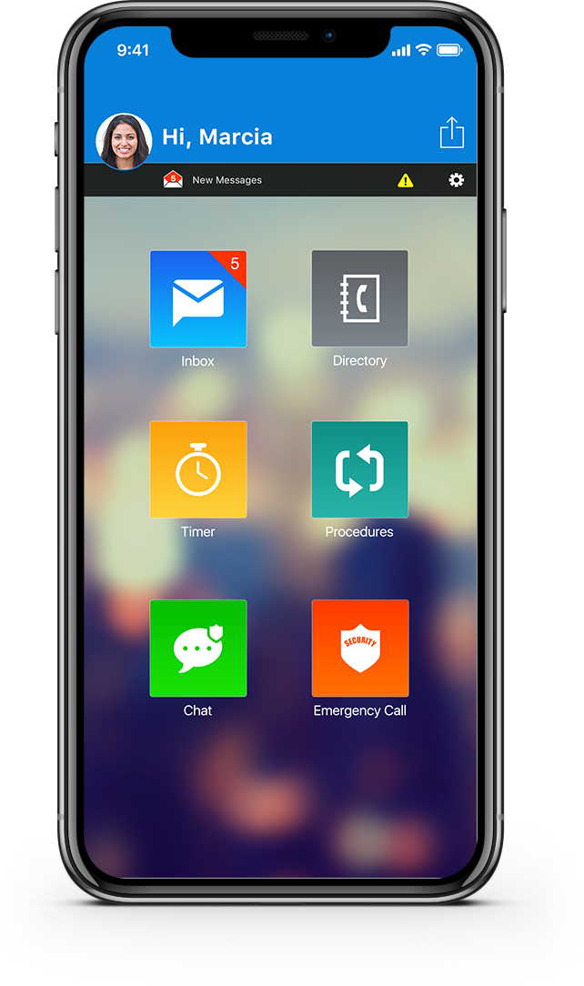
Use Chat
Only if you have something to
report off of laminated card
Specific location of individual (building, floor,
room #, etc.)
Physical characteristics of individual
      Hair color
      Skin color
      Approximate height/weight
Will probably not receive a
Confirmation from our dispatcher…

Slide 13
If you choose not to use the Guardian App
Look for another EBC who is using the App and share information with them so they can send to dispatcher
Use a runner to physically transport the information to GHL 118 (unless directed elsewhere via Rave, etc.)

Slide 14
Can Communicate Directly with EBCs Using Rave
Even if you are not using Guardian you may get EBC directed text messages from the Notification App

Slide 15
Download Guardian and
Test Chat
Text Guardian to 67283
Open Chat feature and text
word “TEST”
“Just Connect Me”

Slide 16
Wrap up and Questions

