Slide 2
Cathy Sherick: Office of Instruction
General Updates
Review of Bylaws
Status of Committee officers

Slide 3
Director/division chair Report I
Robert Hughes w/Bruce Elgort
Enrollment
Activities and Student Success

Slide 4
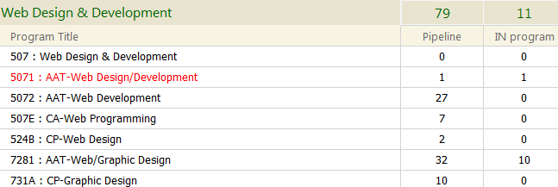
As Presented during the Fall 2014 WDD Program Advisory

Slide 5
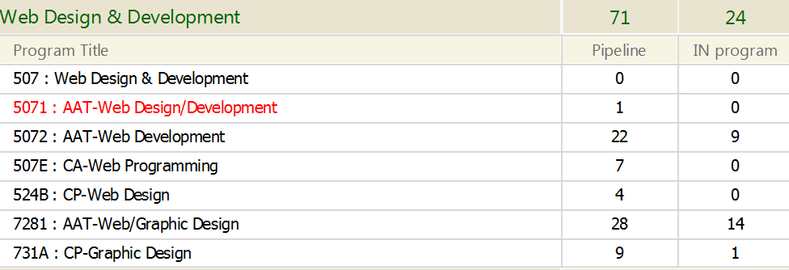
As posted Spring 2015 WDD Program Advisory

Slide 6
Fall 2016 Advisory Meeting

Slide 7
Today’s Enrollment – Spring 2016

Slide 8
WDD Enrollment Across the Quarters
Totals for WDD *
Fall 2014 | 90
Spring 2015 | 95
Fall 2015 | 105
Spring 2016 | 97
 | Fall 14 | Sp 15 | Fall 15 | Sp 16
Web & GD AAT | 42 | 42 | 47 | 48
Web Dev AAT | 27 | 31 | 35 | 27
All WDD Certs | 19 | 21 | 23 | 21
* With some adjustment from transition from old WDD AAT

Slide 9
Web Development 2015-16
Enrollment in CTEC 121 and 122 is strong
Moving beyond two prereq classes to CTEC 126, 127 and beyond a concern
Addressed lower enrollment for second year Web coding classes with “cluster staging” combined
CTEC 227 PHP with SQL I
CTEC 226 API & Advanced Integration
CTEC 260 WordPress II (Development)

Slide 10
CTEC & Web Development 2016-17 Challenges
Need for more qualifying students for CTEC 126 & 127
CTEC 122 and 121 Prerequisite
Continued Concerns for second year qualified students
Will discuss possible solutions and strategies about this later in this meeting

Slide 11
CTEC & Web Development 2015-16 Highlights I
Hybrid Staging for CTEC 260 WordPress I Now expanded to wordpress.org hosting and install
CTEC Programming Classes feature IBM BlueMix Curricula
CGT 105 UX Design classes test for the Regional Cascade Orbis Alliance and do design work for Clark Career Coach
CGT 105 UX Design feature two full PrD (Presumptive Design) workshops with Leo Frishberg

Slide 12
CTEC & Web Development 2015-16 Highlights I
CTEC and Clark served as host for Vancouver Startup Weekend January 2016
Student participation in Digital Technology Expo
Six CTEC Web Dev Students honored in Clark OSWALD Awards

Slide 14
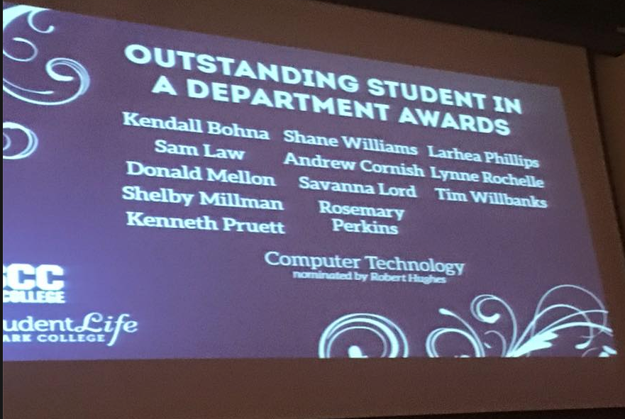

Slide 15
Director/division chair Report I
Kristl Plinz
Fall Sabbatical Activities
CGT Update

Slide 16
Items from 2014-15 Plan

Slide 17
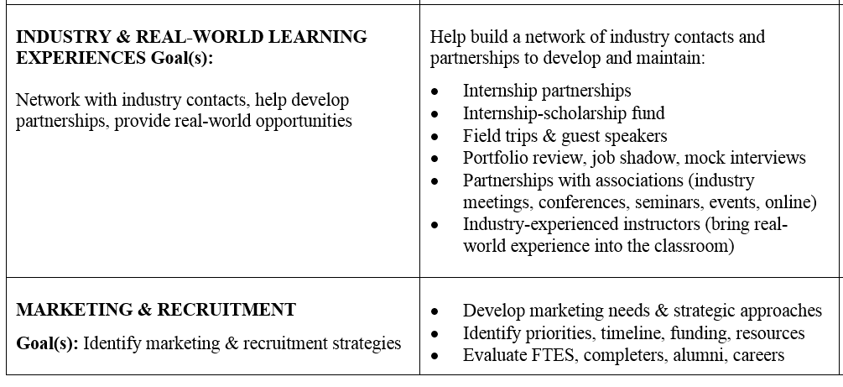
More Current Work Plan Items

Slide 18
Needed Items for Work Plan Update
External Hosting Research/Solutions
Plagiarism/Copyright/IP Policies
Solutions? WorkGroups?
Slack Channels? Meetings?

Slide 19
Review of Changes to Web Development for 2016-17 Catalog
Add CTEC 134 Microsoft MTA Database Fundamentals as an option a more code related option giving students in WD AAT a choice of timeline based Adobe class of either
CGT 104 Web Multimedia Content (Currently Adobe After Effects)
OR
CGT 201 Web Video Production (Adobe Premiere)
Added CTEC 134 MTA Software Dev with C# option
Deleted Web Programming Degree

Slide 20
Outcomes of these Catalog Changes
Students will be better prepared for CTEC 127 PHP w/SQL 1
Opportunity for students to get more training in MS software (non-open source) environment and earn a MTA
More directly addresses a development skill set
Web Programming Degree causing many problems for students with funding resources

Slide 21
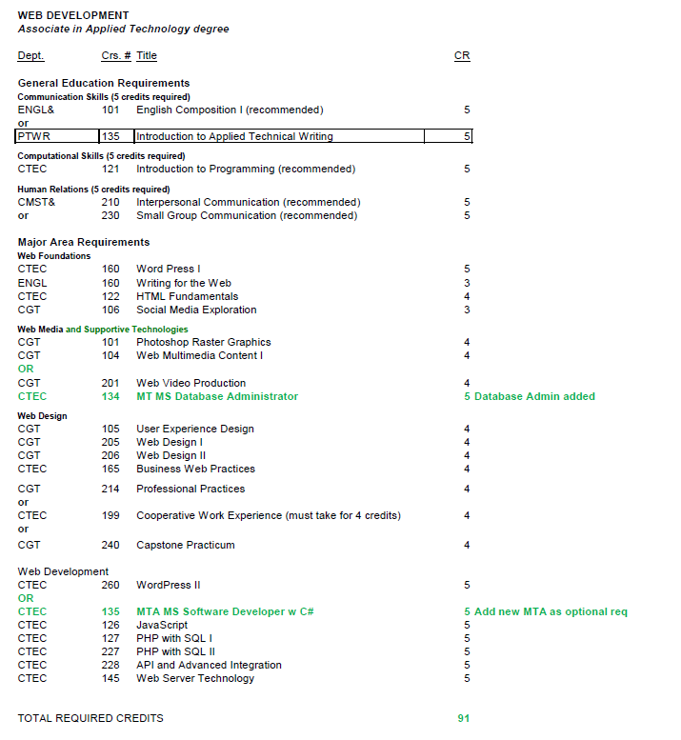

Slide 22
For 2016-17 Catalog: CTEC 135 MTA Software Development w/C#
CTEC 135 Microsoft MTA Software Development with C#
Can be an elective option for Networking and Computer Support programs at Clark
Can be used as launching pad for additional MTA Development offerings at Clark
Requires CTEC 106 or CTEC 121 and CTEC 134 MTA Database Administrator

Slide 23
Returning to CTEC & Web Development 2016-17 Challenges (from earlier in meeting)
Need for more qualifying students for CTEC 126 JavaScript & 127 PHP with SQL I
CTEC 121 Intro Programming and CTEC 122 HTML Fundamentals prerequisites
Continued Concerns for second year qualified students
Responded with Cluster Staging
Special Projects for CTEC 2xx web development classes

Slide 24
Solutions for more CTEC 126 & 127 Qualifiers I
More sections of CTEC 121 Intro Programming and CTEC 122 HTML Fundamentals (budget permitting)
Impact of PTCS 110 and CTEC 106 will be seen by 2017-18
Better access for those interested in Web Coding and Web Coding Careers

Slide 25
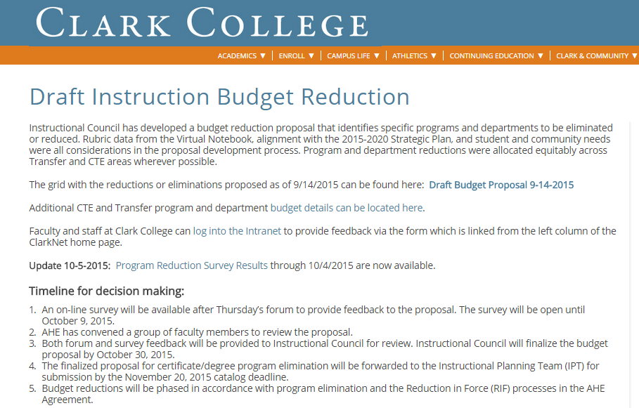

Slide 26
PTCS 110 Professional Technical Computational Skills
Course to serve as a Computational Gen. Ed requirement for AAT degrees and is used as a Math 095 alternative prerequisite for the CTEC 121 Introduction to Programming and Problem solving
Course Description: This is a math course intended for students enrolled in career technical education programs. It includes topics from algebra, geometry, statistics, inductive reasoning and trigonometry with an emphasis on applications and measurement.

Slide 27
For 2016-17 Catalog: CTEC 112 Programming Essentials
A programming class without a low computational prerequisite that will feature hands on but lots on literacy and programming awareness.
Initial Text and tools are the Fluency with Information Technology Model of the National Research Council emphasizing skills, concepts and capabilities and problem solving

Slide 28
Roles of CTEC 112 Programming Essentials
Serve as a required class for the Computer Support AAT program
Will serve as another prerequisite option for
CTEC 126 JavaScript
CTEC 127 PHP with SQL I
New CTEC 135 MTA Software Development
Giving more students opportunity to get access to learn coding and programming

Slide 29
For 2016-17 Catalog: CTEC 112 Programming Essentials
Course Description: Course provides a participatory overview of essential foundational information technology and computer programming concepts. Topics include computing as a creative activity, abstraction, principles of computer operations, debugging, algorithmic thinking and problem solving, programming functions and operations, iteration principles, ethics in computing and the limitations of computing. Students will design and code simple programs

Slide 30
Solutions for more CTEC 126 JavaScript & 127 PHP Qualifiers II
Connect and Inform options to CSE students currently pursuing Computer and Electrical Engineering about CTEC options
Collaborate with CSE faculty and advisement
Market to Community
WSUV CM&DC grads
Industry
Consider possible staging of these and qualifying classes online or hybrid

Slide 31
Staging and Content Concerns CTEC 227, 228 & 260 Classes
In 2014-16 Students and curriculum have benefited from necessary customized approach (CTEC 290 Special Projects) for offering classes to completers
Confirmed that our students are diverse in backgrounds, skills and goals
We’ve learned that advanced topics are still needed but perhaps both API and WordPress Dev clases are not absolutely necessary

Slide 32
Addressing Solutions for 2017-18 Catalog I New Course: CTEC 265 Applied Web Development
Combine CTEC 228 API and CTEC 260 WordPress II (Development)
Strong intersection of these courses
Will address students creating APIs and WordPress elements
Will expand on student’s core skills in JavaScript and PHP
Combined class solution will still address major outcomes covered in both current classes
Will reduce credits by 5 to be made up with HDEV 200 and new course CTEC 295 Web Skills Portfolio

Slide 33
Addressing Solutions for 2017-18 Catalog I Addition of HDEV 200
HDEV 200 Professional Development
“Soft Skills” content by professionals focused on this area
Service Role for CTEC 199 Co-op Internship (Allows reduced manageable hours for internship experiences)
Can allow Capstone and other classes to focus on tech related skillsets
Opportunity for learning communities & linked class with CGT 106 Social Media Exploration
Also complements students who take CGT 214 Professional Practices

Slide 34
Addressing Solutions for 2017-18 Catalog III Addition of CTEC 293
CTEC 293 Web Skills Portfolio
Three credit Class will be staged as one on one or arranged with group with other enrolled students
Focus will be on individual skills and coding portfolio development

Slide 35
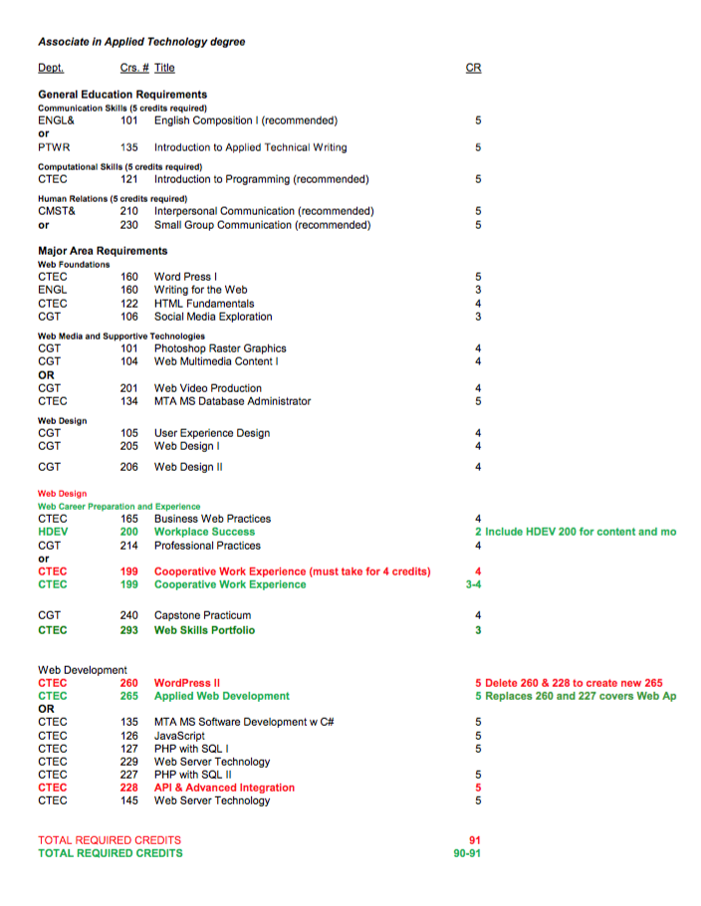

Slide 36
Follow up Items?
Fall Meeting?

